Slide 1
Simple comparison of land cover datasets for biogenic and fire emission estimation within CAMS
Katerina Sindelarova, Jana Markova
(Charles University, Prague)
David Simpson
(MET Norway, Oslo)
Katerina.Sindelarova@mff.cuni.cz

Slide 2
Overview
Activity started during Phase I of CAMS-81 (Global and regional emissions)
Purpose was to harmonize land cover data used for emission estimation in CAMS
Land cover data used for emissions from vegetation (CAMS-81) and biomass burning (CAMS-44) were compared in a simplified way
ESA-CCI land cover was added to comparison as this dataset is planned to be used in the future
More detail on the land cover comparison can be found in CAMS-81 deliverable D81.4.6.1 (CAMS81_2017SC3_D81.4.6.1-202004_v1.pdf)
17 February 2021
2

Slide 3
Overview
Land cover data are principal input information for emission estimation, esp. for emissions of natural origin as they provide information on location of the sources
Wide range of different land cover data with various land cover categorization helps to choose the best datasets for specific task
However, variation in datasets makes it difficult to compare and harmonize
Here we compare land cover data for emissions from vegetation and from biomass burning as they originate in the ‘same’ source.
17 February 2021
3

Slide 4
Land cover data
BVOC emissions from vegetation
Land cover description from the Community Land Model (CLM4; Lawrence and Chase, 2007)
16 Plant Functional Types (PFTs) group vegetation with similar leaf physiology, separate trees and low vegetation
Biomass burning emissions
based on land cover data of GFEDv3.1 (Global Fire Assimilation Dataset; van der Werf et al., 2010)
Dominant burning land cover types of GFED with addition of organic soil and peat maps
CAMS-GLOB-BIO
GFAS
17 February 2021
4

Slide 5
Land cover data
ESA-CCI land cover data
Both CAMS-81 and CAMS-44 use/plan to use this dataset in future → included in the comparison
Could be a good candidate for harmonization of land cover inputs within CAMS
Product of Climate Change Initiative of the European Space Agency (ESA-CCI)
Series of annual mean land cover maps (1992-2018) based on satellite observations
CCI-LC user tool v4.3 (Poulter et al., 2015) was used to convert ESA-CCI to CLM-like categories (+ separation of classes to climate zones – tropical, boreal, temperate)
17 February 2021
5

Slide 6
Land cover data comparison
Categories present in all 3 datasets were selected and lumped to create common classes for comparison
  Agricultural land
  Tropical forest
  Extratropical forest
Note: Lumping was performed with the ESA-CCI data converted by the User tool to CLM-like categories and separated to the climate zones
17 February 2021
6

Slide 7
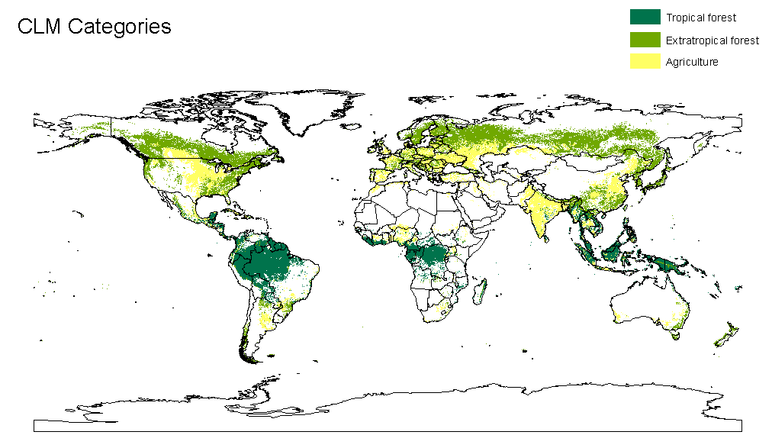
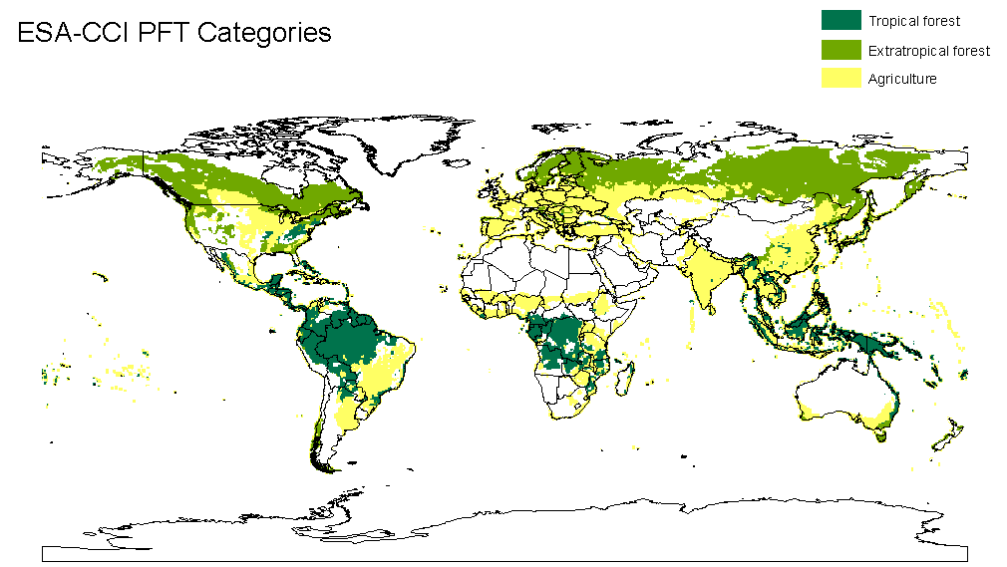
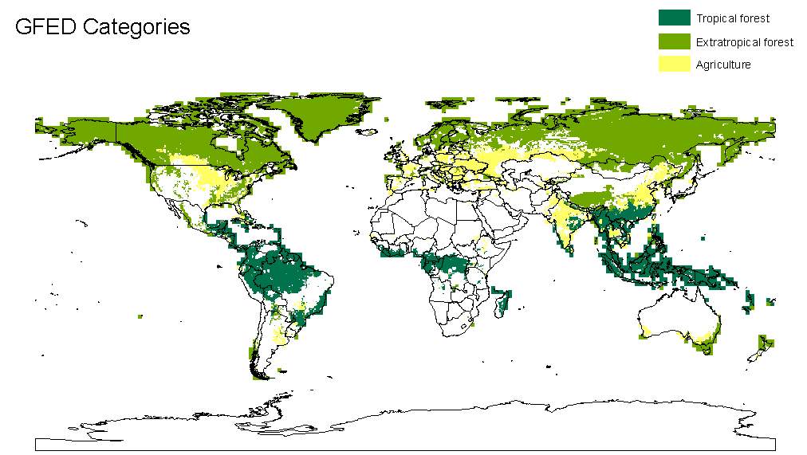
CLM Categories
Overview
CMS-81
Meeting on Land use data in CAMS/ECMWF
ESA-CLM Categories
GFAS Categories
Dominant categories in each grid cell
17 February 2021
7

Slide 8
Land cover data comparison
Spatial coverage by land cover categories calculated from the dominant category of each grid cell
17 February 2021
8

Slide 9
Land cover data comparison
Spatial coverage by each category
For ESA-CCI calculated from the original non-converted data
Inaccuracies and caveats
  Definition of LC categories, their lumping and conversion (esp. crops and grass)
  Regridding to lower resolution (e.g. ESA-CCI regridded from 300 m to 0.5 deg.)
49 451 (10³ km²) in converted data
17 February 2021
9

Slide 10
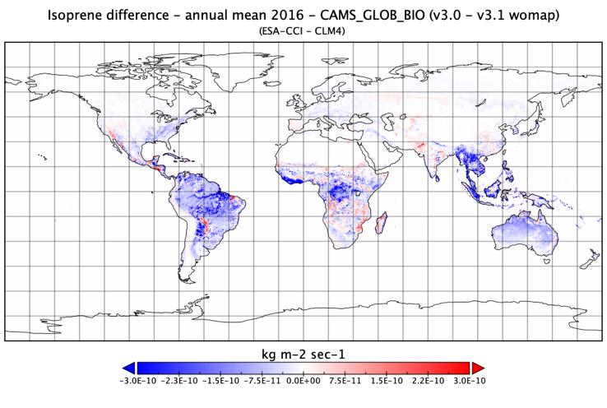
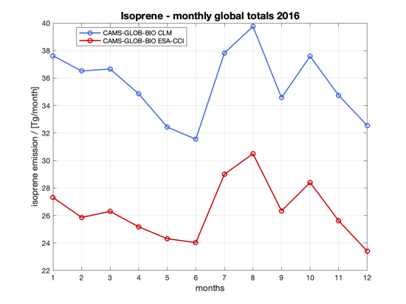
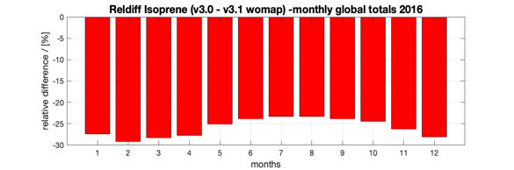
Land cover impact on isoprene
(ESA-CCI - CLM)
(ESA-CCI - CLM)
Isoprene annual global totals
CAMS GLOB BIO CLM= 427 Tg/year
CAMS GLOB BIO ESA-CCI = 316 Tg/year
17 February 2021
10
Notes:
v3.1 = 465 Tg/year
10

Slide 11
Current status in BVOCs and plans for future
Current MEGANv2.1 model is designed for 16 PFTs, with emission potential maps developed from more detailed land cover data for main species (i.e. higher spatial resolution and detail of species composition)
Recent update of isoprene EP maps in Europe based on detailed information from the EMEP model (>100 species mapped and assigned with EF)
New model MEGANv3 aims to provide more detail in land cover description and species composition; however difficult to collect such data on global level
LAI as a driver of the emissions, currently MEGANv2.1 uses grid average (MODIS), improvement by LAI per PFT to keep link with vegetation type
ECMWF intents to calculate BVOC emission online inside IFS
→ as a start it is planned to use EF per PFTs; should keep in mind inaccuracies of such approach (one PFT includes various species with very different EFs)
→ need to decide on which land cover description to use (ORCHIDEE and ESA-CCI possible)
17 February 2021
11

Slide 12
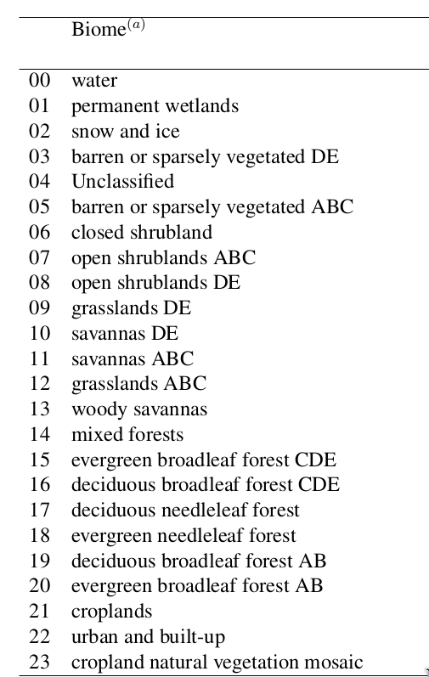
Current status in soil NOx emissions
Soil NO emissions (v2.1)
MODIS based (MCD12C1v006)
Merged with Köppen-Geiger climate maps (A,B, etc.) - to distinguish e.g. equatorial, warm temperate, polar...)
To provide 23 biomes which are consistent with the soil biome emission factors of Steinmamp & Lawrence 2011.
Caveats and issues
- Main problem is uncertainty in emission factors
(EFs) and assignment to LC categories,
- e.g. open shrublands in cooler climates have dry EF of ~ 0.05 ng(N)/m2/s, whereas grasslands have 6.2!
- How to spot the difference!
17 February 2021
12

