Slide 1
ECMWF LDAS, December 2020
Current and future coupled land-atmosphere data assimilation at ECMWF
Patricia de Rosnay, David Fairbairn, Pete Weston, Yoichi Hirahara, Phil Browne, Kenta Ochi, Dinand Schepers, Stephen English,
and many other colleagues

Slide 2
Toward coupled assimilation in ECMWF’s operational systems
4D-Var
Atmosphere
Sea Ice
3D-Var
Integrated Forecasting System (IFS)
Land
EKF-OI
Ocean
3D-Var
Waves
OI
- Modularity to account for the different components in coupled assimilation
- Consistency of the coupling approaches across the different components of the Earth System
- Common infrastructure for ocean, sea ice, wave, land, atmosphere, for NWP and reanalysis

Slide 3
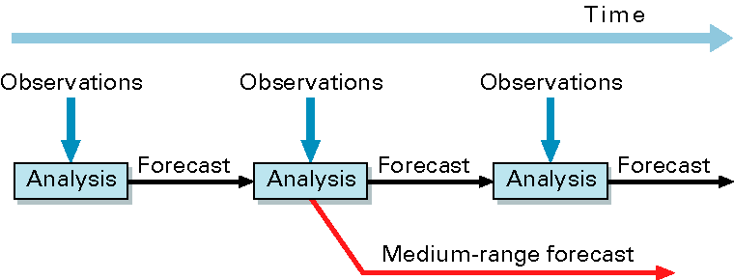

ECMWF Integrated Forecasting System (IFS)
(10-day)‏
Coupled Forecast Model
Data Assimilation: atmosphere (4D-Var), land (SEKF,OI), waves (OI), ocean/sea ice (3D-Var)
Land assimilation: snow and soil moisture

Slide 4
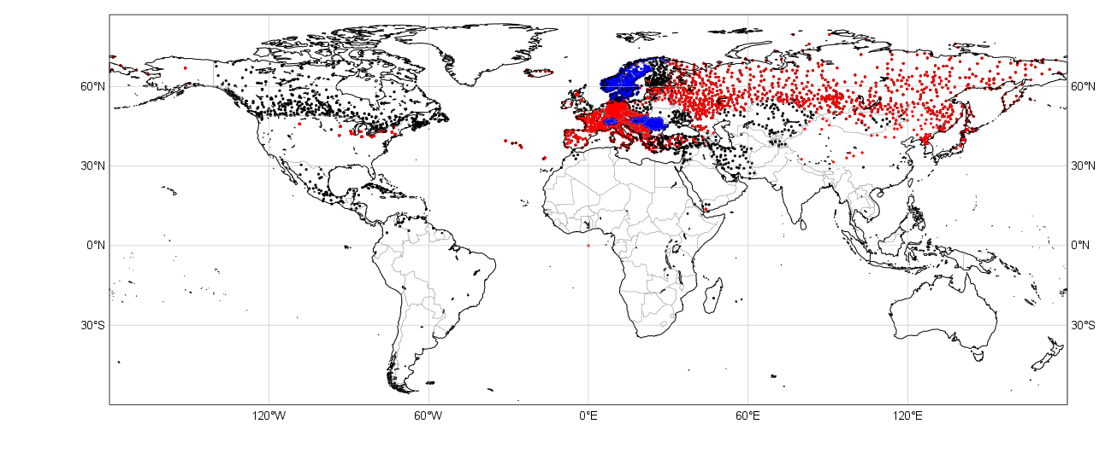
In situ snow depth observations
GTS Snow depth availability
SYNOP TAC SYNOP BUFR national BUFR data
15 January 2015

Slide 5
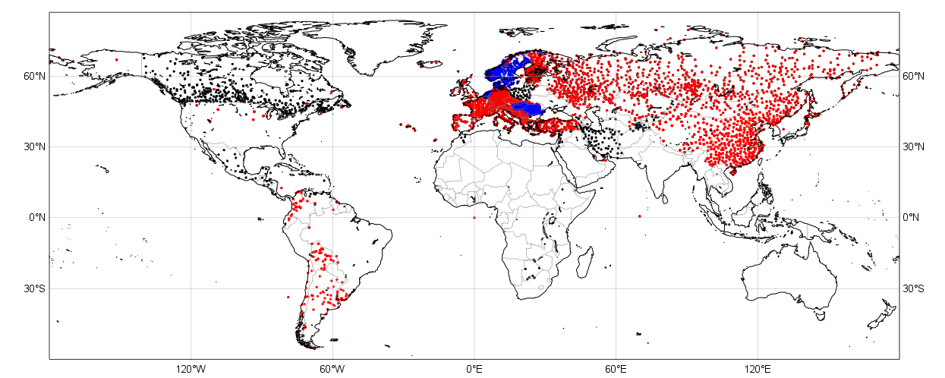
In situ snow depth observations
GTS Snow depth availability
SYNOP TAC SYNOP BUFR national BUFR data
15 January 2020
2021: Expected improvement in the US (NOAA)

Slide 6
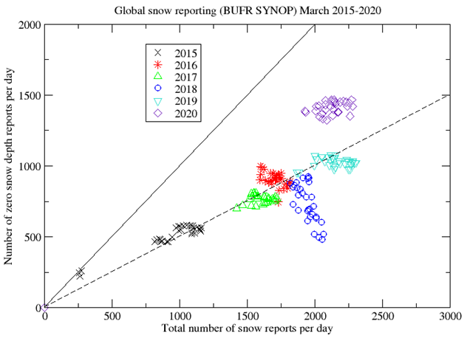

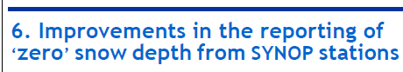
In situ snow depth observations
“Zero” Snow depth
(de Rosnay, Pullen, and Nitu)
Confirm increase in available snow depth data from distinct SYNOP stations reporting in BUFR
Slight increase in ‘zero’ snow depth reports

Slide 7
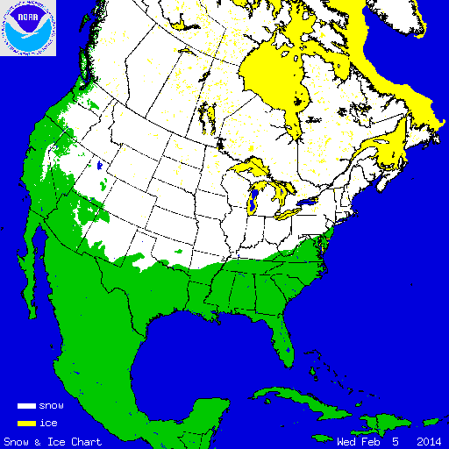
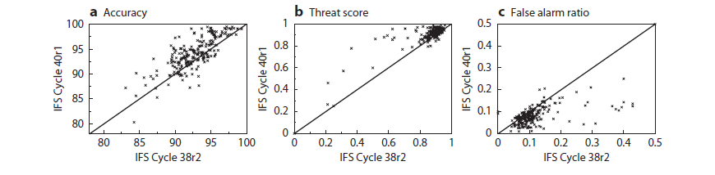
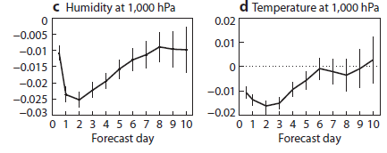
Snow analysis: 2D-OI Forecast impact
NOAA/NESDIS IMS data
Impact on snow October 2012 to April 2013 (251 independent in situ observations)
☺
☺
☺
Impact on atmospheric forecasts
October 2012 to April 2013 (RMSE new-old)
Consistent improvement of snow and atmospheric forecasts
Importance of snow cover observations
☺
☺
de Rosnay et al., ECMWF
newsletter 143, Spring 2015

Slide 8




Soil Moisture coupled data assimilation
Since 2019 (IFS 46r1) EDA-SEKF and SMOS NN DA
Ensemble Data Assimilation (EDA)
NWP Forecast
Coupled Land-Atmosphere
Land initial conditions
EDA Jacobians
T2m, RH2m
& soil moisture
Background
Soil Analysis (SEKF)
SM1, SM2, SM3
σ_{O_T2M}= 1K
σ_{b_}= 0.01m3/m3
σ_{SMOS_NN}= 0.02+3ε
σ_{O_RH2M}= 4%
σ_{ASCAT}= 0.05m3/m3
EC SMOS Neural network
SMOS TB
in situ
T_2m RH_2m
Snow Depth
2D-OI
T_2m, RH_2m, snow
satellite
ASCAT SM
SMOS SM
IMS
$$σoT2m=2K$$
$$σoRH2m=10\%$$
$$σoSD=4cm$$
$$σoIMS=8cm$$

Slide 9
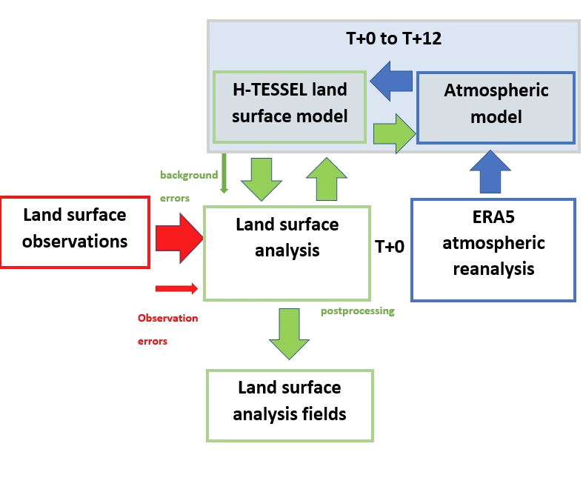
Stand-alone Surface Analysis and offline systems
→ Support land surface reanalysis
Three options:
Offline surface model forced by atmospheric reanalysis (e.g. ERA5-land)
  ☺ Allows enhanced surface model/resolution
  ☹ No land-atmosphere coupling and no land DA
Offline soil moisture DA (e.g. H SAF ASCAT soil moisture data records)
  ☺ As (1), but offline soil moisture analysis included
Stand-alone surface analysis (SSA, Fairbairn et al., 2019)
  ☺ Full land DA system in IFS (soil moisture, snow, etc…)
  ☺ Coupled land-atmosphere model
  ☹ Significantly more computationally expensive than (1) and (2)
SSA forced by ERA5
D. Fairbairn, P. de Ronsay, and P. Browne, “The new stand-alone surface analysis at ECMWF: Implications for land-atmosphere DA coupling,” J. Hydrometeor, 2019. https://doi.org/10.1175/JHM-D-19-0074.1
Notes:
9

Slide 10
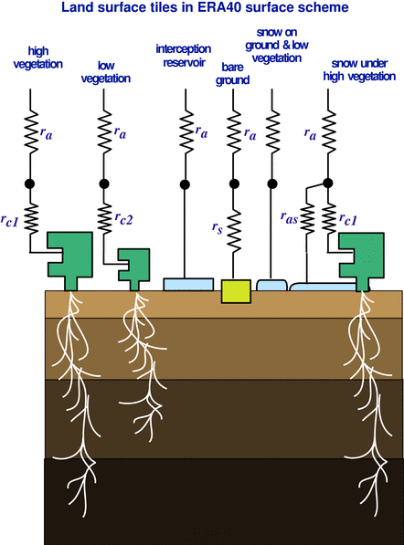
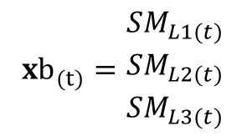
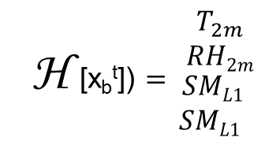
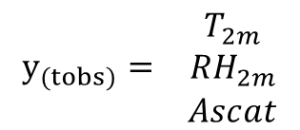
Surface-only LDAS
Simplifed EKF soil moisture analysis
x _{a}= x _{b}+ K (y-H [x _{b}])
Elements of the SEKF for each individual grid point in the case of:
- Assimilation of 4 observations: T2m, RH2m, ASCATsm, SMOSsm
de Rosnay et al., QJRMS, 2013
- State vector x: volumetric soil moisture (SM) of the model layers, L1, L2, L3 (in m3/m3)
Control vector
Observations vector
Observations operator
$${xb}_{(t)}=\begin{matrix}{SM}_{L1(t)} \\ {SM}_{L2(t)} \\ {SM}_{L3(t)}\end{matrix}$$
H [x_{b}^{t}]) $=\begin{matrix}T_{2m} \\ RH2m \\ {\begin{aligned} SML1 \\ SML1\end{aligned}}_{\begin{aligned} \\ \end{aligned}}\end{matrix}$
$$y_{(tobs)}= \begin{matrix}T_{2m} \\ {RH}_{2m} \\ Ascat\end{matrix}$$
[K]
[%]
[m³/m³]
[m³/m³]
ASCAT_{sm}
SMOS_{sm}
Observation error
Background error
10

Slide 11


Soil moisture satellite observations used operationally
Active microwave data:
ASCAT: Advanced Scatterometer
On MetOP-A (2006-), MetOP-B (2012-), MetOP-C (2018-)
C-band (5.6GHz) backscattering coefficient
EUMETSAT Operational mission
Passive microwave data:
SMOS: Soil Moisture & Ocean Salinity (2009-)
L-band (1.4 GHz) Brightness Temperature
ESA Earth Explorer, dedicated soil moisture mission
(Munoz-Sabater et al., GRSL, 2012)
MetOP-C
SMOS
Scatterometer soil moisture also used in ERA5 (ERS-SCAT, Metop/ASCAT)

Slide 12
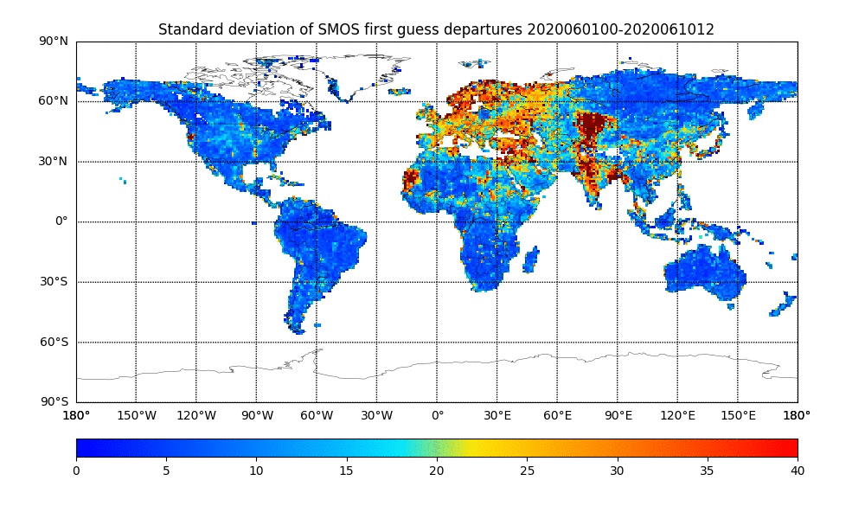
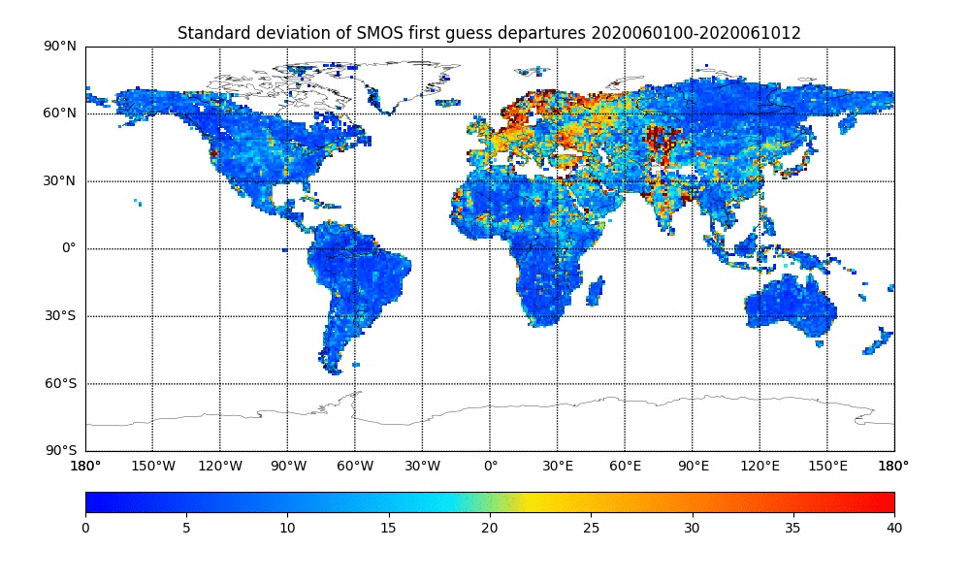
SMOS near real time brightness temperature monitoring
In early July we detected a large area of RFI (Radio Frequency Interference) contamination over South-East China
The new screening does a better job of filtering it out but still not perfect
  Hence the need for further improvements in RFI filtering flags
Basic RFI screening
Stronger RFI screening
Slide from Pete Weston

Slide 13
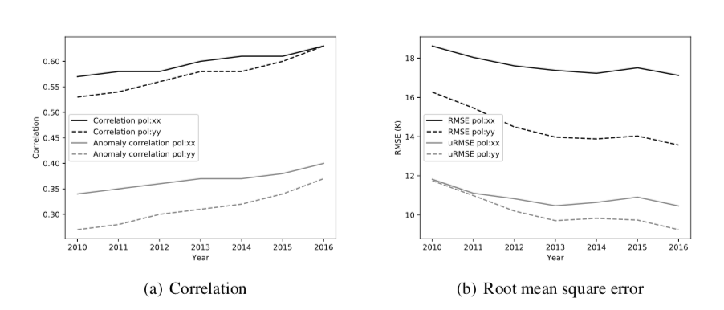
Comparison between SMOS and ECMWF forward TB for 2010-2016
CMEM: Community Microwave Emission Modelling platform
de Rosnay et al, RSE, 2020
13

Slide 14
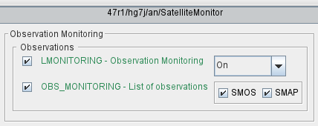
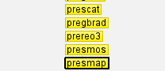
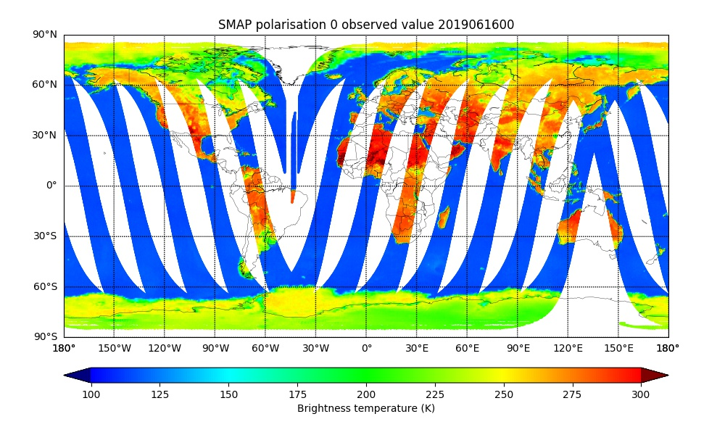
SMAP monitoring
Scripts, suite and prepIFS changes complete
IFS changes in progress
Experiments to test assimilation into SEKF in 2021
Slide from Pete Weston

Slide 15
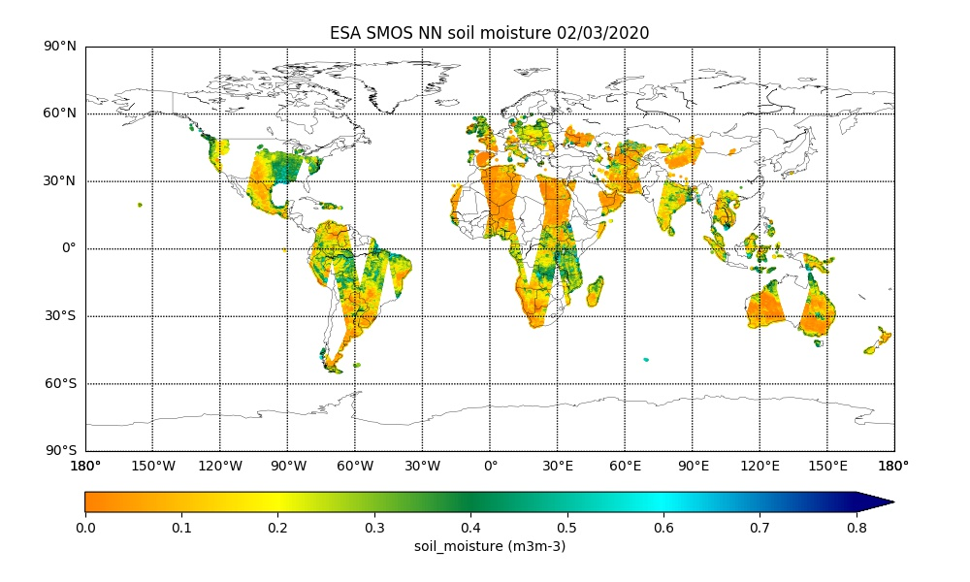


SMOS Neural network: ESA level 2 SMOS NRT Soil Moisture product
Input layer
Hidden layer
Output layer
SMOS L1c brightness temperatures
Model soil temperature
Soil moisture
Weston et al., 2020
Designed by CESBIO/Estellus, Implemented by ECMWF
Rodriguez-Fernandez et al, HESS 2017
Neural Network used to retrieve SMOS L2 SM:
  Trained on SMOS L2 soil moisture
  Single hidden layer, 5 neurons
Product available within 4 hours of sensing time
Available in NetCDF, since March 2016 on ESA SMOS Online Dissemination service
https://smos-ds-02.eo.esa.int/oads/access
15
15

Slide 16
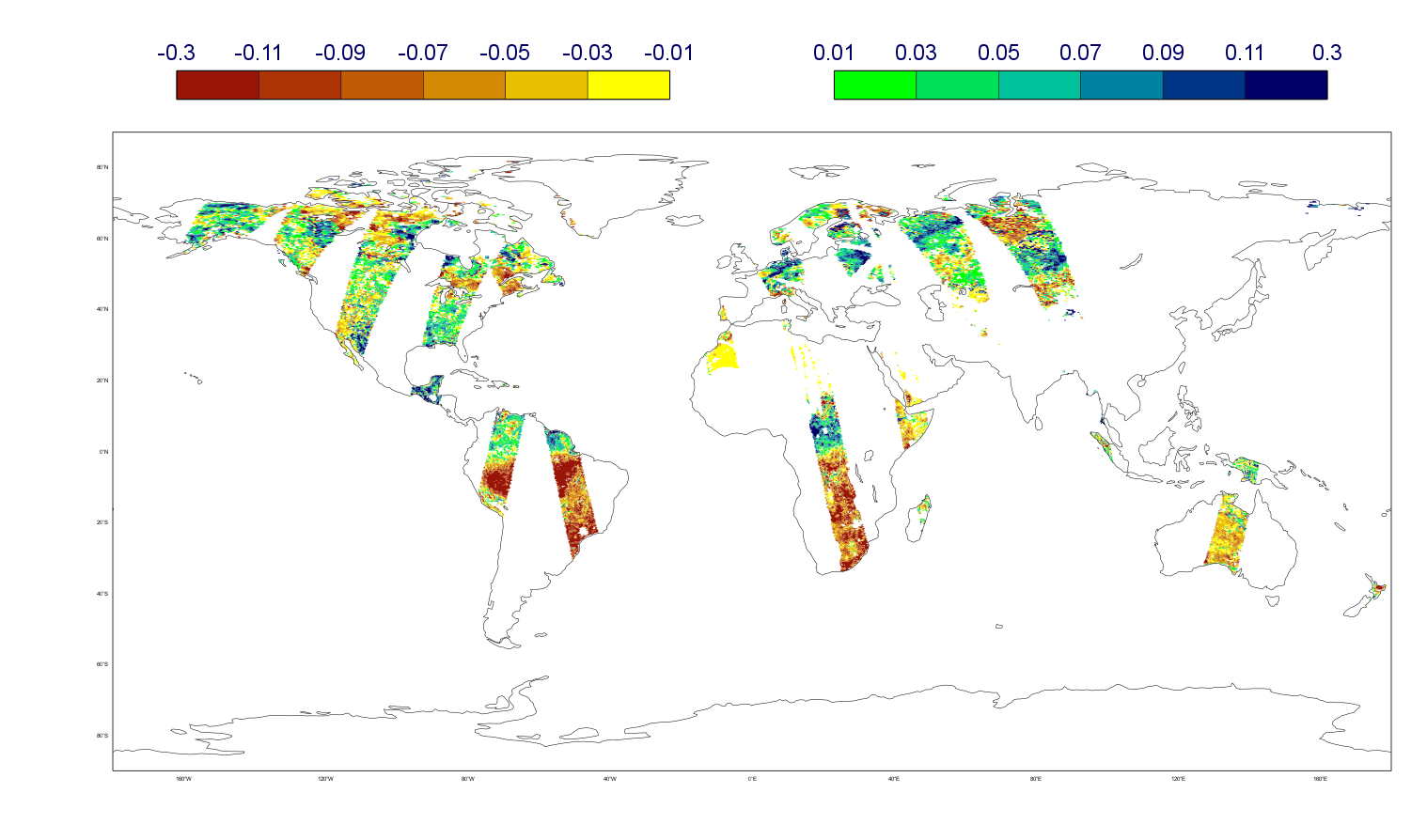
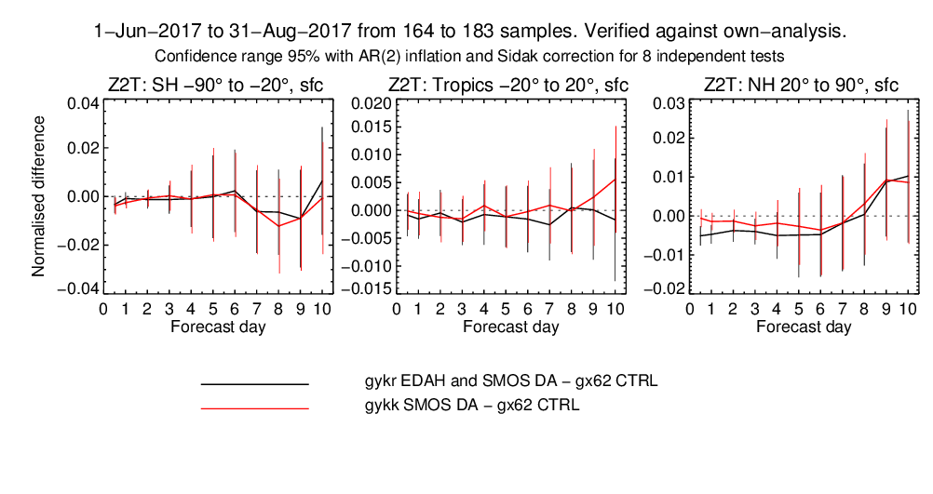
SMOS Neural Network in the IFS and Ensemble SEKF approach
Reduction of the SEKF CPU cost by a factor ~3.6
Impact of:
Use the Ensemble Data Assimilation (EDA) in the SEKF
SMOS neural network soil moisture assimilation
Resol. | NPES*THREADS | 45r1 | 46r1
Tco 1279 (9km) | 300*9 | 1580 | 435
Ensemble and SMOS DA impact
SMOS DA impact
(CTRL has no Ensemble and no SMOS)
Different Jacobians tapering coefficients at depth
de Rosnay et al, ESA_LPS 2019
SMOS innovation (obs-model)
01 August 2017 (m3/m3)
Atmospheric forecasts impact (T2m) compared to CTRL

Slide 17
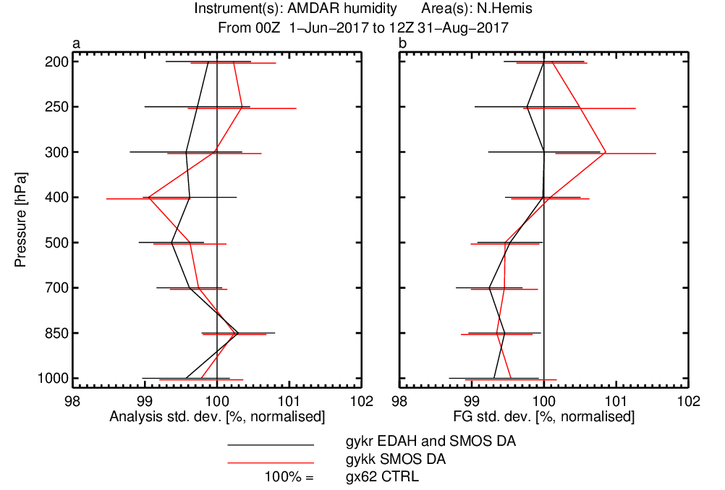
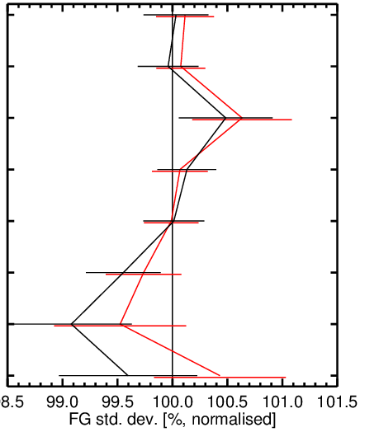
Atmospheric impact: fit to aircraft observations
Aircraft humidity (JJA 2017)
Aircraft temperature (JJA 2017)
SMOS impact
EDASEKF+SMOS impact
Improved fit
low troposphere

Slide 18
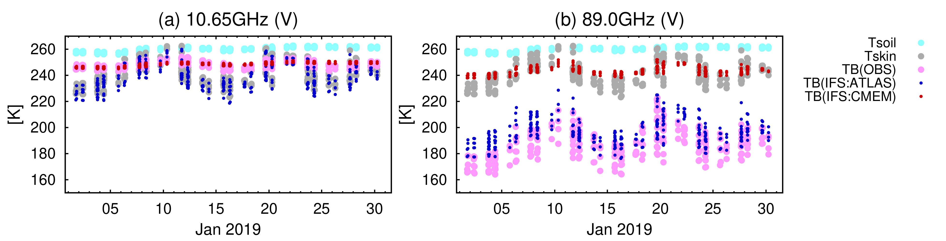
Toward assimilation of surface-sensitive satellite data over land
  - New interface between CMEM and RTTOV, processing of surface sensitive observations through the all-sky code path.
  - Implementation of multi-layer snow radiative transfer scheme in CMEM (complementarity with multi-layer snow pack model from Arduini et al., JAMES, 2019)
AMSR2
RTTOV
CMEM-RTTOV
ECMWF, JMA
Hirahara et al
Remote Sens. 2020, 12(18), 2946; https://doi.org/10.3390/rs12182946
18

Slide 19
Summary and outlook
- ECMWF land data assimilation: combine OI, and EDA-SEKF
- Satellite data used operationally: SMOS, ASCAT, IMS
- Coupling developments: EDA-SEKF, multi-layer snow MW observation operator, coupling with hydrology, future outer-loop coupling → consistent with ocean coupling
- Continuous integration of reanalysis capabilities → preparation of ERA6 and ERA6Land
- Obs usage plans: near future SMAP data, VOD assimilation, LST
- Ongoing developments: soil temperature and snow in the SEKF
- Work on surface mapping (→ Balsamo, Boussetta, Arduini, Choulga)
- Consistency NWP, hydrology, CO2 →link to Copernicus Services (C3S, CEMS, CAMS)
19

Slide 20


https://www.mdpi.com/journal/remotesensing/special_issues/Land_Surface_Earth_System_Modeling
31 May 2021
Land surface data assimilation
Land surface re-analysis
Land surface forward modelling (VIS/IR/MW),
Inverse modelling and machine learning
Land surface parameter retrieval
Coupled assimilation (land-hydrology-atmosphere)
Intercomparison (model and DA)

