Slide 1
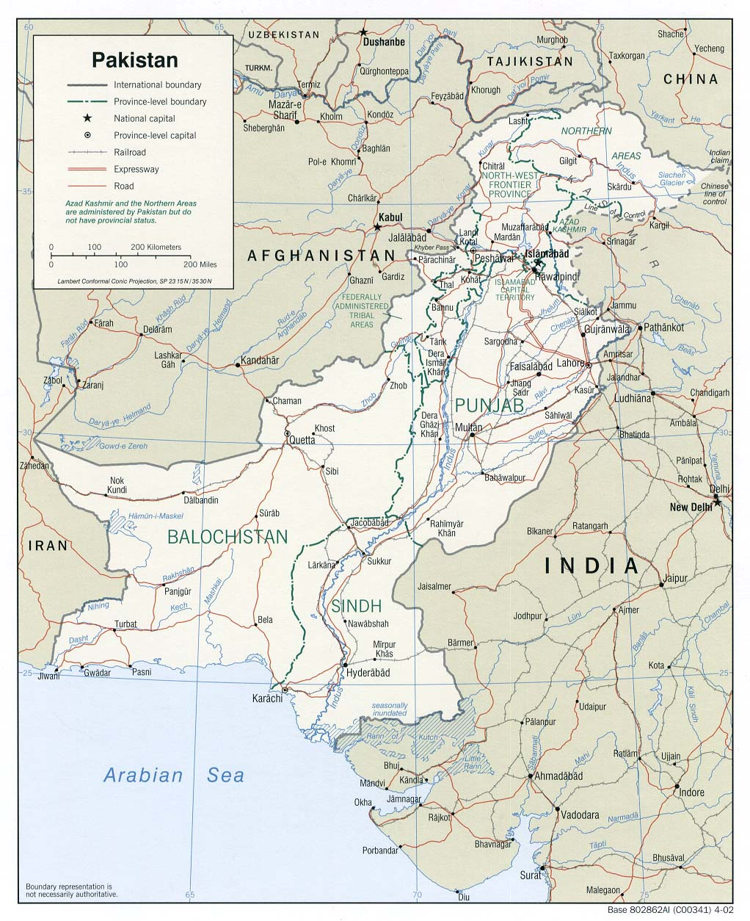
September 2012
Forecast for Pakistan

Slide 2
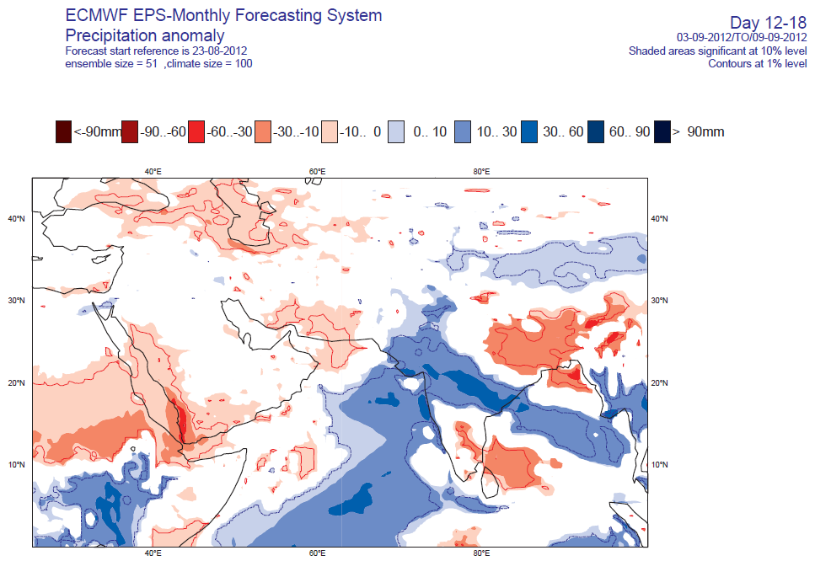

Slide 3
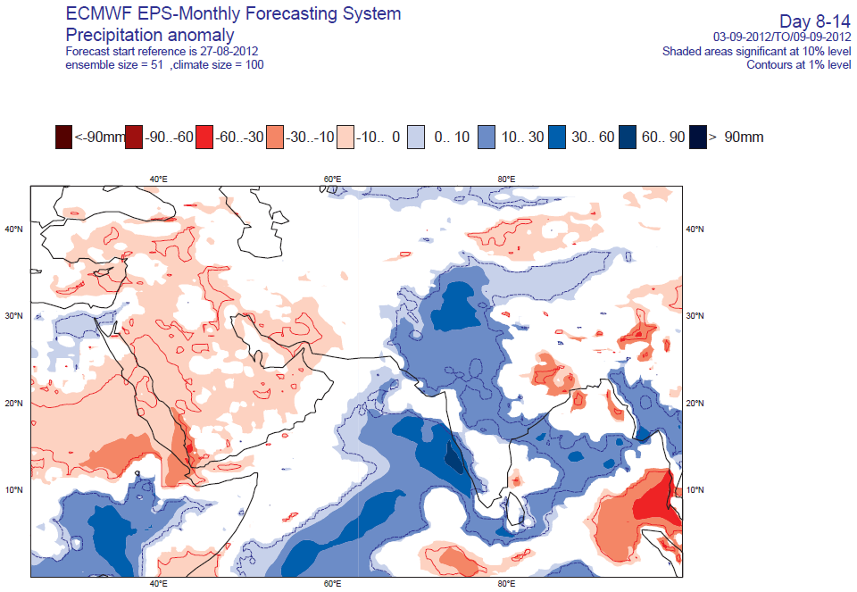

Slide 4
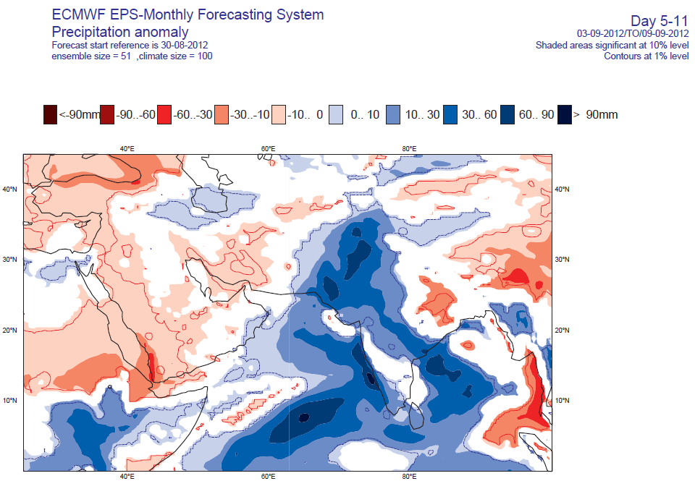

Slide 5
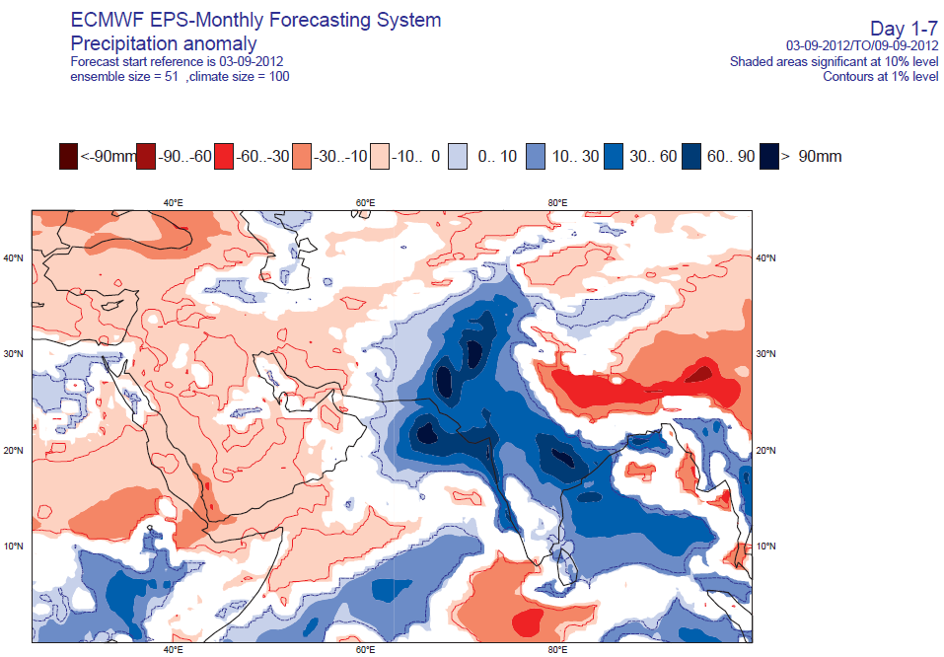

Slide 6
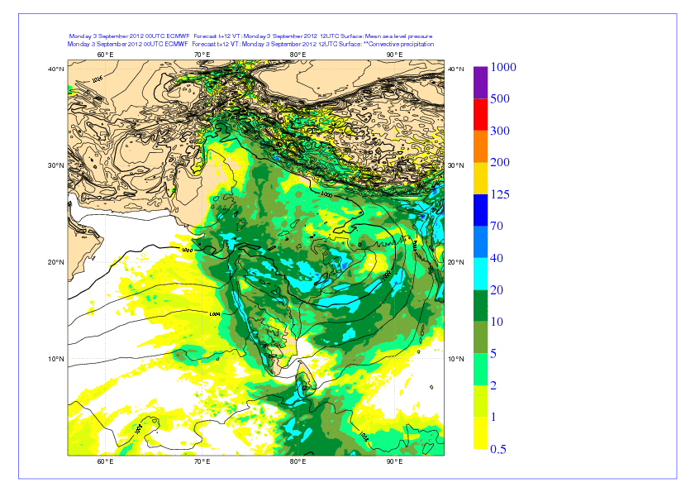
T1279 based on 3/Sept/2012; 00 UTC: MSL and 12 hours accumulated precip

Slide 7
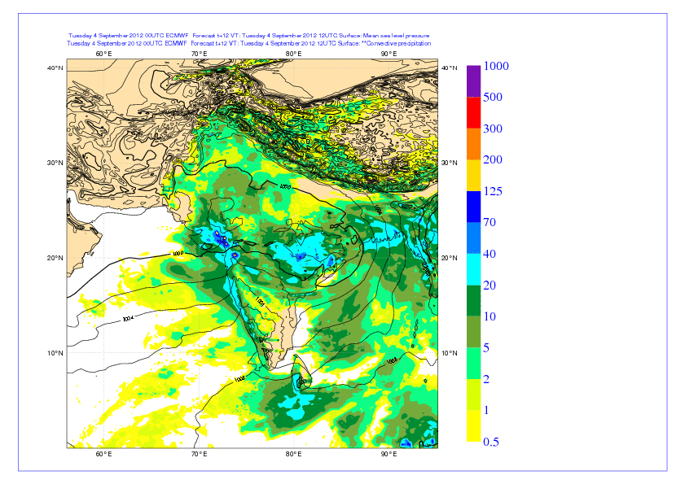
T1279 based on 4/Sept/2012; 00 UTC: MSL and 12 hours accumulated precip

Slide 8
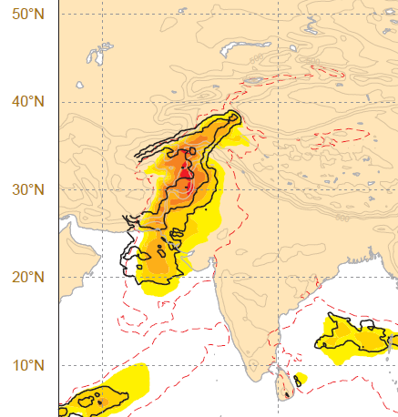

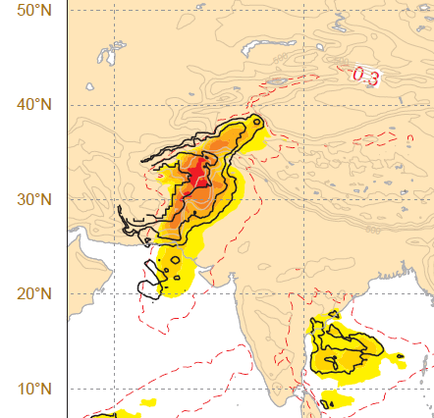

Slide 9
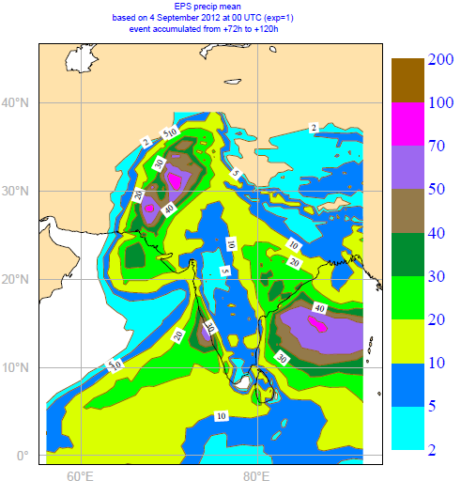
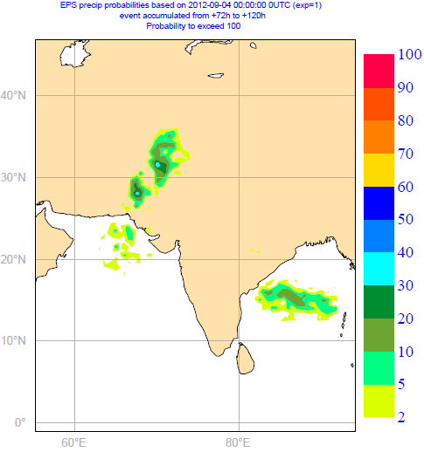
EPS based on 4/Sep/2012; 00 UTC: D+3 to D+5 EM and probability of precip > 100 mm

Slide 10
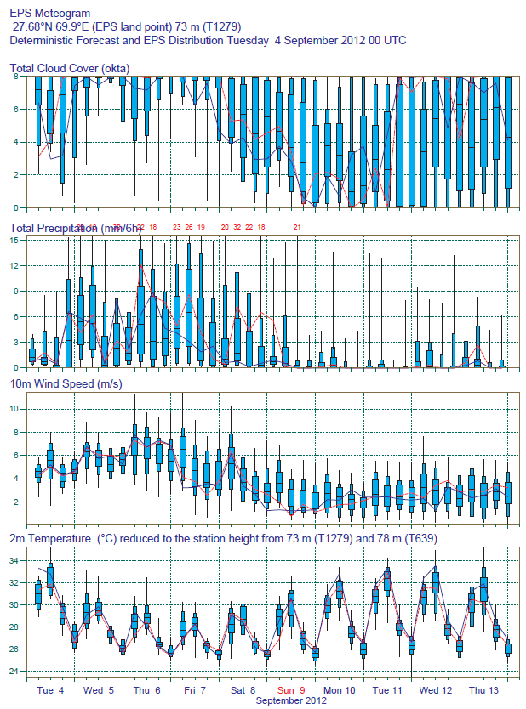
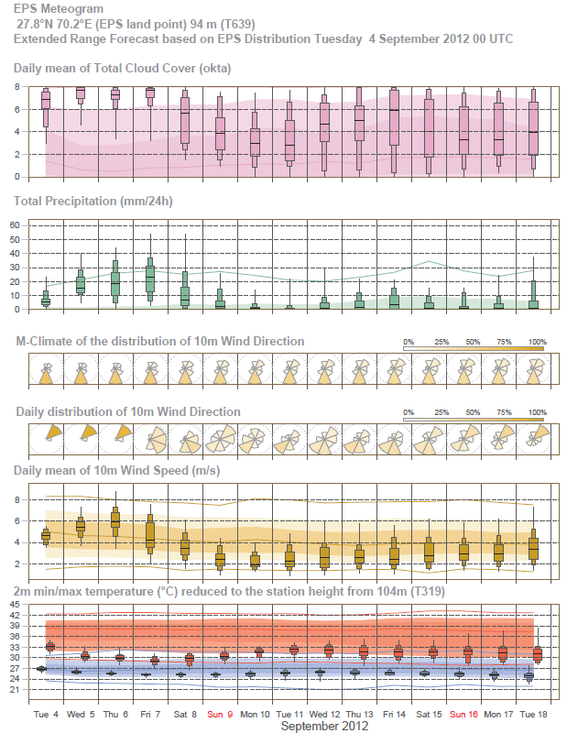
Rahimyar-Khan

Slide 11
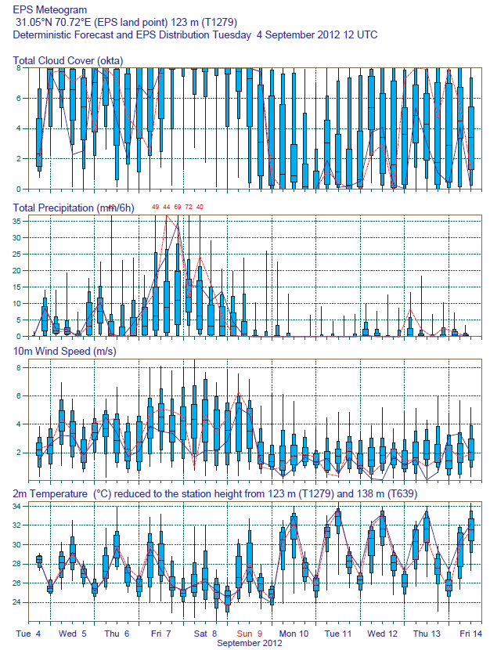
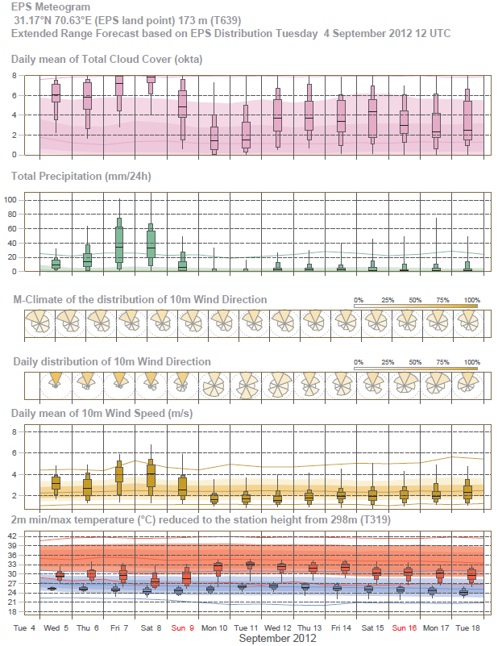
Faisalabad

Slide 12
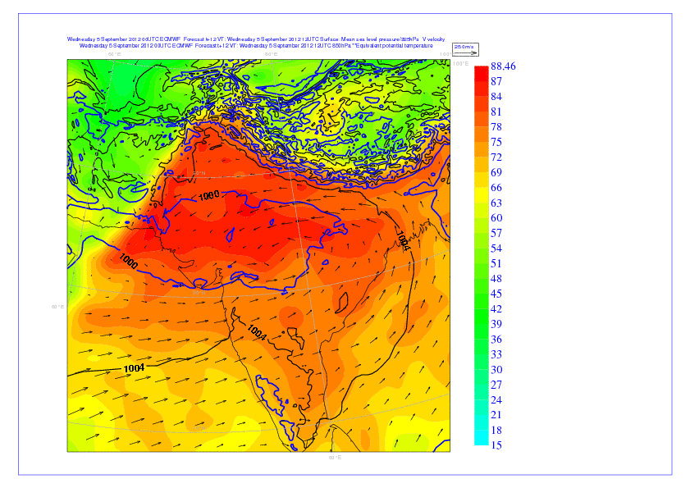
T1279 based on 5/Sept/2012; 00 OTC : MSL,850 hPa eq pot temp and 925 hPa winds

Slide 13
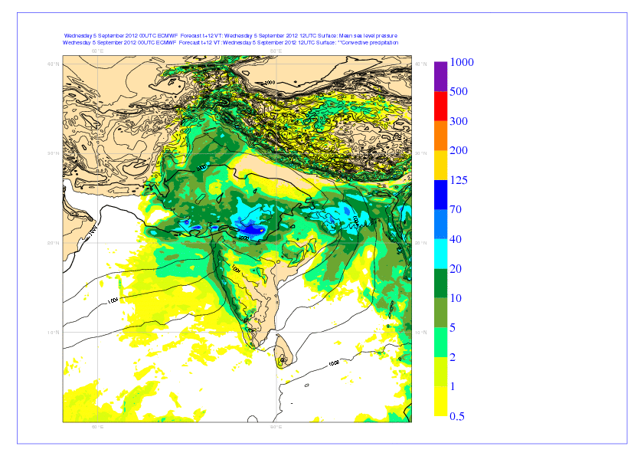
T1279 based on 5/Sept/2012; 00 UTC: MSL and 12 hours accumulated precip

Slide 14
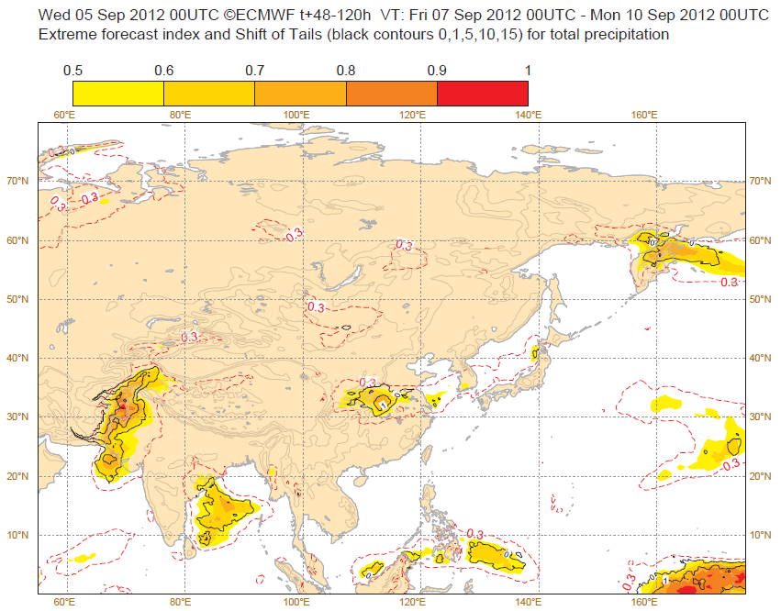

Slide 15
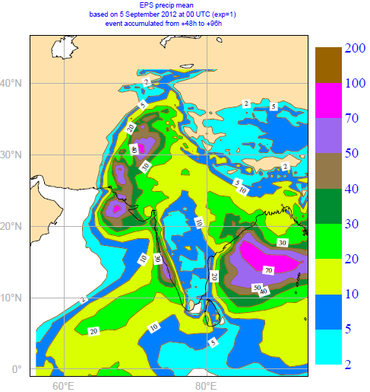
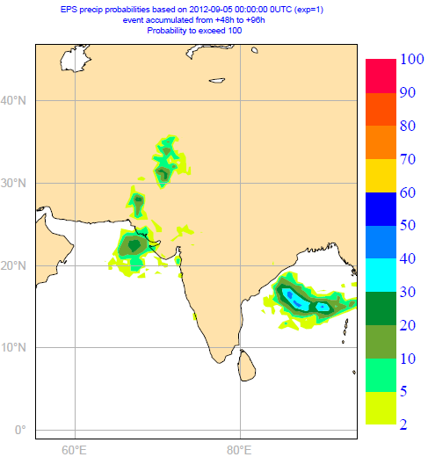
EPS based on 5/Sep/2012; 00 UTC: D+2 to D+4 EM and probability of precip > 100 mm

Slide 16

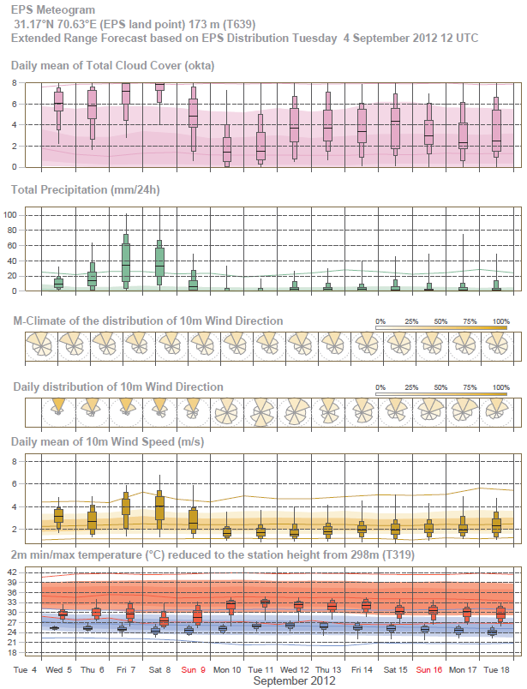
Faisalabad

Slide 17
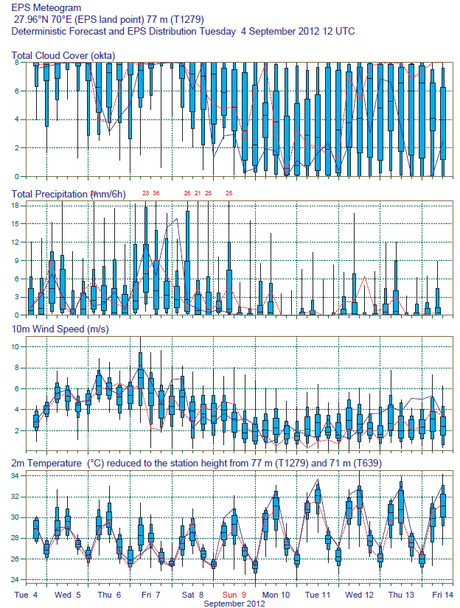
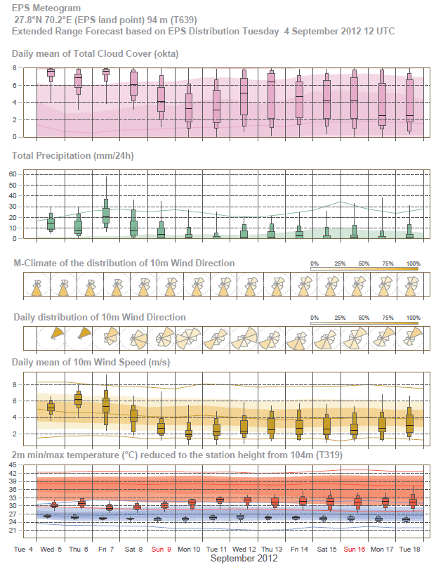
Rahimyar-Khan

Slide 18
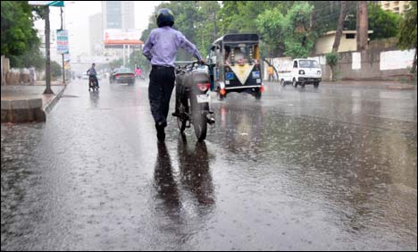
5/September/2012
SEVERE EVENTS IN FORECAST
Comments
The precipitations are starting to produce damages in Pakistan
KARACHI: Monsoon rains have hit different parts of the country causing fifteen deaths in rain-related accidents Wednesday, Geo News reported. According to sources, heavy downpour in Tehsil Nasirabad of Azad Kashmir swept away seventeen people including two women and four children while the bodies of four persons were recovered. Police also confirmed the death of thirteen other persons who were drowned. Neelum Highway was blocked for sort of traffic due to land sliding while the administration has instructed the residents living at the banks of River Jhelum to shift to safer grounds.
The signal of the EPS on Pakistan is consistent with the previous days.

Slide 19
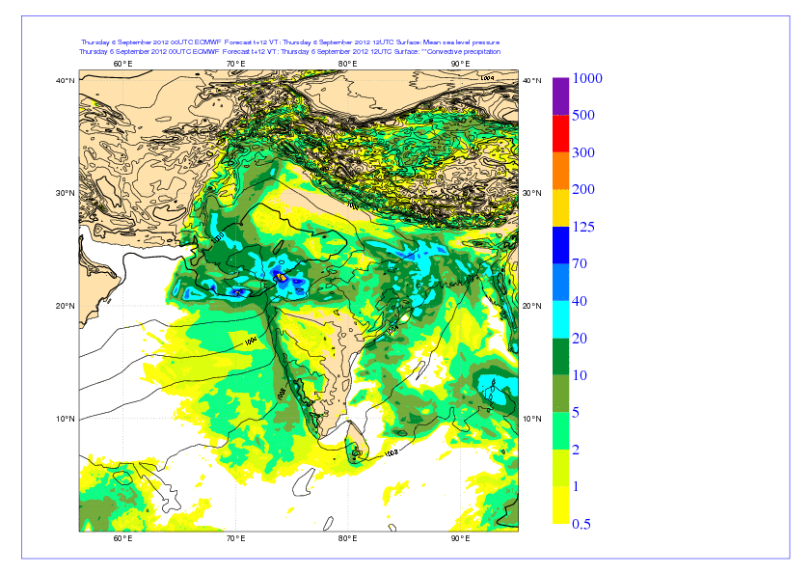
T1279 based on 6/Sept/2012; 00 UTC: MSL and 12 hours accumulated precip

Slide 20
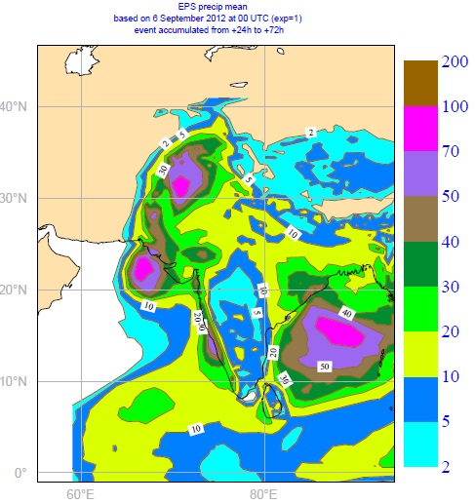
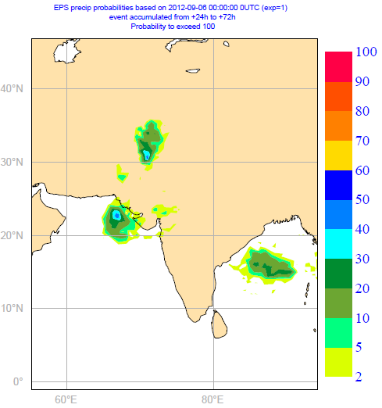
EPS based on 6/Sep/2012; 00 UTC: D+1 to D+3 EM and probability of precip > 100 mm

Slide 21
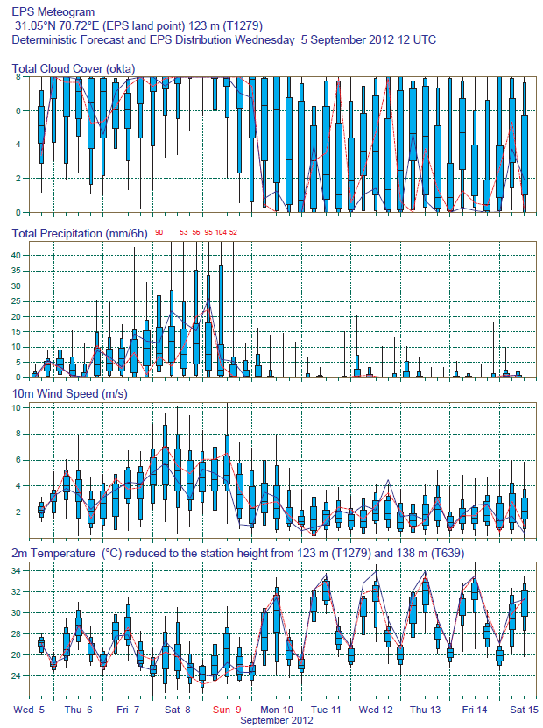
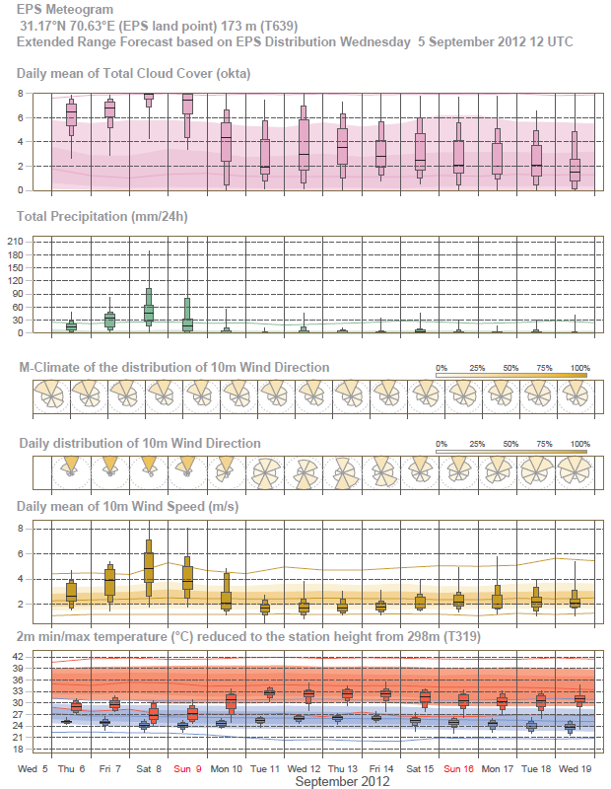
Faisalabad

Slide 22
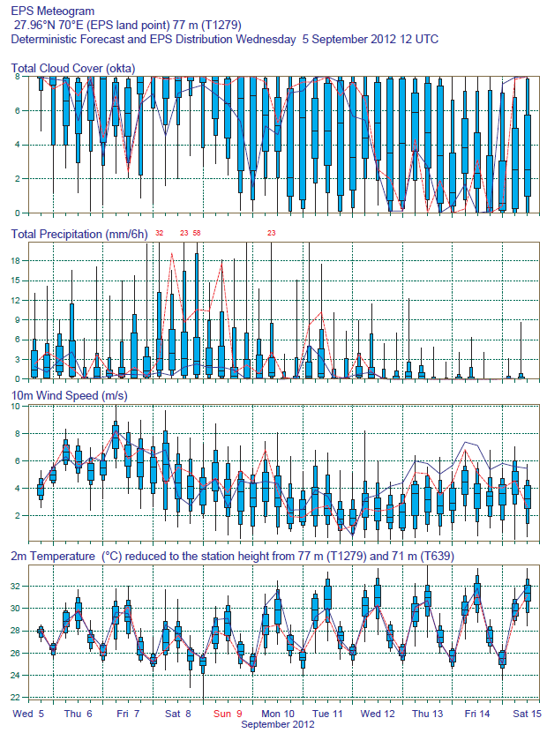
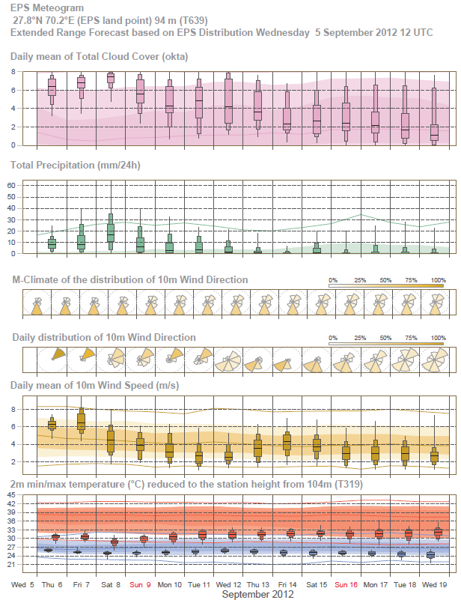
Rahimyar-Khan

Slide 23
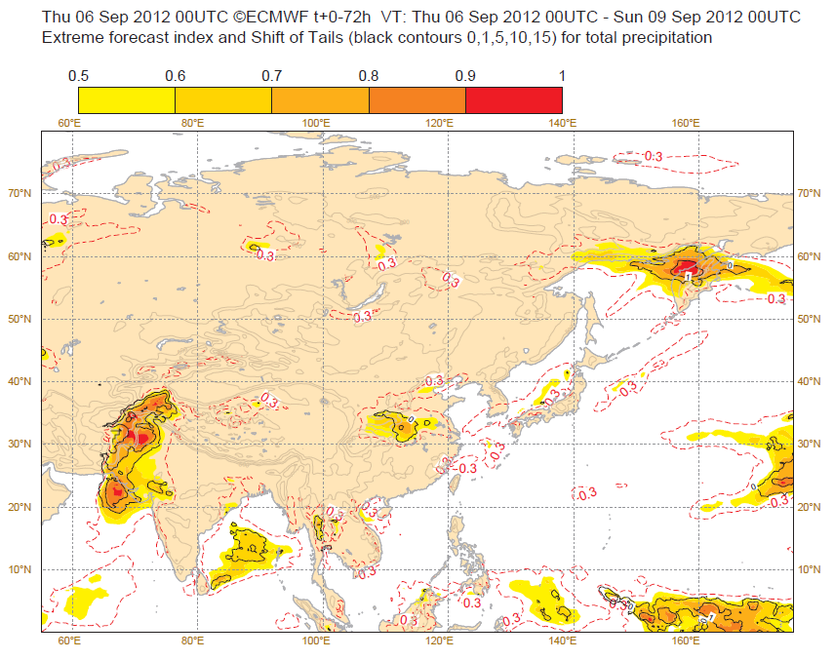

Slide 24
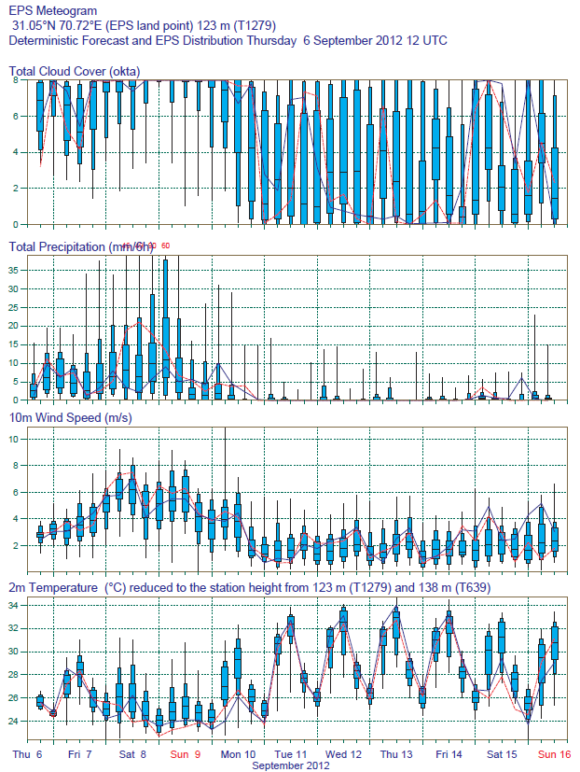
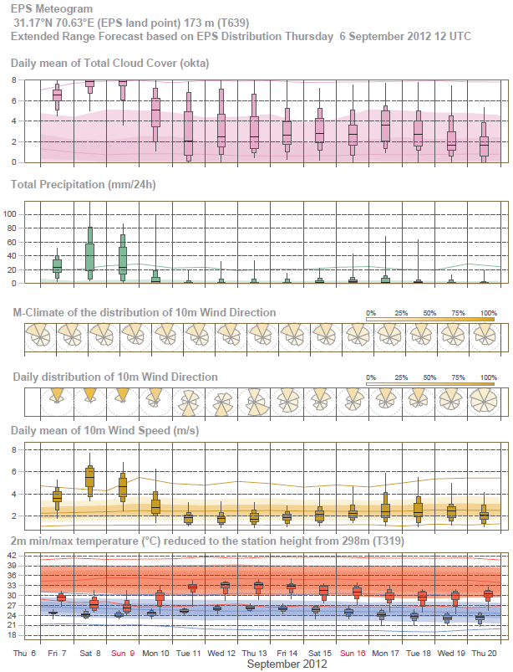
Faisalabad

Slide 25
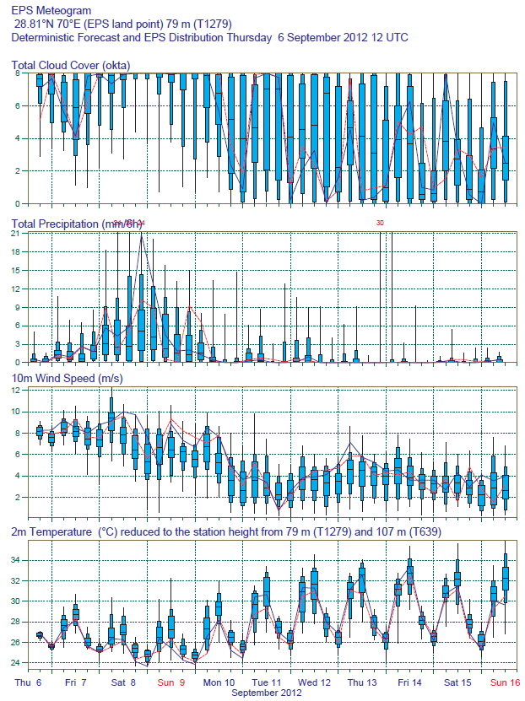
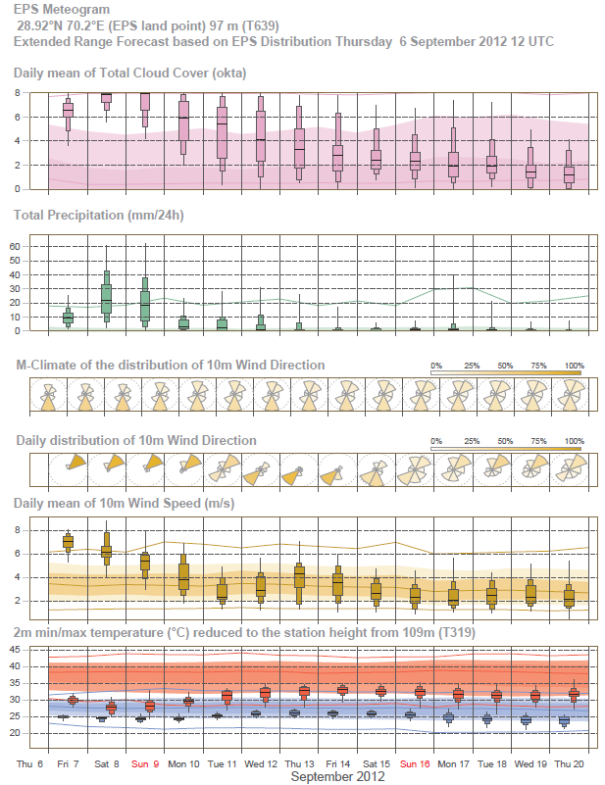
Rahimyar-Khan

Slide 26
The Pakistan Meteorological Department is issuing weather advisories (see below)
Weather advisory issued today:
Dated: 5th Sep, 2012 Time: 1700 PST
Weather Advisory-4
Widespread Monsoon Rains predicted from Thursday to Saturday
Heavy Rains would generate urban & flash floods in the vulnerable areas of the country
Yesterday’s well marked Low Pressure Area is located over Madhya Pradesh (India) and adjoining areas today. This well marked low is likely to move northwest ward in next 48 hrs (towards Pakistan). Under the influence of this weather system strong monsoon currents would start to penetrate in Pakistan from Thursday, giving Widespread Monsoon rains with scattered heavy downpours in the country from Thursday to Saturday. Heavy downpours would generate urban and flash floods in the vulnerable areas during the period. There is also a probability of Riverine Floods, particularly in Eastern Rivers.

Slide 27
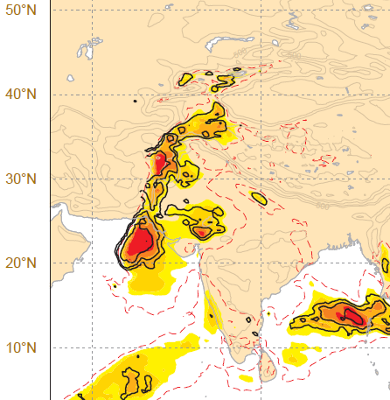
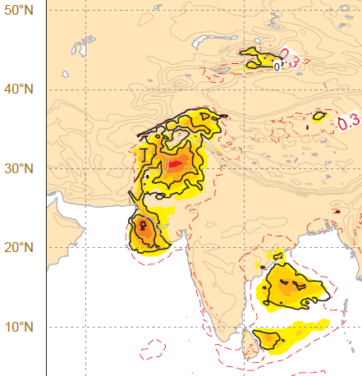

Slide 28
Update of the weather advisory issued by Pakistan Met Office
Dated: 7th Sep, 2012 Time: 1700 PST
Weather Advisory-6
Widespread Monsoon Rains predicted on Saturday/Sunday
Heavy Rains would generate urban & flash floods in the vulnerable areas of the country
Yesterday's well-marked Low Pressure Area has entered in eastern parts of Rajasthan (India) and adjoining areas today. This well marked low is likely to move further northwestward in next 24 hrs and likely to enter in southeast Punjab and adjoining areas of upper Sindh on Sunday. Under the influence of this weather system, strong monsoon currents would penetrate in central parts of Pakistan on Saturday/Sunday, producing widespread Monsoon Rains over there. A westerly wave is located over Afghanistan and its trough is extended up to western parts of Pakistan. Heavy rains would generate flash floods in the vulnerable areas of Southern Punjab, Upper Sindh, Lower KP and Northeast Balochistan during the period.

Slide 29
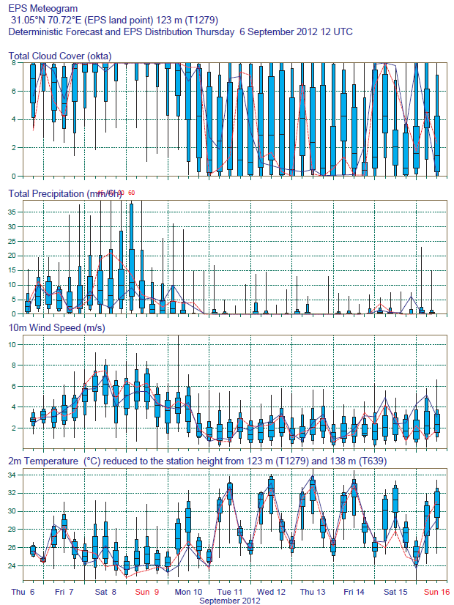
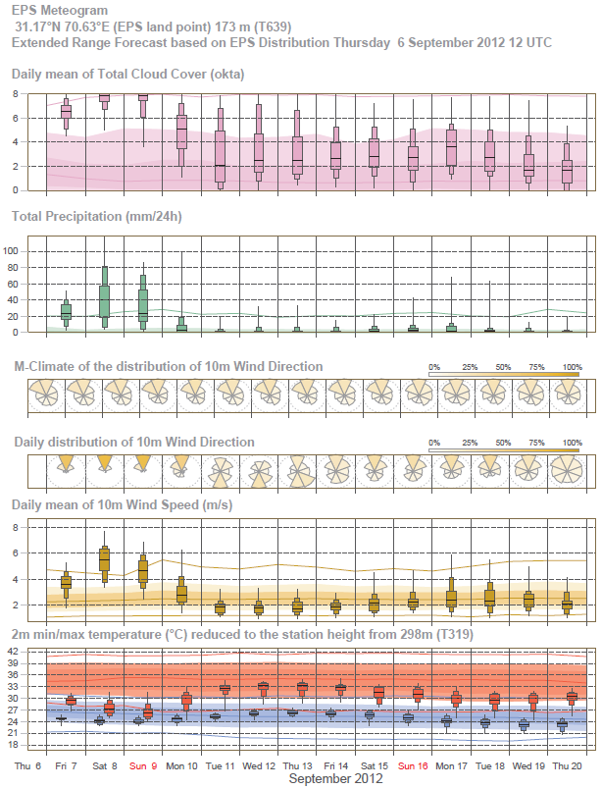
Faisalabad

Slide 30
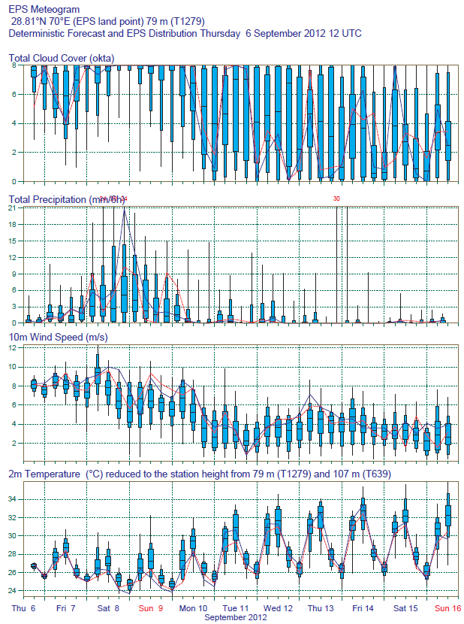

Rahimyar-Khan

Slide 31
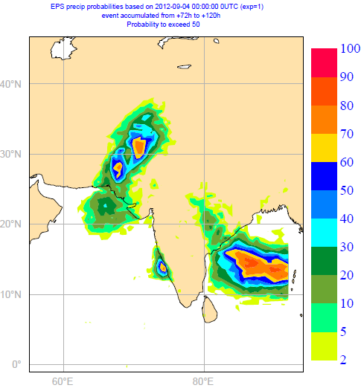
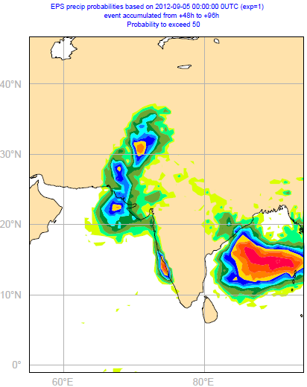
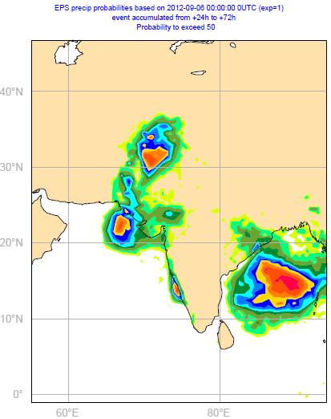
Probabilities of precip > 50 mm/48 hours

Slide 32
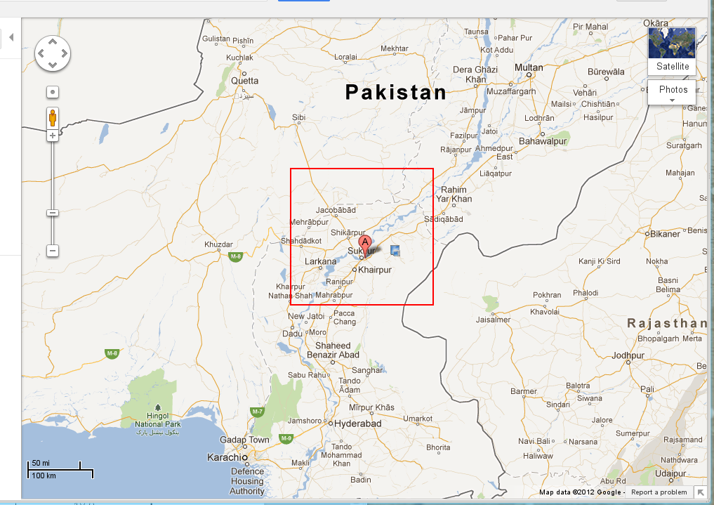
Today, the National Meteorological Service of Pakistan has posted the amount of precipitation accumulated over 24h (ending this morning) for a few stations. I have picked three locations:
Jaccoabad 305mm/24h
Sukkur 164mm/24h
Rohri 152mm/24h
These three locations are within the red box in the following plot:
The forecast for the severe weather (precipitation above the 90 percentile) has been generally quite successful.
305 mm/24 hr

