Slide 1
CKDMIP progress meeting 8 Sept 2020
1. What is required from participants?
2. Results so far
5. Questions for discussion
Robin Hogan and Marco Matricardi
ECMWF
r.j.hogan@ecmwf.int
Any objections to recording this meeting for the benefit of colleagues who could not attend? Recording will not be posted publicly on internet.

Slide 2
Agenda
What is being asked of CKDMIP participants? (Robin)
  Discussion: what further help/software/data would be of use to participants?
Summary of results so far (Robin)
Overview of SOCRATES CKD tool (James Manners)
  Discussion: what are the interesting differences between CKD approaches that we can evaluate using the CKDMIP dataset?
Towards a community tool chain for gas optics (Robert Pincus)
  Discussion: what are the community needs, can existing codes be released open source?
Discussion of next steps (all)
  What is a realistic timeline: from gathering contributions from all models to a CKDMIP results paper?
  What else is needed, e.g. clouds, spectrally varying surface albedo, non-LTE…?
  Next meeting(s)?

Slide 3
Objectives
To use benchmark line-by-line calculations to evaluate the accuracy of existing CKD models. Done for RRTMG, RRTMGP and RRTMGP-NN (LW)
To explore how accuracy varies with number of k-terms / g-points in individual CKD schemes for applications spanning short-range weather forecasting to climate modelling. Done for ecCKD
To understand how different choices in way that CKD models are generated affects their accuracy for the same number of g-points.
To provide freely available datasets and software to facilitate the development of new gas-optics models, with the ultimate aim of producing a community tool to allow users to generate their own gas-optics models targeted at specific applications.
The impact of different spectroscopic databases on radiative forcing, e.g. related to water vapour, was not originally intended to be part of CKDMIP: it has been studied before, and we want to understand the impact of algorithmic choices in the formulation of CKD tools

Slide 4
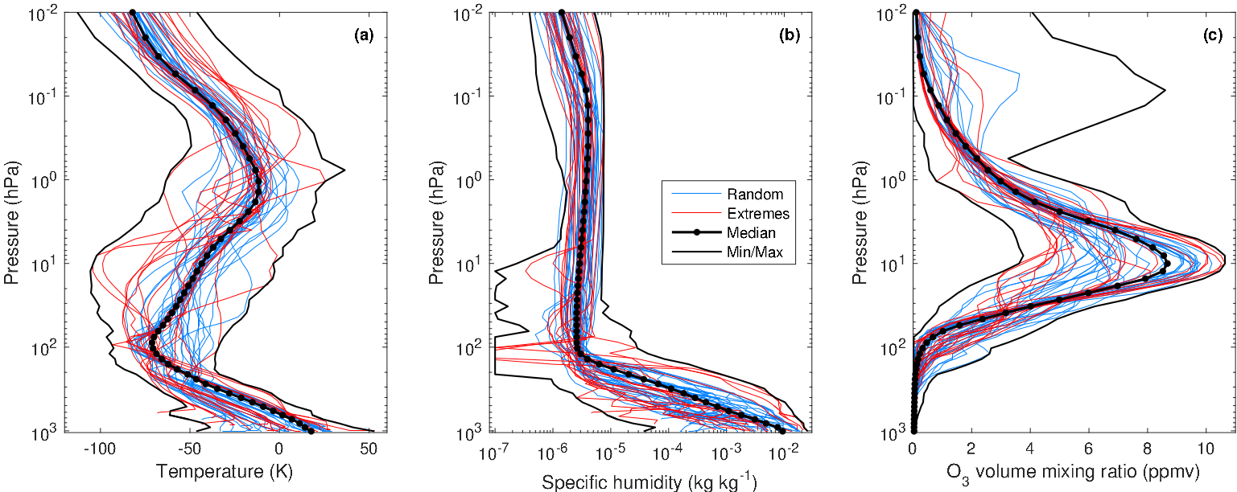
100 evaluation profiles of T, q and [O₃] in two evaluation datasets
Evaluation-1: 50 profiles for which the LBL spectra and broadband fluxes are available to participants
Evaluation-2: 50 profiles for which the spectra and fluxes are withheld for independent evaluation
Evaluation-1

Slide 5
Trace gas variations: 34 scenarios (18 in shortwave)
justification
One concentration file per scenario, containing 50 profiles
2x50x34 = 3400 profiles in 2x34 = 68 files, e.g. ckdmip_evaluation1_concentrations_present.nc

Slide 6
Participants requested to use 5 “wide” and 13 “narrow” bands in SW and LW, but single band (FSCK) also permitted
Absorption spectra for the “median” profile at 100 hPa
Line-by-line absorptions calculated by Marco Matricardi

Slide 7
SW workflow for one scenario, one CKD model
ckdmip software package
FTP site
mean-ssi_nrl2.nc
Solar spectral irradiance
ckdmip_evaluation1_concentrations_present.nc
50 profiles of T, p and mole fractions of 9 gases
in layers and at layer interfaces
Participants’
tasks
Your shortwave CKD model for a particular application, band structure and total number of g-points
One file per CKD model/scenario
One file per CKD model
ecckd-0.6_evaluation1_sw_climate_wide-38_optical-depth_present.nc
optical_depth(column, layer, g_point) or total optical depth
rayleigh_optical_depth(column, layer, g_point) & single scat. albedo
incoming_sw(column, g_point)
ecckd-0.6_sw_climate_wide-38_spectral_definition.nc
gpoint_fraction(wavenumber_interval, g_point)
ckdmip_sw
ckdmip software package
FTP site
ckdmip_evaluation1_sw_fluxes_present.nc
LBL fluxes
ecckd-0.6_evaluation1_sw_climate_wide-38_fluxes_present.nc
ckdmip software package
Matlab scripts
Evaluation plots on CKDMIP web site

Slide 8
LW workflow for one scenario, one CKD model
FTP site
ckdmip_evaluation1_concentrations_present.nc
50 profiles of T, p and mole fractions of 9 gases
in layers and at layer interfaces
Participants’
tasks
Your longwave CKD model for a particular application, band structure and total number of g-points
One file per CKD model/scenario
One file per CKD model
ecckd-0.6_evaluation1_lw_climate_wide-42_optical-depth_present.nc
optical_depth(column, layer, g_point)
planck_hl(column, half_level, g_point)
ecckd-0.6_lw_climate_wide-42_spectral_definition.nc
gpoint_fraction(column, layer, g_point)
ckdmip_lw
ckdmip software package
FTP site
ckdmip_evaluation1_lw_fluxes-4angle_present.nc
LBL fluxes
ecckd-0.6_evaluation1_lw_climate_wide-42_fluxes-4angle_present.nc
ckdmip software package
Matlab scripts
Plots on CKDMIP web site

Slide 9
How many CKD models should I submit?
Can be as few as one, e.g. RRTMG, RRTMGP, Fu-Liou…
If it affects the number of g points you need, you can vary the application:
  Climate (all scenarios, 0.02-1100 hPa), Global NWP (present-day scenario only, 0.02-1100 hPa), Limited-area NWP (present-day scenario, 4-1100 hPa)
  Evaluation statistics will be limited to applicable scenarios and pressure ranges
You can vary the band structure:
  CKDMIP proposes a set of narrow and wide bands, but other band structures accepted
You can vary the number of g points (k terms)
  Explore the trade-off between accuracy and efficiency
Could be 3x2x6 = 36 different CKD models! Up to you how many you submit depending on interest (e.g. only climate) and your time

Slide 10
What do I do with the LBL datasets?
If you can only use your own LBL model to generate CKD models, you can ignore them
However, intention of CKDMIP is to compare CKD models generating assuming the same spectroscopy, so we can eliminate spectroscopy differences as a cause of apparent errors
Therefore, the FTP site contains absorption spectra for three of the four CKDMIP datasets (Evaluation-2 held back for independent evaluation) using LBLRTM 12.8, which you can use for training (ecCKD uses all three of these datasets, for example)
The Technical Guide explains how the CKDMIP software can be used to perform some manipulation of these datasets, including radiative transfer calculations
See contents of FTP site

Slide 11
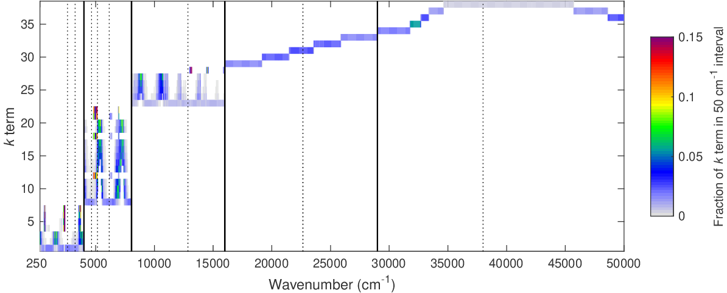
What does the “spectral definition” file contain?
Longwave ecCKD wide-43 model
Normally we have N g-points in a band but don’t care where in the band
For wide bands this becomes important when representing clouds: for more accuracy the cloud optical properties could be parameterized per g point not per band
The spectral definition file contains gpoint_fraction, which sums to 1 along the wavenumber axis
If your model uses a different g(wn) relationship at different pressures, I suggest you use a mid-tropospheric reference pressure of 500 hPa
If difficult, I can generate a “dummy” file…
Jump to end
Shortwave ecCKD wide-38 model

Slide 12
Use realistic vertical profiles for the five well-mixed greenhouse gases

Slide 13
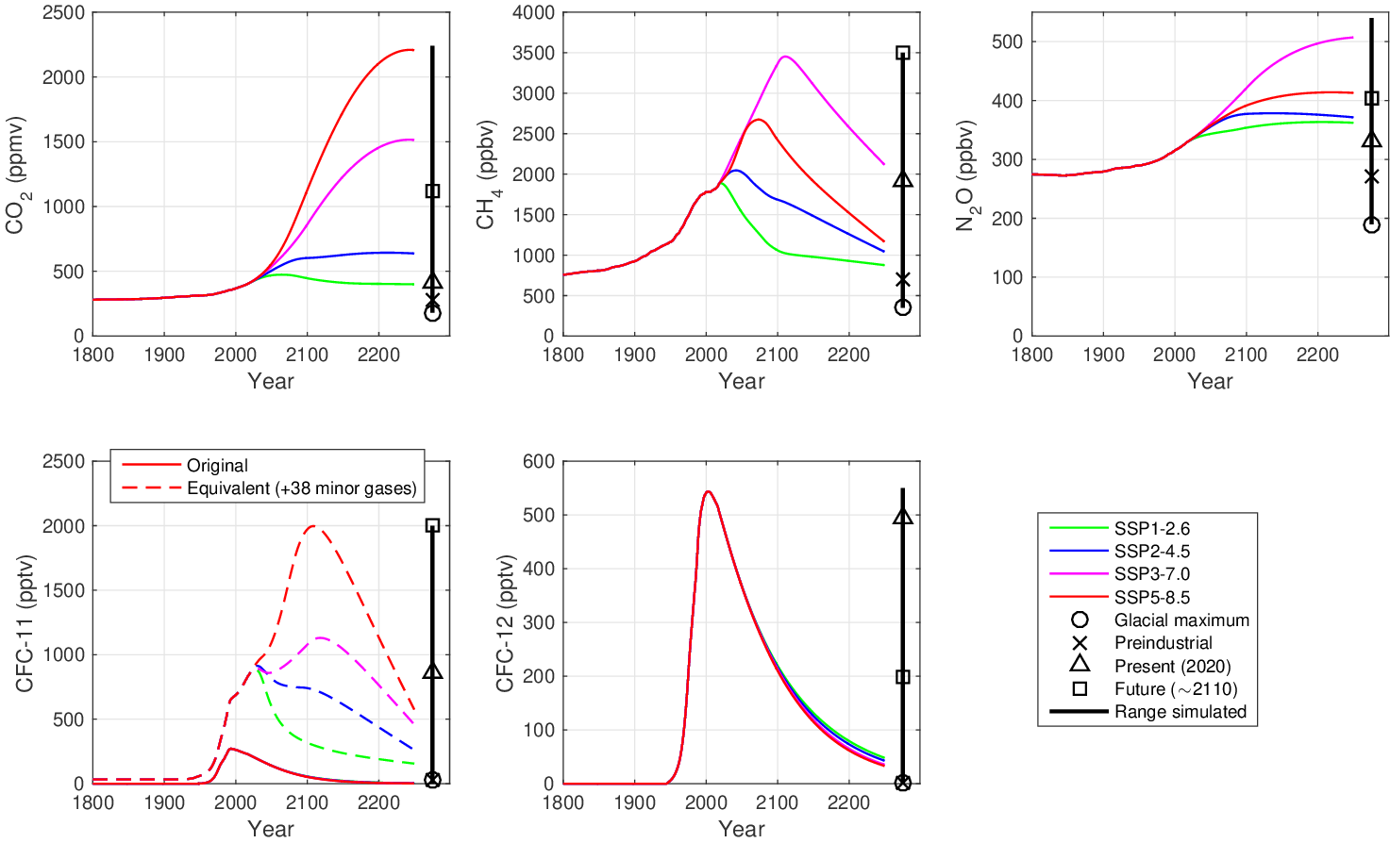
CKDMIP Evaluation-1 dataset: Well-mixed gases
Consider five well-mixed greenhouse gases
Further 38 implicitly considered via “equivalent CFC11” (Meinshausen et al. 2017)
Evaluate concentrations from Glacial Maximum to the worst of the CMIP6 future scenarios
Participants produce CKD models for both climate and present-day NWP
Per-molecule absorption of these gases is independent of concentration, so only store absorption spectra at one concentration and scale
Also N₂ and O₂ absorption

Slide 14
Three “applications”
Most contributors are interested primarily in the “climate” application: your model will be tested over all 34 climate scenarios at pressures down to 0.02 hPa
If you think you can produce a faster CKD model (fewer g points) for present-day NWP applications, you can submit results for separate CKD models that will be evaluated only using the “present” greenhouse-gas scenario, and optionally also only pressures down to 4 hPa for limited-area NWP

Slide 15
Two proposed band structures: 13 narrow bands, 5 wide bands
Longwave Shortwave

Slide 16
FTP site directory contents
concentrations/ 34 scenarios for each of the Evaluation-1 and Evaluation-2 datasets
lw_spectra/, sw_spectra/ LBL gas absorption spectra (big!)
  evaluation1/ Spectra for Evaluation-1 dataset (Evaluation-2 kept back for independent evaluation)
  idealized/ Spectra for regularly spaced temperature pressure and humidity – can use for training
  mmm/ Spectra for maximum, minimum and median T, q and [O3] – can use for training
lw_fluxes/, sw_fluxes/: LBL fluxes per narrow band for each scenario & profile – for evaluation
  evaluation1/
results/
  CKD-TOOL/lw_optical-depth/, CKD-TOOL/sw_optical-depth/ Files submitted by participants
  CKD-TOOL/lw_fluxes/, CKD-TOOL/sw_fluxes/ Fluxes calculated by from submitted optical depths
Not essential! Available for participants if they wish

Slide 17
Dataset volumes
Absorption spectra use 7.1M points in longwave, 3.1M in shortwave
Stored in NetCDF4/HDF5 format with compression
Evaluation-1 dataset:
  50 profiles: 265 GB in LW, 136 GB in SW
Evaluation-2 dataset:
  For independent evaluation (not released)
  Same size as Evaluation-1
MMM dataset:
  Median, min and max profiles
  3 profiles: 30 GB in LW, 15 GB in SW
Idealized dataset:
  For creating CKD look-up tables
  6 profiles: 139 GB in LW, 74 GB in SW

Slide 18
End of part 1

Slide 19
Results Models and tools participating in CKDMIP
CKD model | Contact | LW status | SW status
RRTMG (ecRad) | Robin Hogan | v1.2.0 | v1.2.0
RRTMGP (RTE) | Robert Pincus | v181204 | v181204
RRTMGP-NN | Peter Ukkonen | v1.0
MODTRAN | Alexander Berk
Fu-Liou | Lei Lin
CKD tool | Contact | LW status | SW status
SOCRATES | James Manners
ecCKD | Robin Hogan | v0.5 | v0.6
ARTDECO-PyKdis | Mathieu Compiegne
INSA-CNRS/LOA/HYGEOS | Frederic Andre, Mathieu Compiegne
PSLACKD | Seiji Kato, Fred Rose
CMA scheme | Hua Zhang
mstrnX | Miho Sekiguchi
KBIN | Nils Madenach, Juergen Fischer, Rene Preusker
a

Slide 20
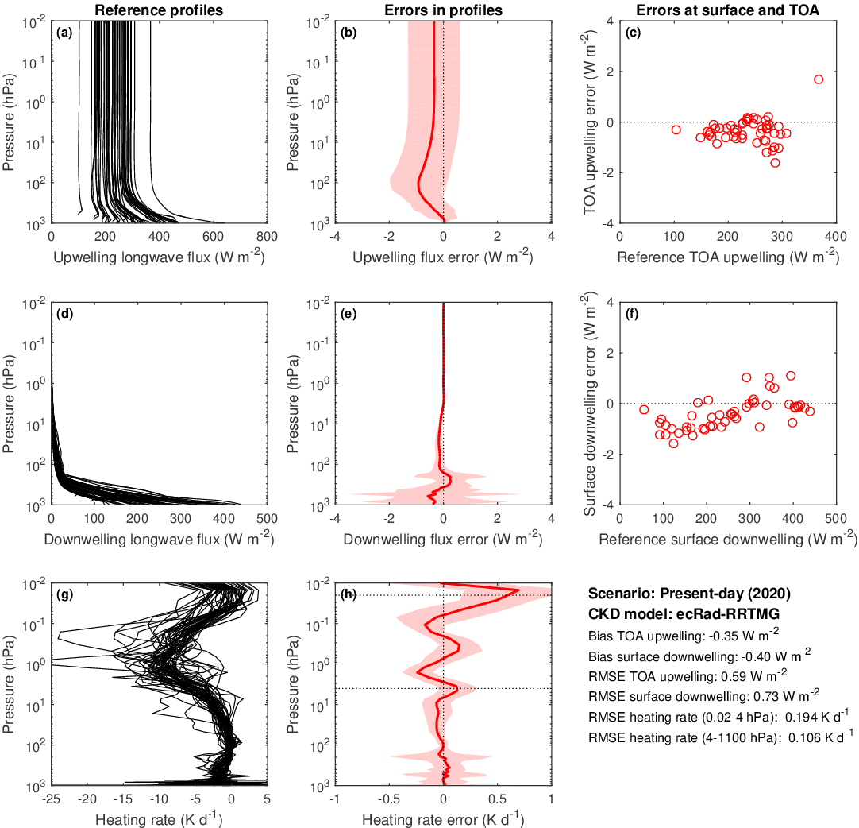
Longwave
RRTMG
16 bands
140 g points

Slide 21
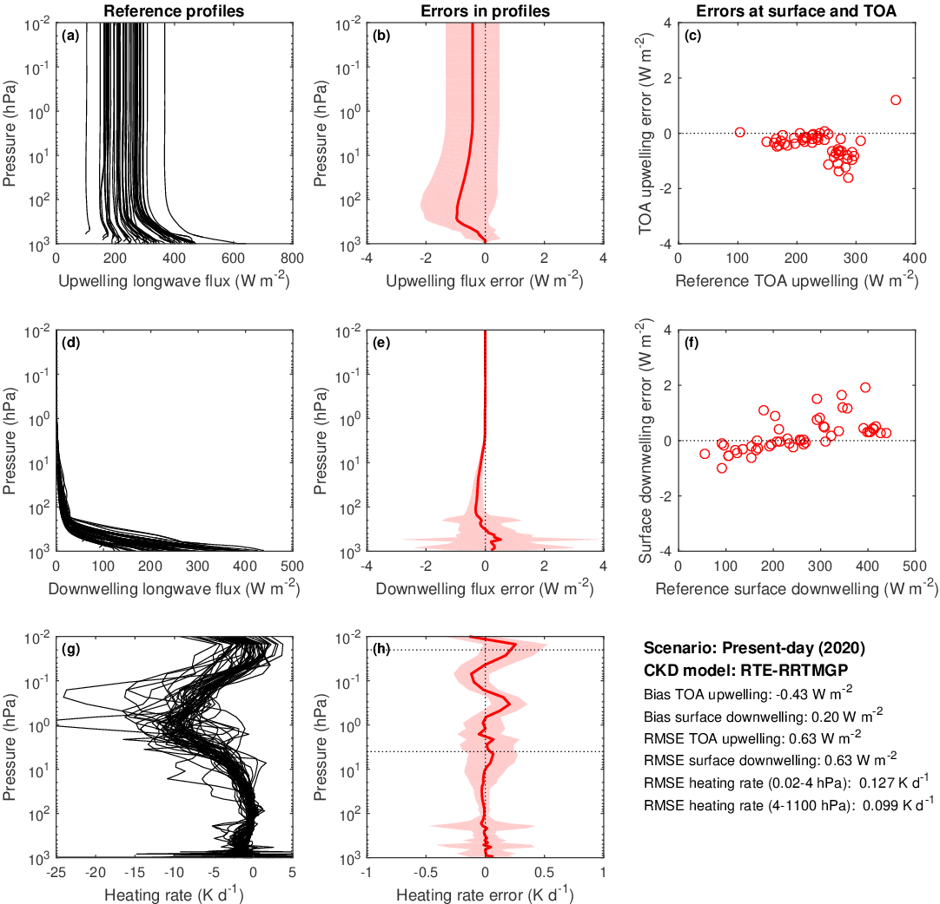
Longwave
RRTMGP
16 bands
256 g points

Slide 22
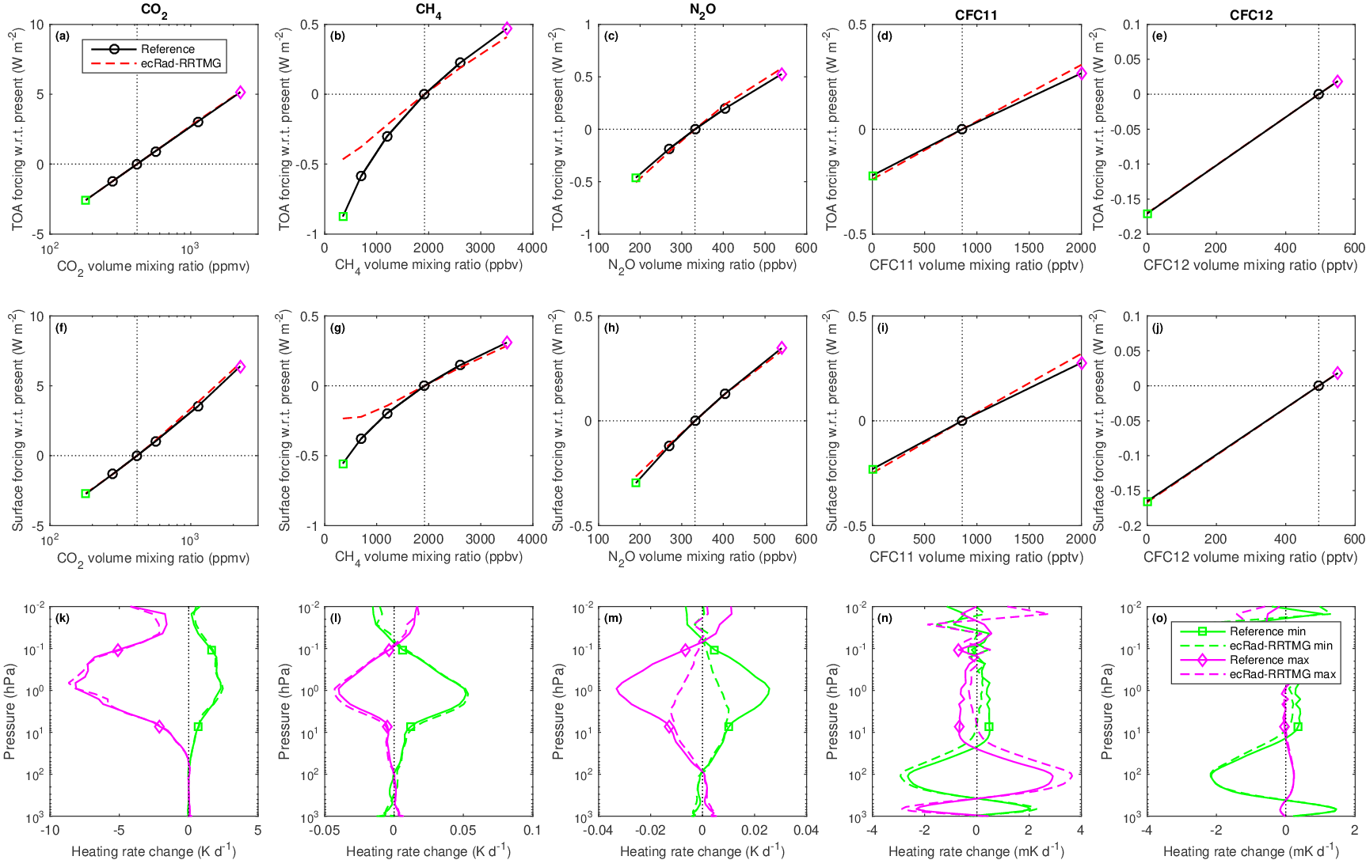
Longwave RRTMG

Slide 23
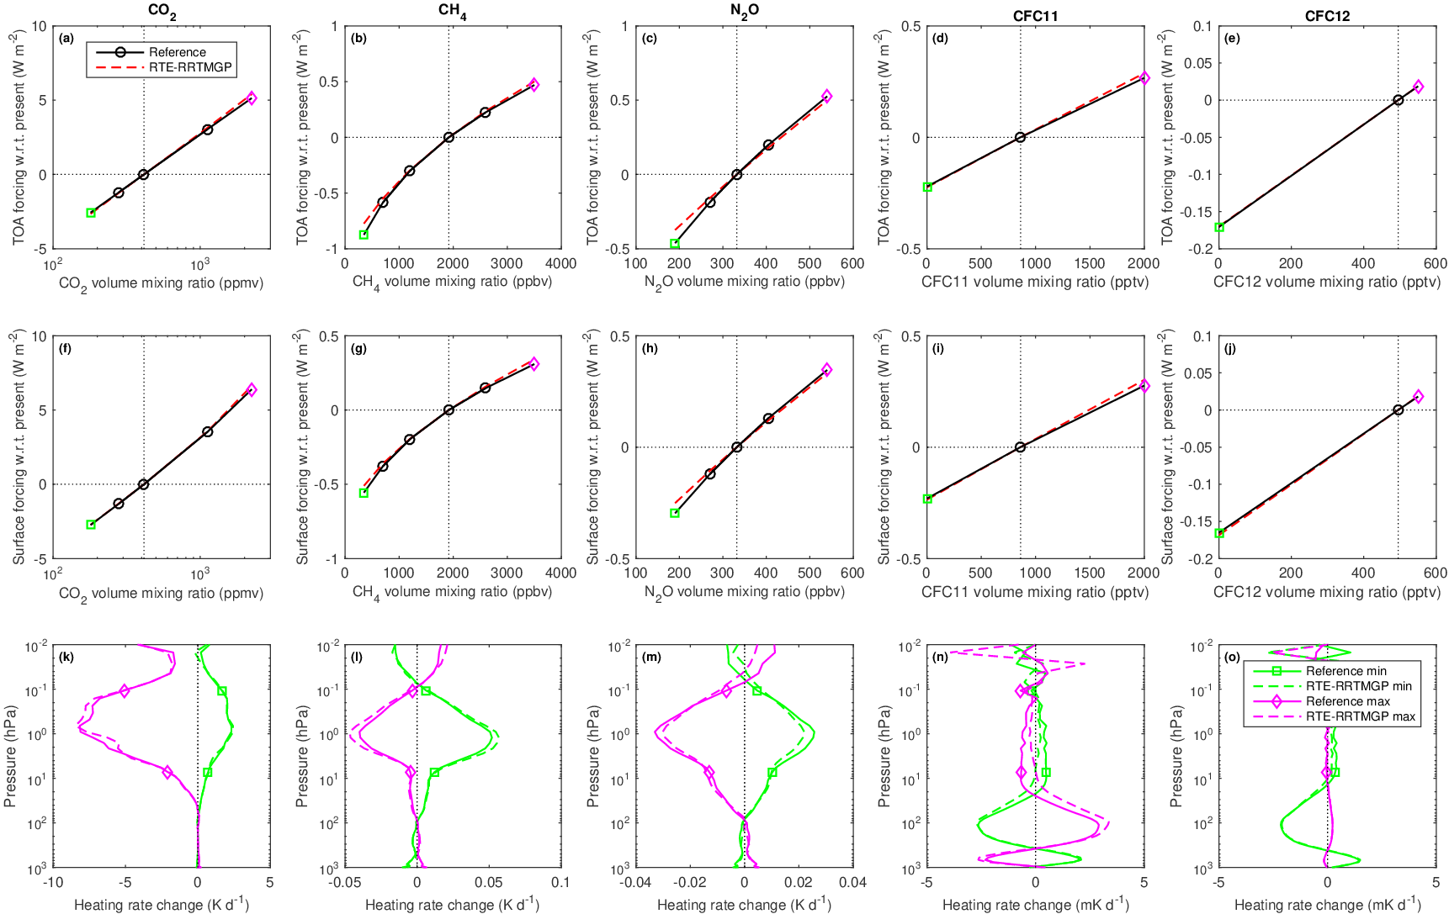
Longwave RRTMGP

Slide 24
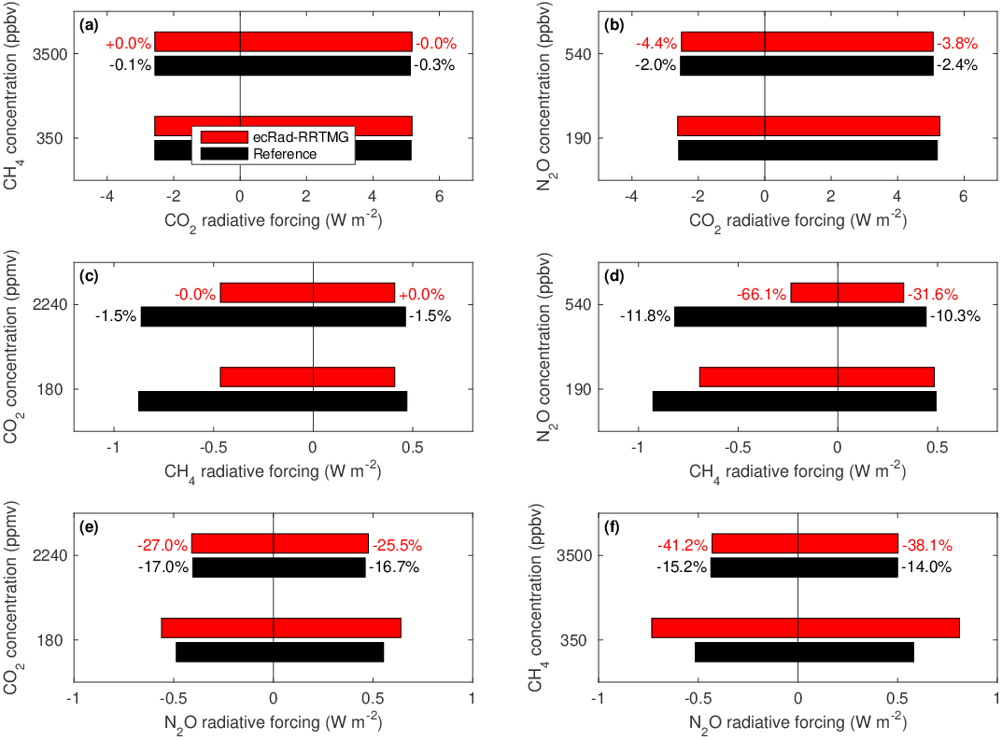
Longwave
RRTMG

Slide 25
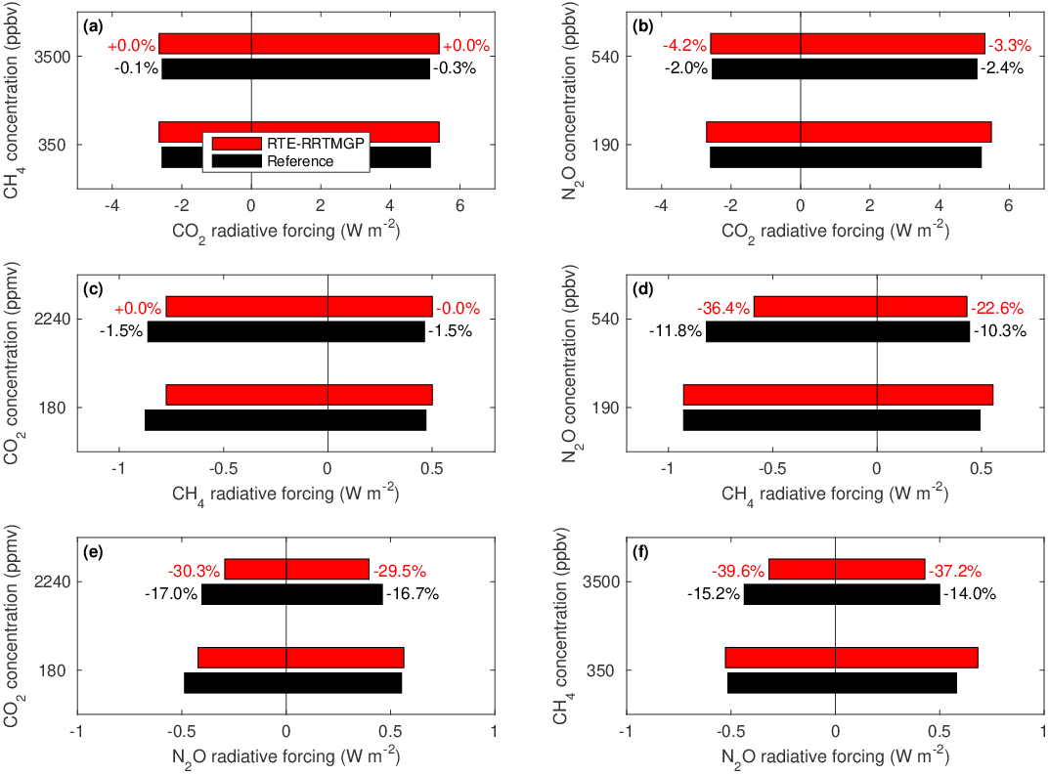
Longwave
RRTMGP

Slide 26
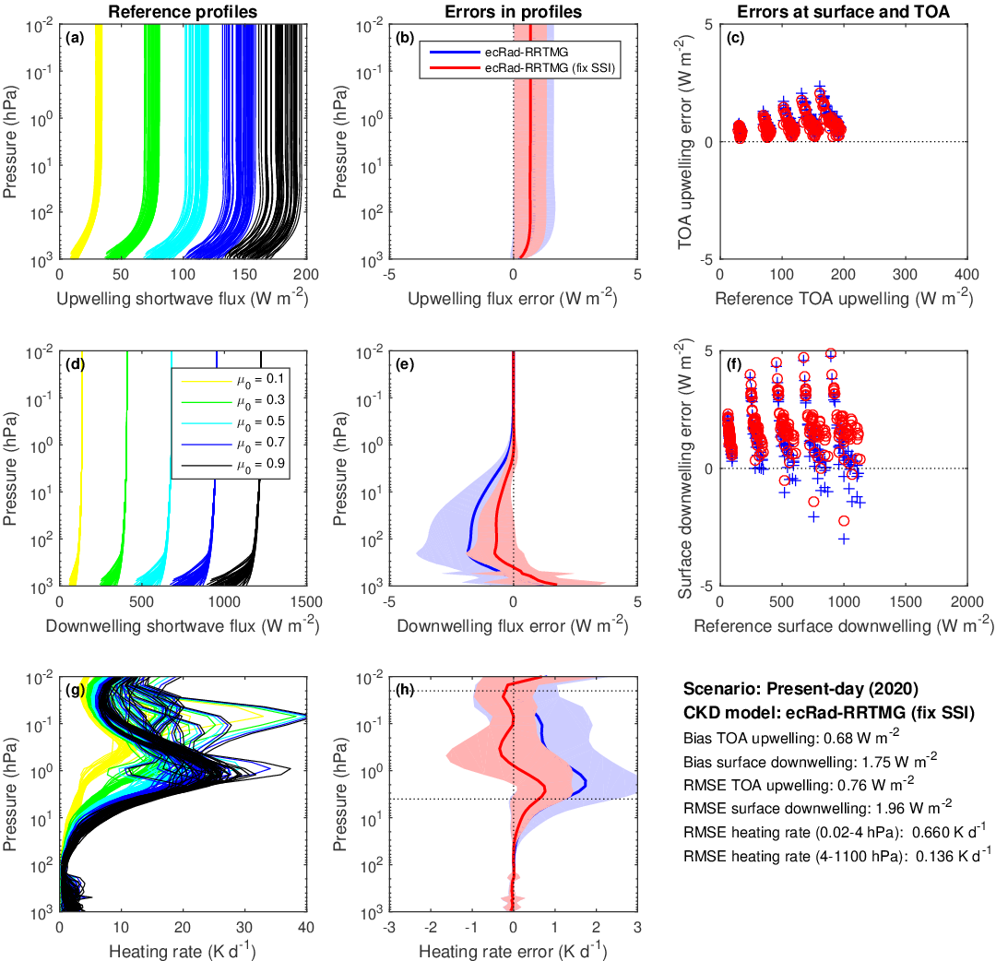
Shortwave
RRTMG
14 bands
112 g points

Slide 27
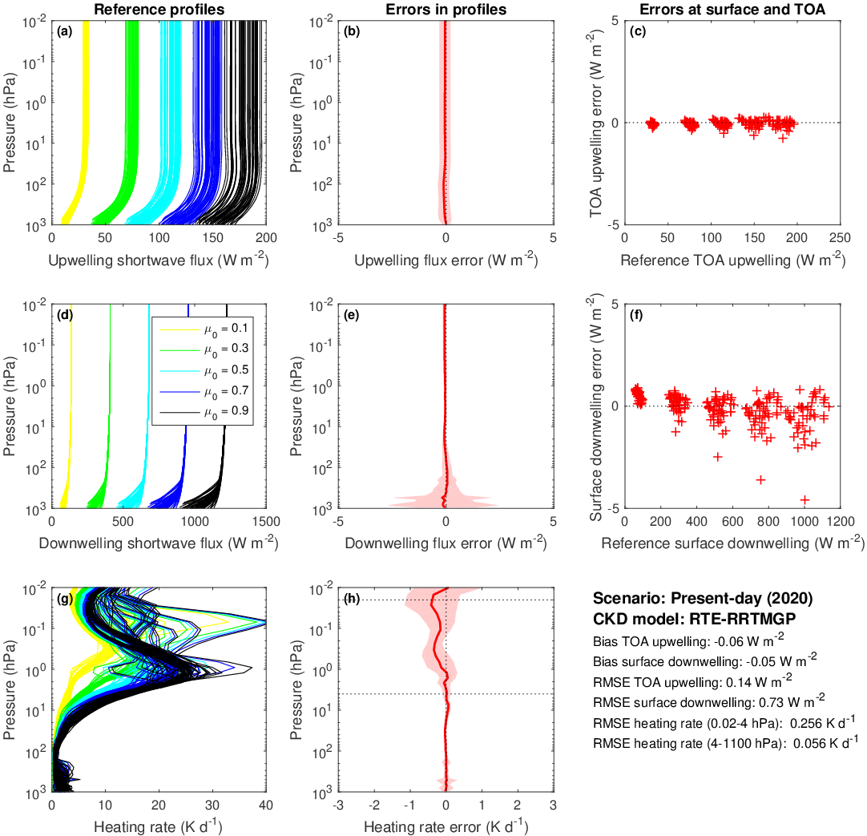
Shortwave
RRTMGP
14 bands
224 g points

Slide 28
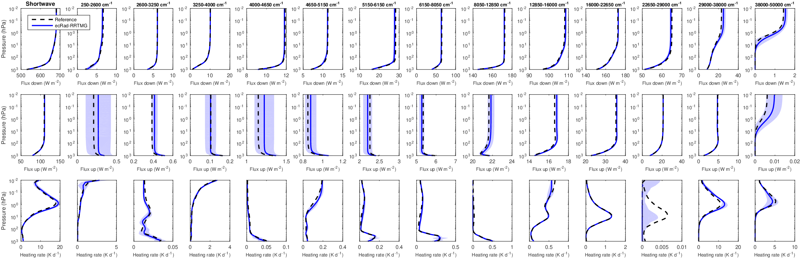
Shortwave RRTMG

Slide 29
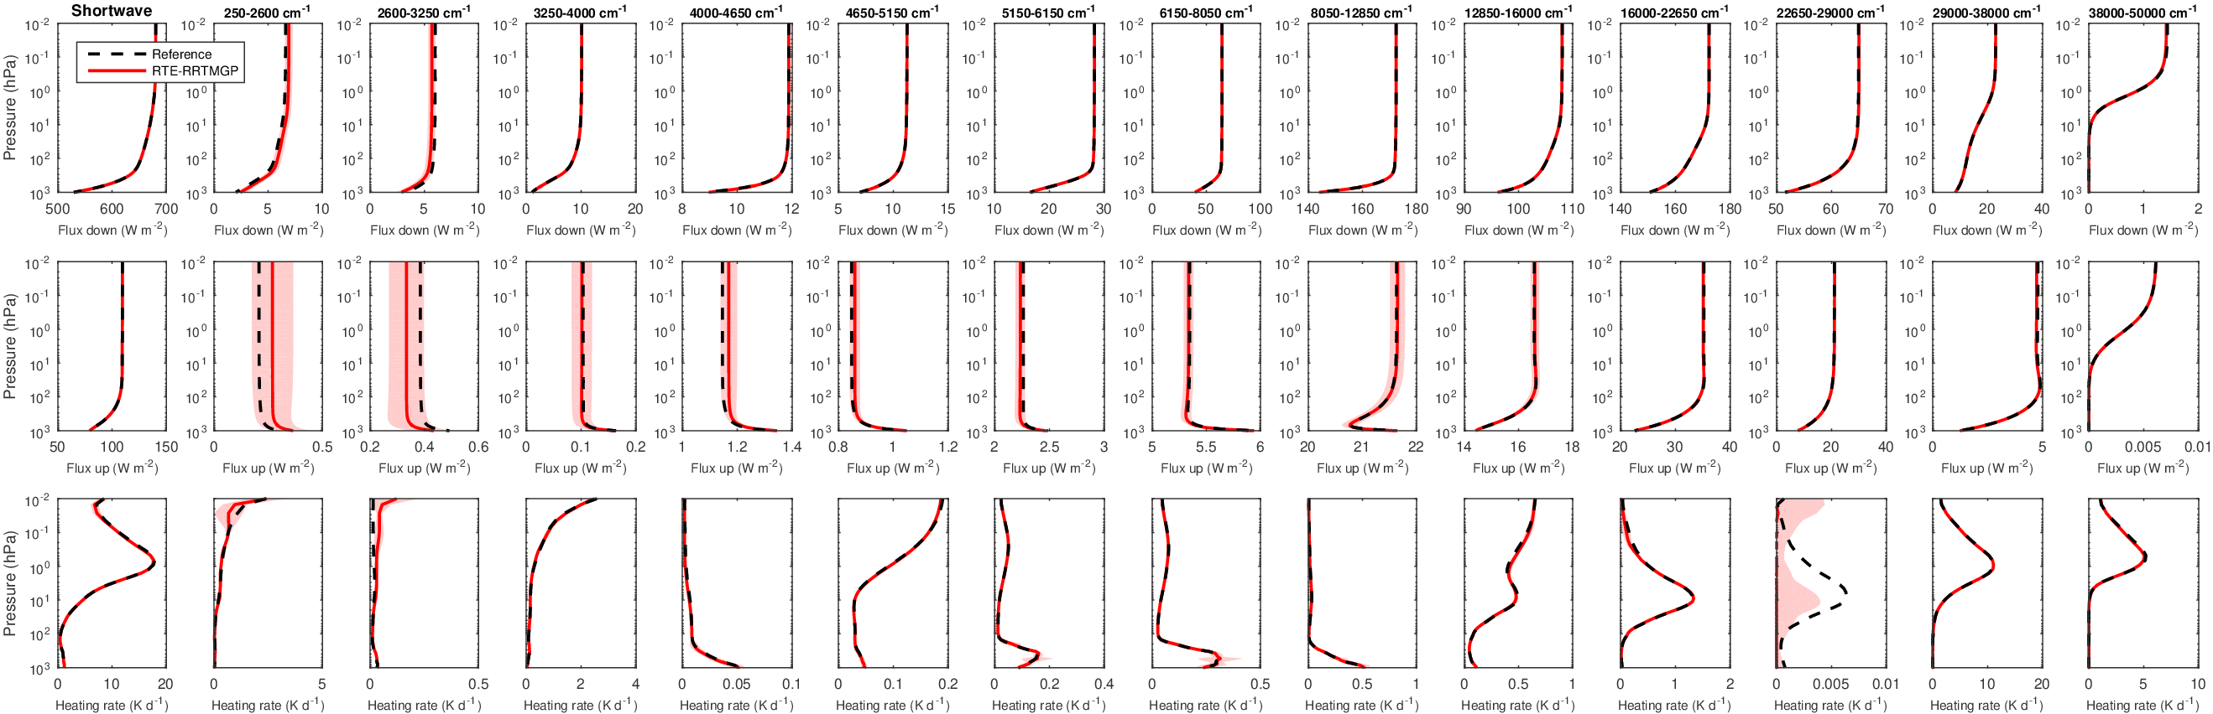
Shortwave RRTMGP

Slide 30
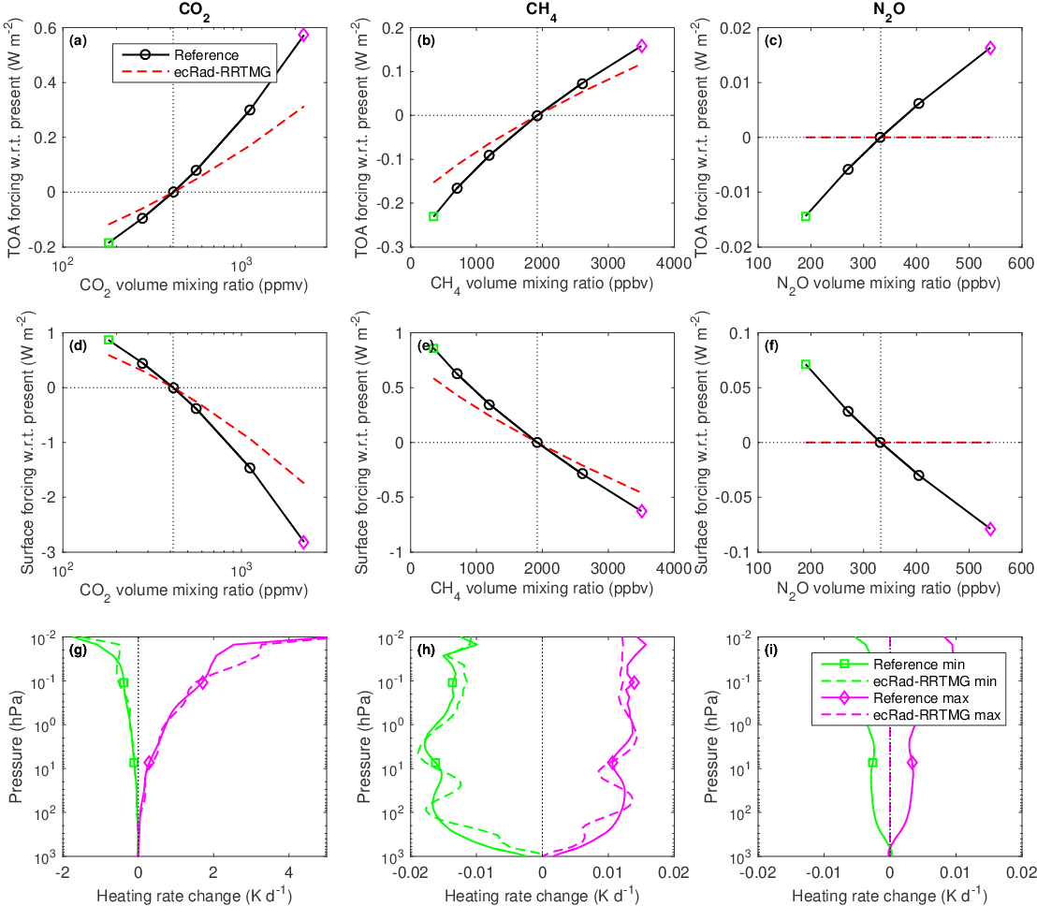
Shortwave
RRTMG

Slide 31
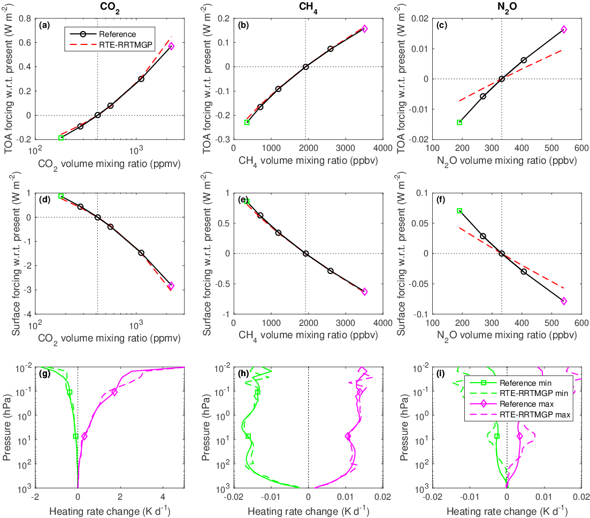
Shortwave
RRTMGP

Slide 32
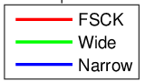
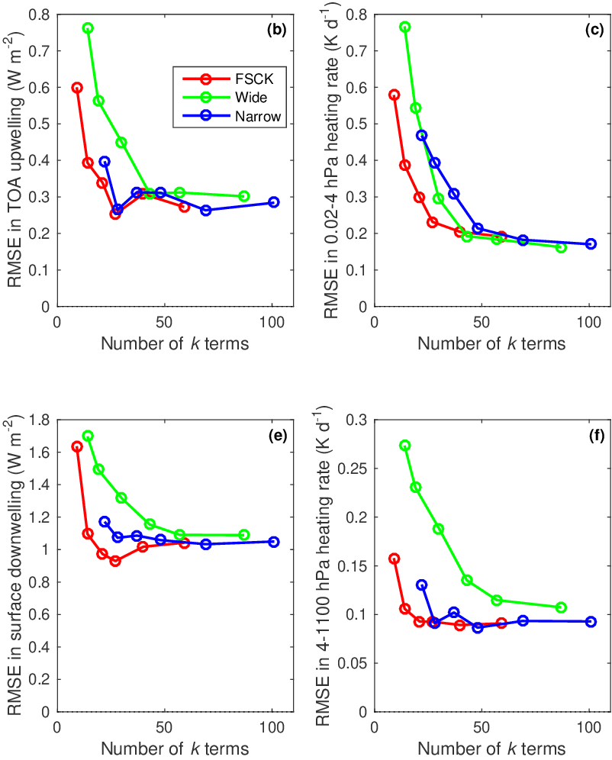
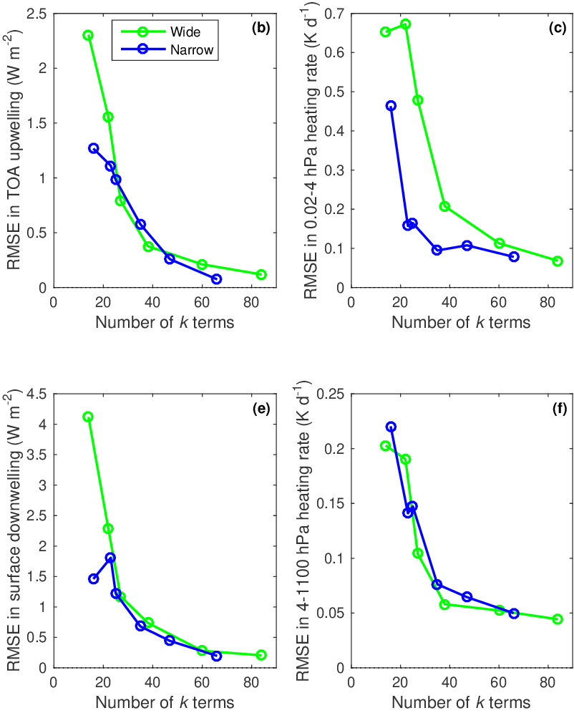
ecCKD: error versus computational cost (number of k terms) for all scenarios
Unsurprisingly, error decreases with number of k terms, but can flatten off
Full-spectrum correlated-k (FSCK) method works well in longwave, but not yet in shortwave
Longwave:
Shortwave:
See detailed plots
LW-FSCK-27
SW-Wide-38

Slide 33
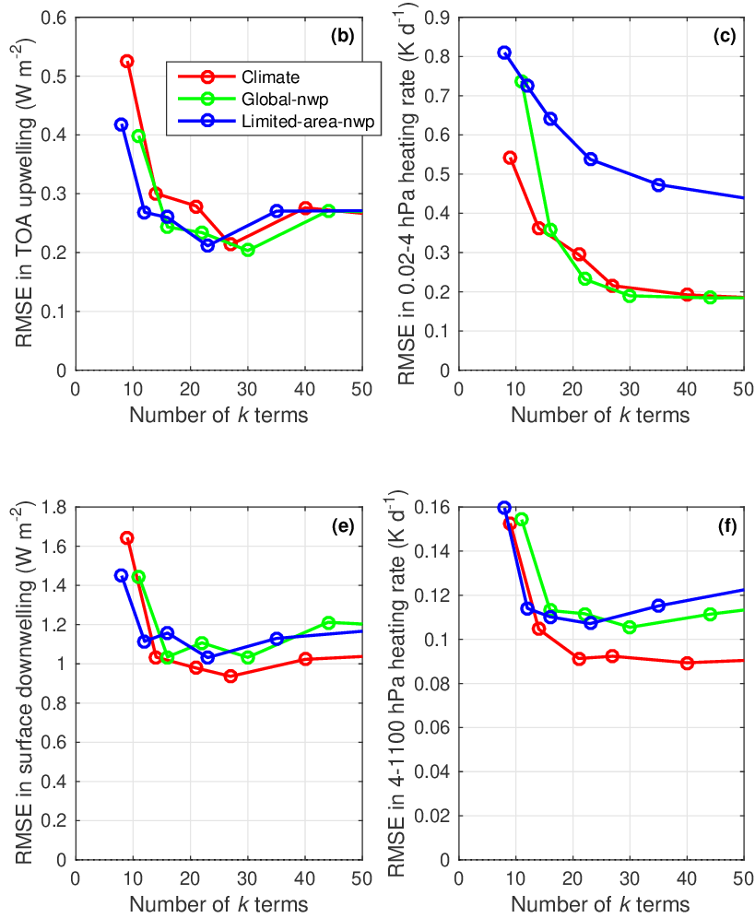
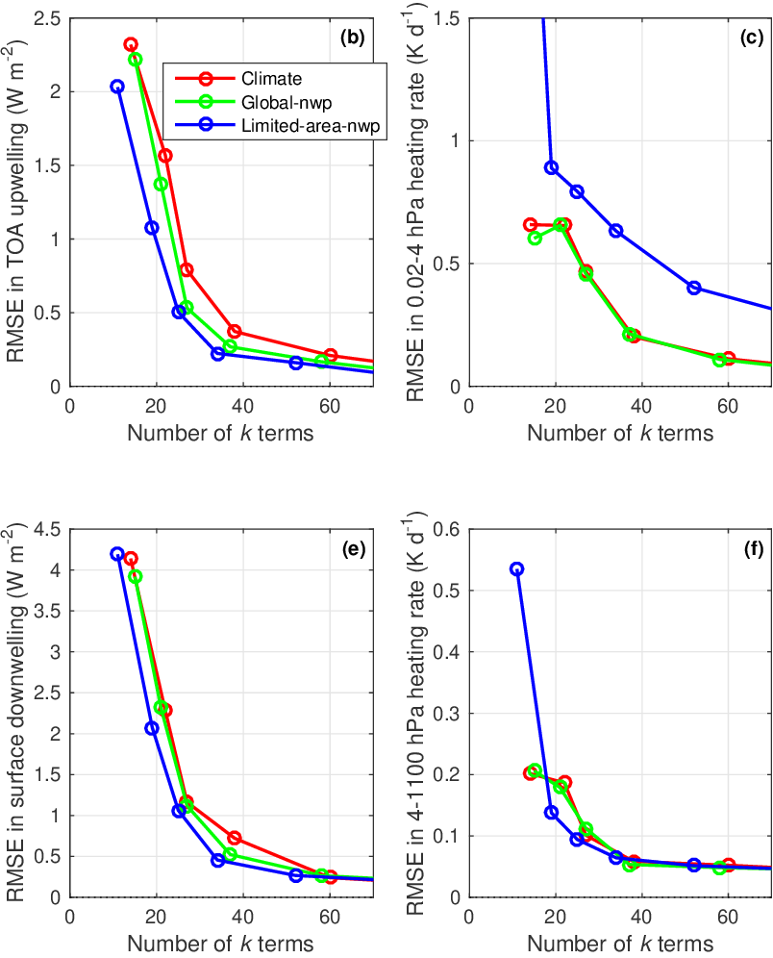
More efficient to train for NWP applications?
Rather than all climate scenarios, global-nwp trains for present-day only, and low-top limited-area-nwp for pressures larger than 4 hPa (rather than 0.02 hPa)
Longwave:
Shortwave:
Low-top model doesn’t waste k terms for accurate heating in upper atmosphere, so gets same accuracy in shortwave fluxes with fewer k terms
Not much difference for global-nwp, or longwave

Slide 34
End of part 2

Slide 35
Discussion of next steps
GMD protocol paper has just received second review, will be revised in the coming few weeks, and one of the reviewers raised a question of the scope of CKDMIP: should it include the effect of uncertainties in spectroscopy?
What is a realistic timeline for gathering contributions from all models?
What is a realistic timeline to a CKDMIP results paper?
Making things more complicated (may be possible without more data from participants)
  Clouds & aerosols
  Spectrally varying surface albedo and emissivity
  Non-LTE? Quantifying mesosphere heating rates a bit misplaced if non-LTE missing?
Other science questions that could be answered?
See other insightful comments from one of the GMD referees e.g. why isn’t there a formal theory for how to optimally discretize a k distribution?
Next meeting: date and purpose?

Slide 36
Should CKDMIP tackle the impact of spectroscopic uncertainties?
Reviewer comment: The design of the CKDMIP, particularly the first and second evaluation data sets (table 1 and 2) containing randomly selected realistic thermodynamics profiles, is going to make it much harder to search for systematic errors associated with the treatment of water vapor than is necessary or feasible. Since water vapor is by far the dominant radiatively active species in both the shortwave and the longwave, and since the literature cited in the first major comment above shows that there is still significant spread in the accuracy of the parameterization of near-IR H2O absorption across the CMIP ensembles, this is my principal concern regarding the design of CKDMIP. It’s really important to be able to look at the change in the k distributions and resulting fluxes and heating rates when water vapor alone is perturbed. There is a simple fix for this, fortunately, if CKDMIP were to also ask for the exact same set of data from each contributing group for the idealized profiles as for the Evaluation-1 and, ultimately, Evaluation-2 datasets.
Should CKDMIP be limited to algorithmic problem of formulating a CKD model given a spectroscopic database? Previous intercomparisons have always mixed algorithmic and spectroscopic differences
Should uncertainties in spectroscopy (especially in water vapour) be introduced into CKDMIP?
Will they be present in CKDMIP inadvertently because some participants are not using the same spectroscopy, and what can we do about it?

Slide 38
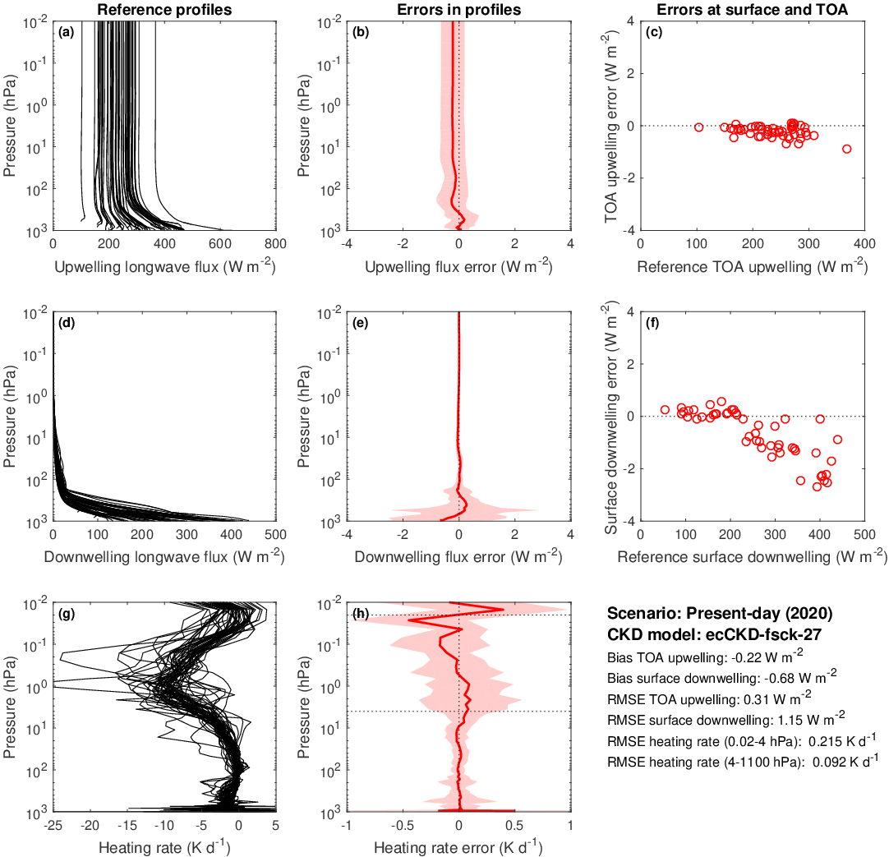
Longwave ecCKD
climate-fsck-27

Slide 39
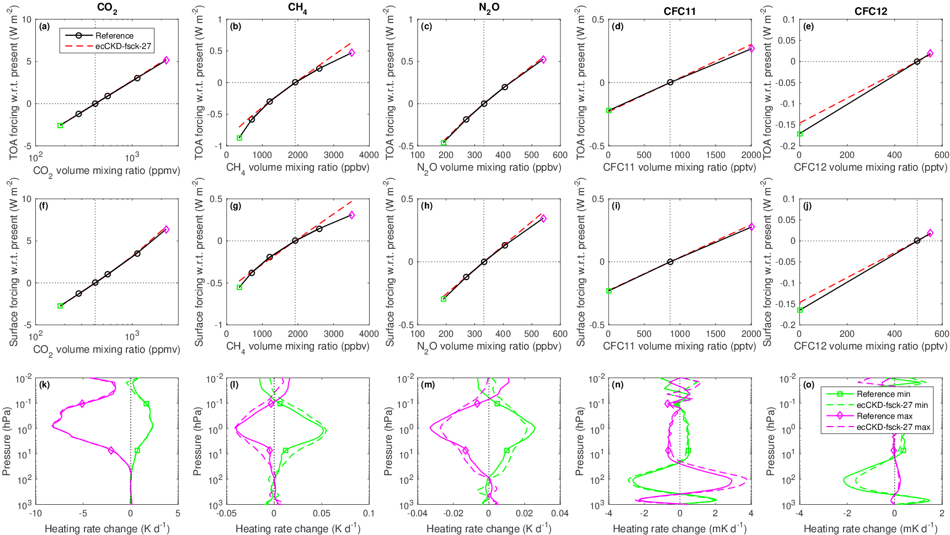

Slide 40
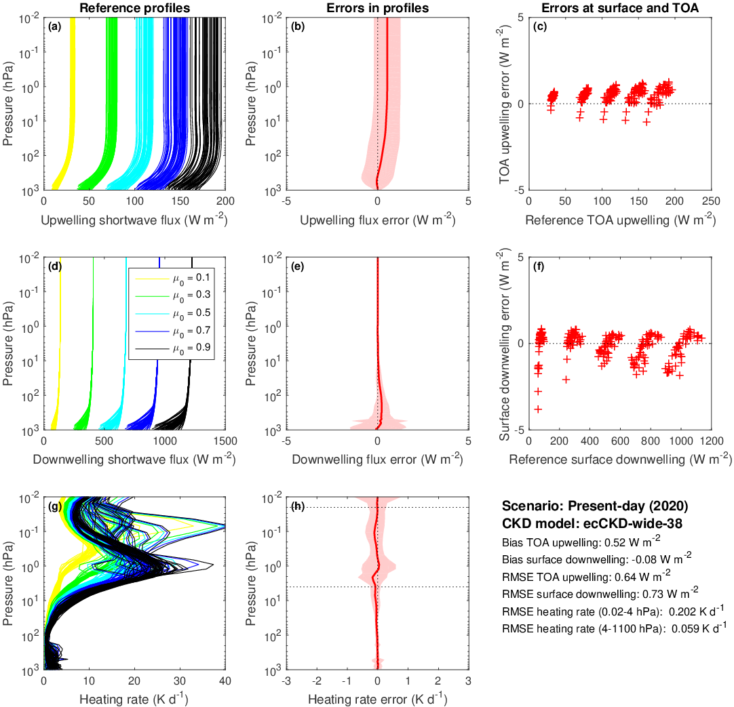
Shortwave ecCKD
climate-wide-38

Slide 41
