Slide 1
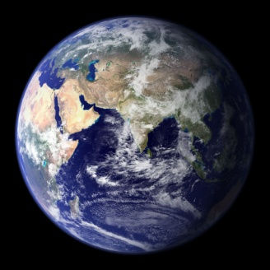
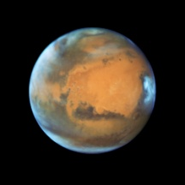
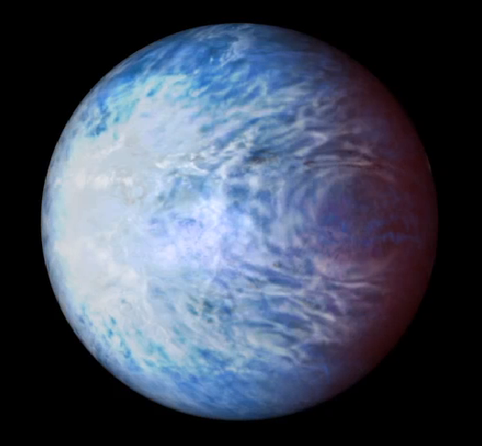
Socrates: correlated-k methods
James Manners, Met Office
CKDMIP Workshop, 8/9/20

Slide 2
Socrates: Suite Of Community RAdiative Transfer codes based on Edwards & Slingo
Two-stream code used in Met Office GCMs
Spherical harmonics radiance code
Correlated-k code: calculate optimal k-terms
Mie scattering code: calculate droplet optical properties

Slide 3
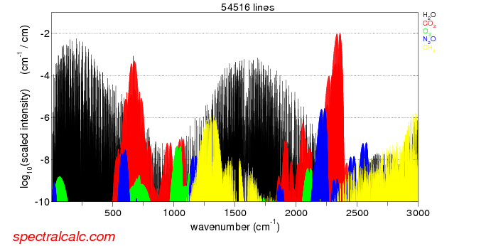
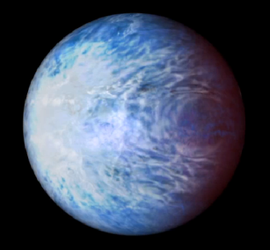
Flexible configuration: spectral files
Spectral bands: high / low resolution
Gas k-terms
Aerosol / cloud optical properties
Solar spectrum (including time variation) etc.
HadCM3
Hot Jupiters
HadGEM1
Many configurations can be run
HadGEM2
GA3
GA7
Mars
300 band LW / 260 band SW

Slide 4
Stage 1: generate line-by-line absorption coefficients
line-by-line absorption coefficients (netCDF)
HITRAN line data
HITRAN cross-sections
Other sources (e.g. ExoMol for Exo-planet spectral files)

Slide 5
Stage 2: generate k-terms separately for each gas
k-terms in each spectral band
Pressures and temperatures
Line-by-line absorption coefficients (netCDF)
Max column amount of absorber

Slide 6
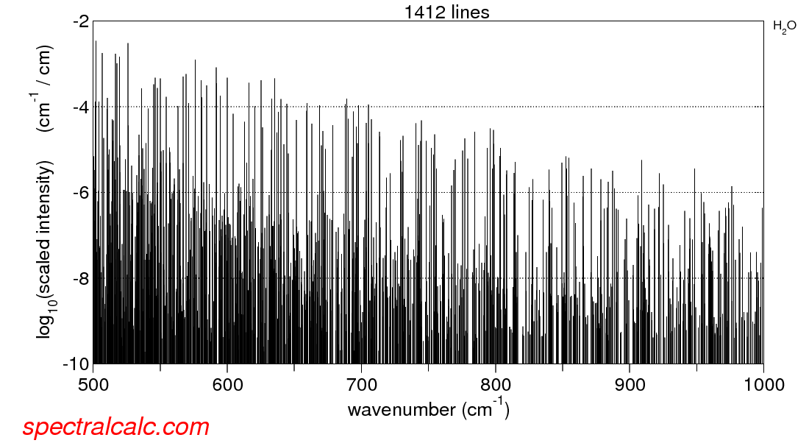
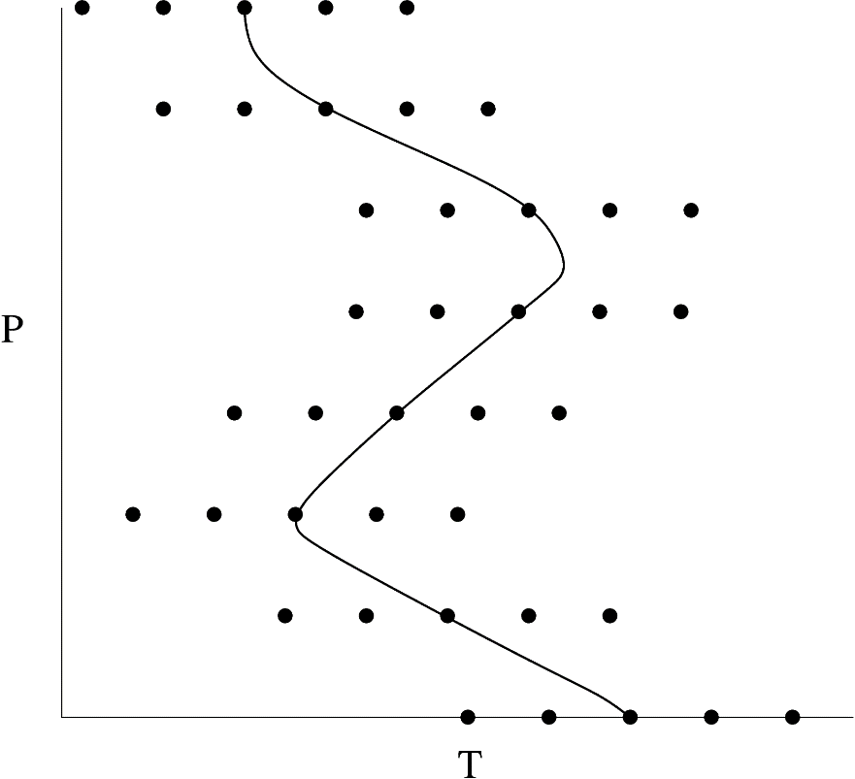
Optimal selection of k-term weights
Effective absorption coefficient for column down to τ=1
k_{τ =1}
τ =1
g
k_{τ =1}
Use weights that give equal increments in log k_{τ=1}
weight
( Based on similar ideas from Hogan 2010 )

Slide 7
Calculate k-terms for P/T look-up table
k_{P/T}
Re-order absorption coefficients for each P/T
g
k_{P/T}
Within each g-interval fit the
k-terms to match transmission over a range of paths
weight

Slide 8
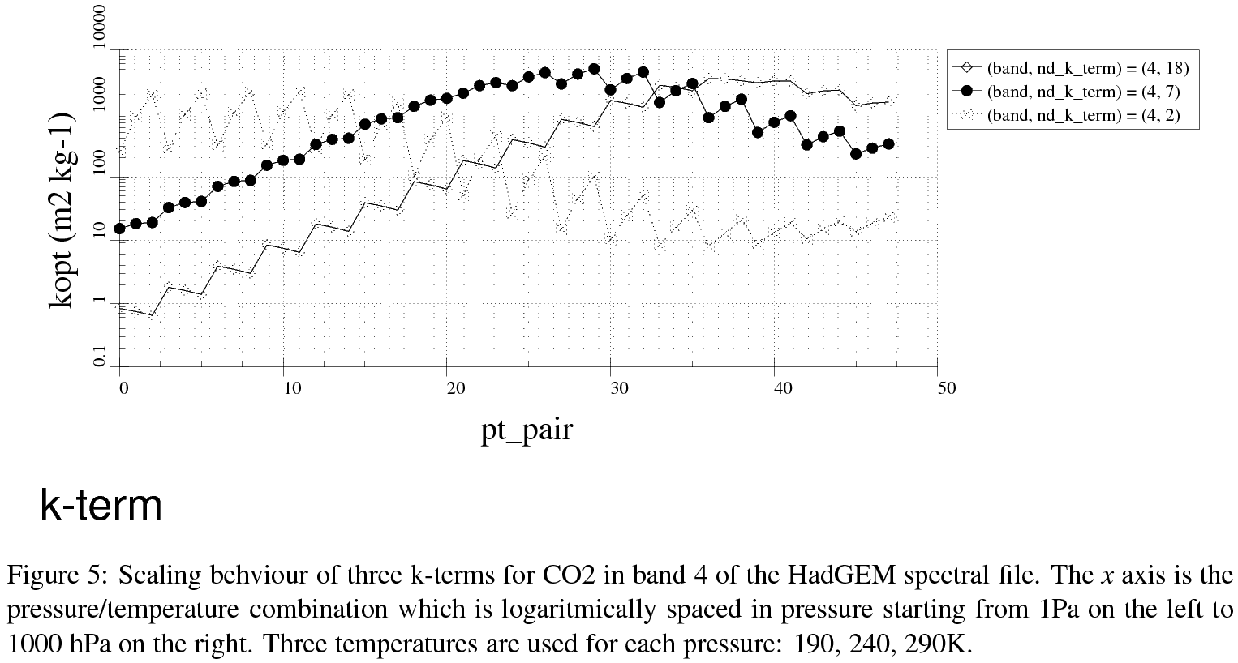
Option to bin according to scaling behaviour of absorption as well as just absorption strength

Slide 9
Overlapping gaseous absorption
LW bands used in broadband configuration
1
2
3
5
7
8
9
4
6
CO₂
H₂O
N₂O
O₃
CH₄
Relative abundances at 10km
(mid-latitude summer, ~ tropopause)

Slide 10
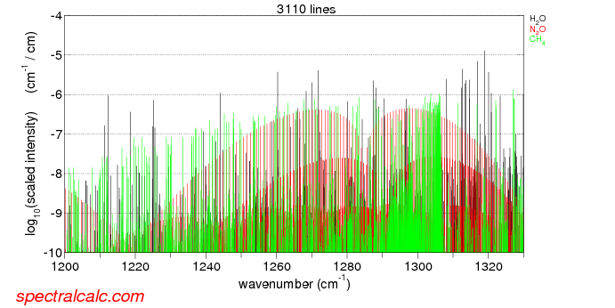
Random overlap of absorption lines
k-terms
LW band 7
H₂O
N₂O
CH₄
Requires 2*2*6 = 24 monochromatic calculations

Slide 11
Equivalent extinction
k-terms
LW band 7
Major gas
H₂O
Minor gas
N₂O
Minor gas
Calculate single “equivalent extinction” coefficient using clear-sky atmosphere with minor gas.
Requires 2*1*1 = 2 monochromatic calculations
CH₄

Slide 12
Complications for intercomparison:
LW equivalent extinction:
  Full (scattering) calculations for each “major” gas k-term
  Plus non-scattering calculations for each “minor” gas k-term
SW equivalent extinction
  Diffuse fluxes as LW
  Direct fluxes use accurate “random overlap” without additional cost
  (equivalent extinction is adjusted to give the product of transmissions for each gas)
Optical properties of scatterers, surface, etc. also require appropriate band structure / wavelength resolution.

Slide 13
Questions

