Slide 1
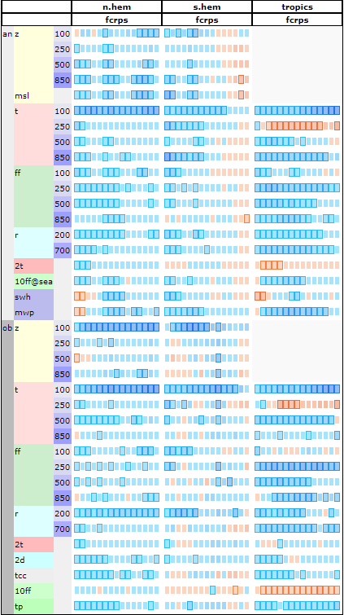
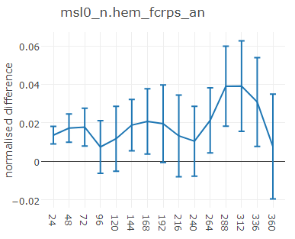
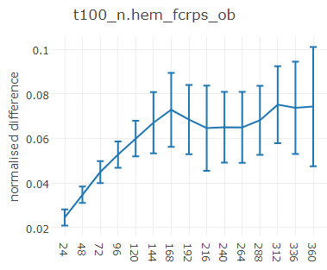
Impact of vertical resolution
TCo639L137 vs TCo639L91, Summer, 3 Month, initialized every 2 day, 8 member ensemble, CY46r1
mslp vs analysis nhem
t100hPa vs obs nhem

