Slide 1
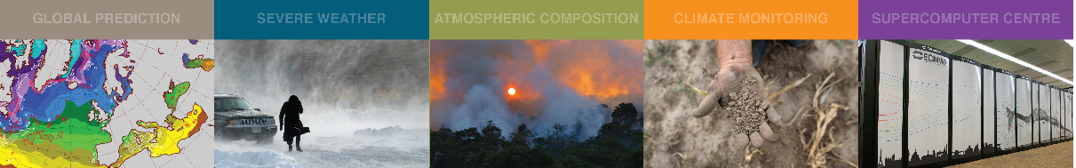
Atlas code sprint
March 2019, ECMWF
Willem Deconinck
willem.deconinck@ecmwf.int

Slide 2

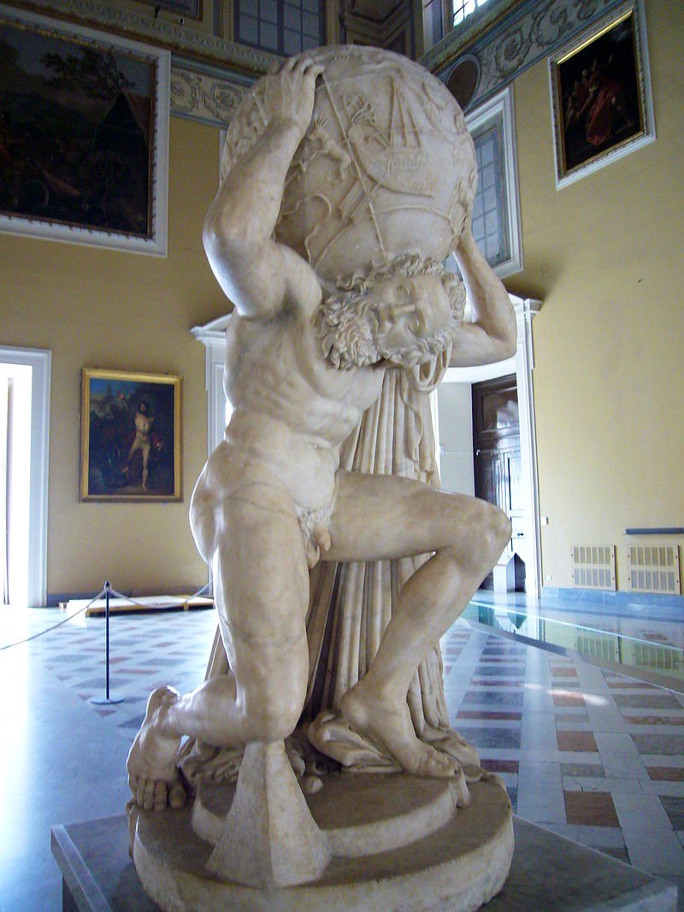
Atlas, a library for NWP and climate modelling – Deconinck et al. 2017, J-CPC
A new foundation built with future challenges for HPC in mind
Modern C++ library implementation with modern
Fortran 2008 (OOP) interfaces → integration in existing models
Open-source (Apache 2.0), http://github.com/ecmwf/atlas
Data structures to enable new numerical algorithms,
e.g. based on unstructured meshes
Separation of concerns:
  Parallelisation
  Accelerator-awareness (GPU/CPU/…)
Readily available operators
  Remapping and interpolation
  Gradient, divergence, laplacian
  Spherical Harmonics transforms
Support structured and unstructured grids (global as well as regional)

Slide 3
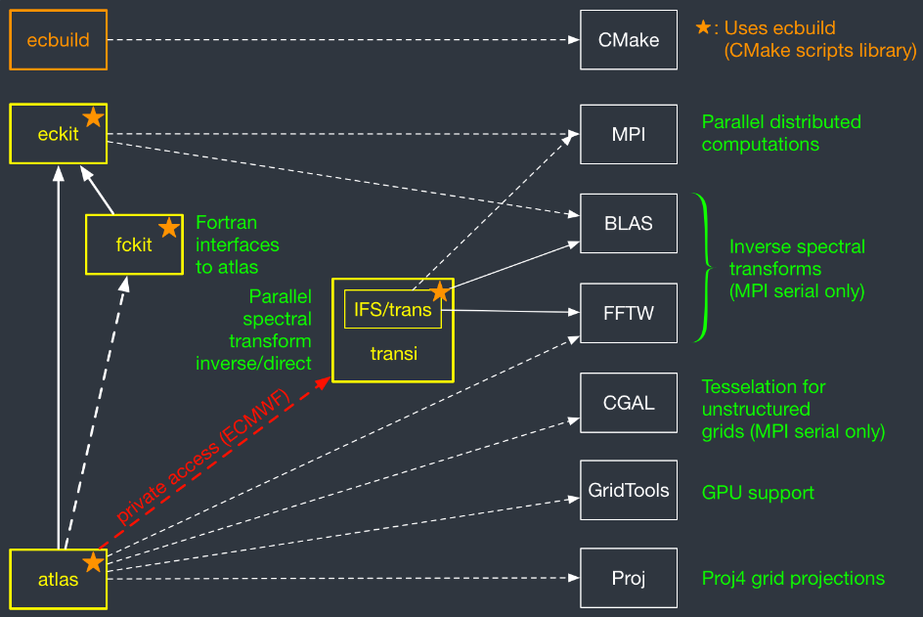
Atlas dependencies and requirements
Linux, OSX, …
→ POSIX
Compilers:
C++ 11
Fortran2008

Slide 4
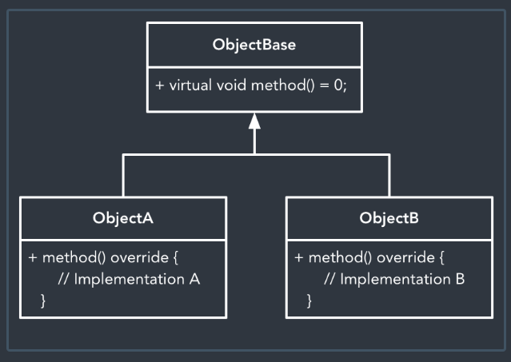
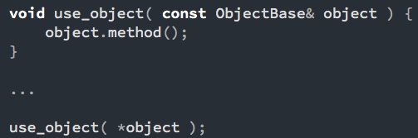
Object oriented design >> Polymorphism
Use abstract interface in algorithms:
Creating a polymorphic object:

Slide 5
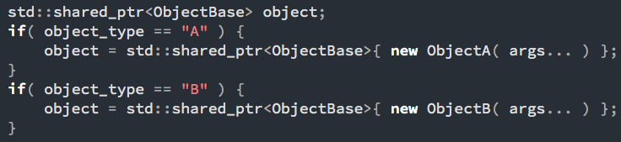
Object oriented design >> Factory with self-registration
How to create the object? Lots of IFS?
NO! Use a factory:
Could just wrap the ifs, but what we really want is self-registration so we can extend Atlas

Slide 6
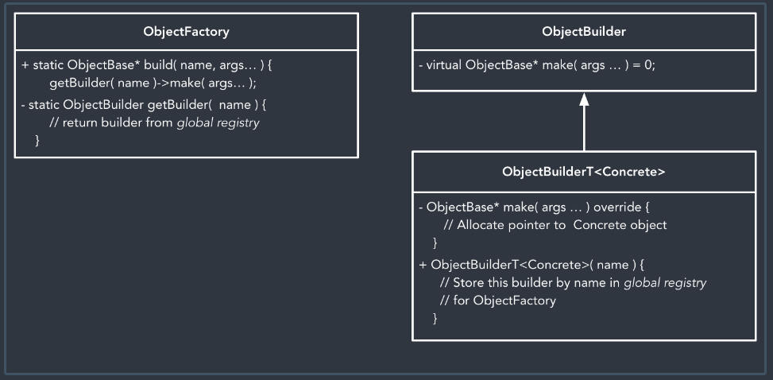

Object oriented design >> Factory with self-registration
Registers itself upon construction!

Slide 7
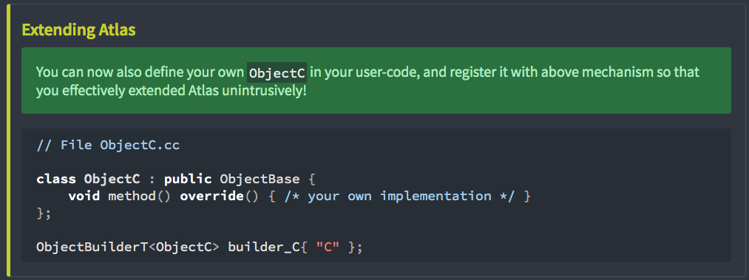
Object oriented design >> Factory with self-registration

Slide 8
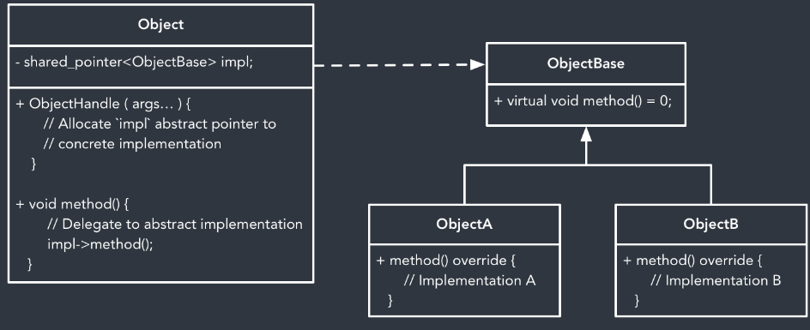
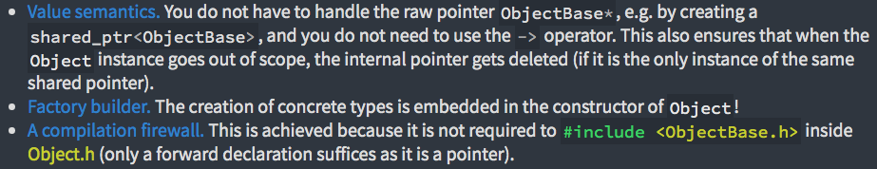
Object oriented design >> Pointer to abstract implementation

Slide 9
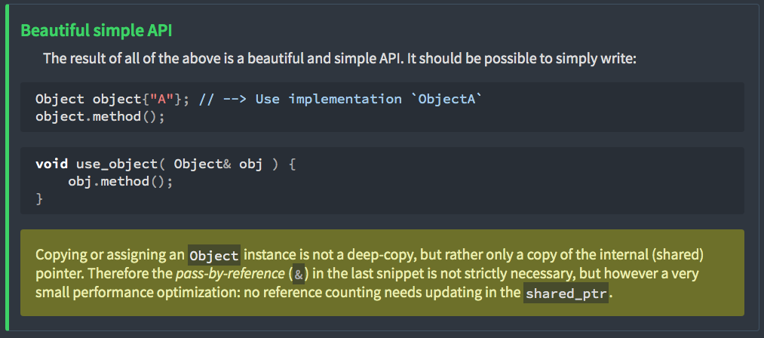
Object oriented design >> Pointer to abstract implementation

Slide 10
Object oriented design C++ / Modern Fortran
C++
Reference counting:
Last user destroys the object
Avoid memory leaks
Counting is tracked between languages.
Same object can be stored both in C++ and Fortran
{ // scope a begins
atlas::Grid a(“O1280”); // count = 1
{ // scope b begins
atlas::Grid b = a // count = 2
} // scope b ends
// not destroyed // count = 1
} // scope a ends
// destroyed // count = 0
Fortran
subroutine scope
type(atlas_Grid) :: a, b
a = atlas_Grid( “O1280” ) ! count = 1
b = a ! count = 2
call b%final() ! count = 1 --> not destroyed
call a%final() ! count = 0 --> destroyed
end subroutine
When most Fortran compilers support finalisation, we will no longer need the calls to a%final() and b%final()

Slide 11
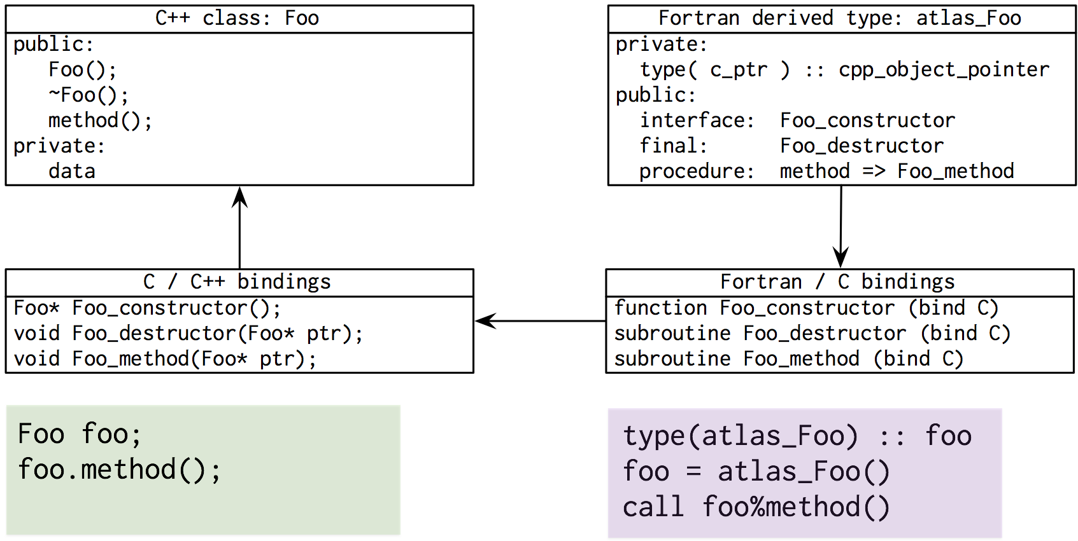
Object oriented design C++ / Modern Fortran

Slide 12
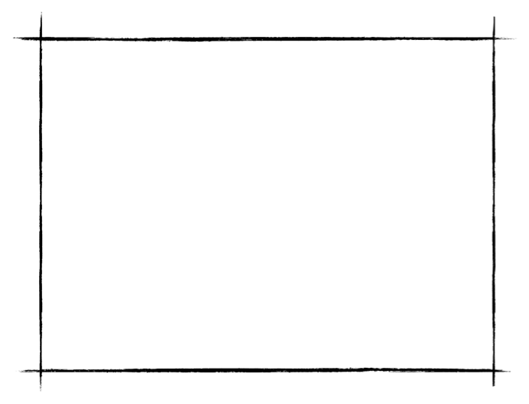
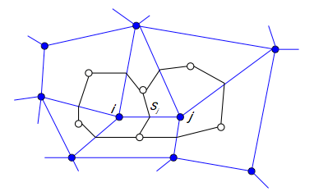
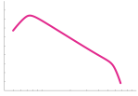
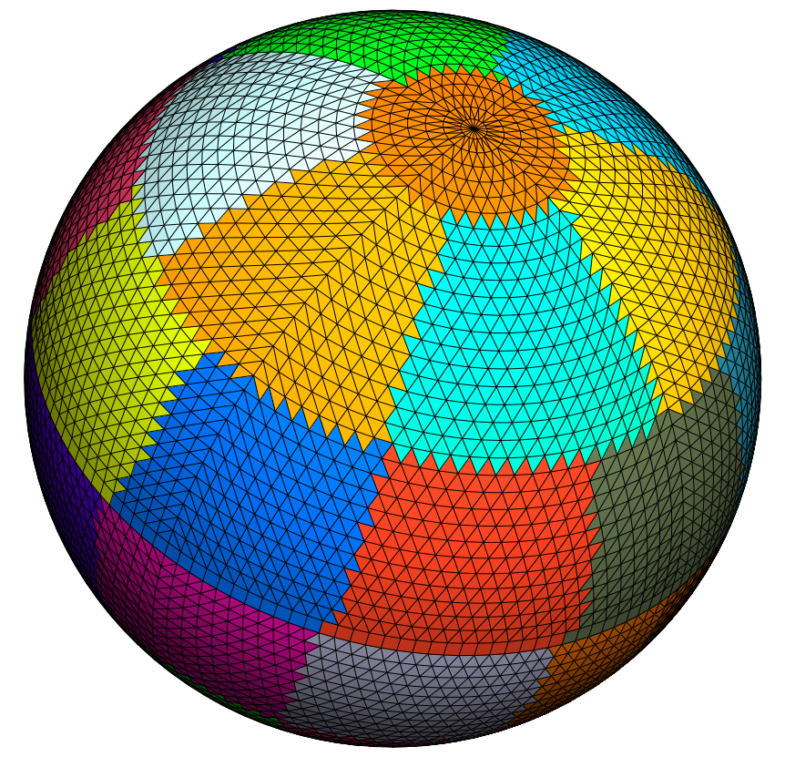


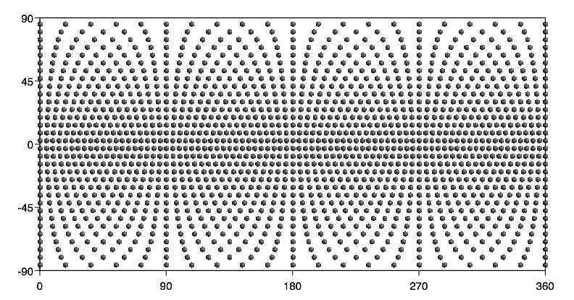

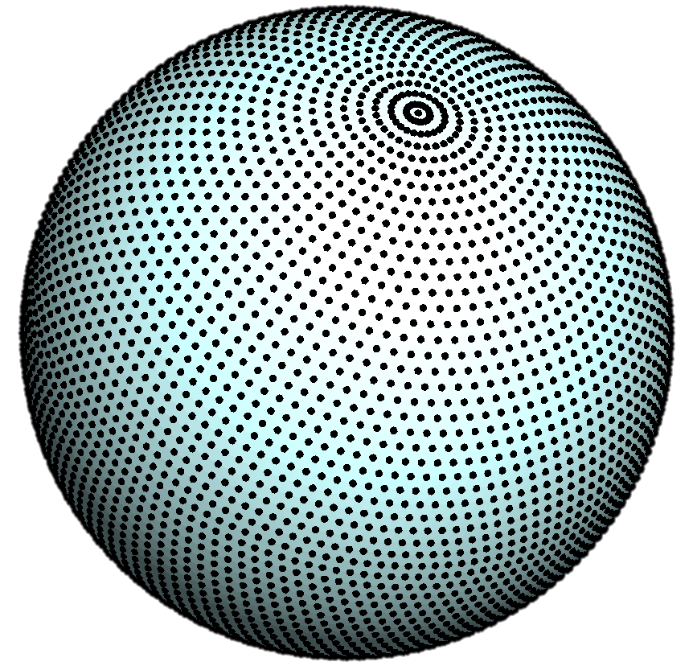

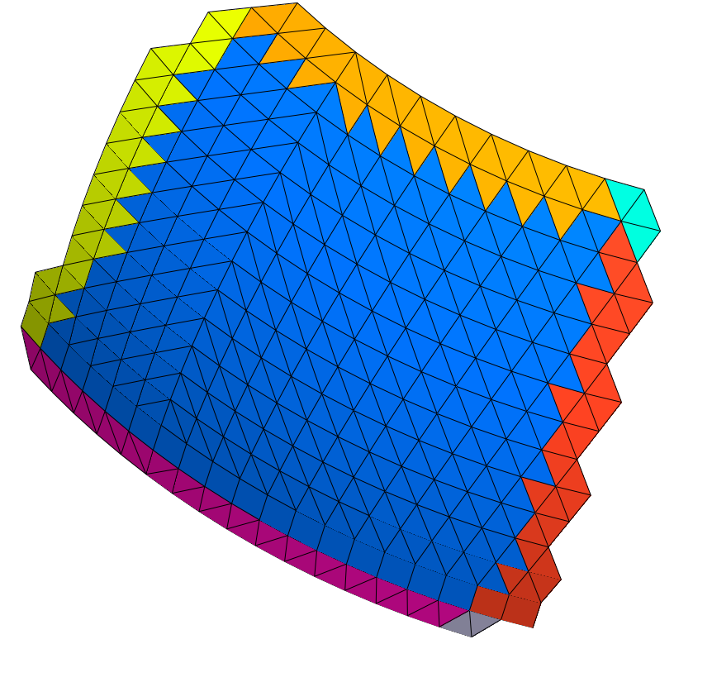
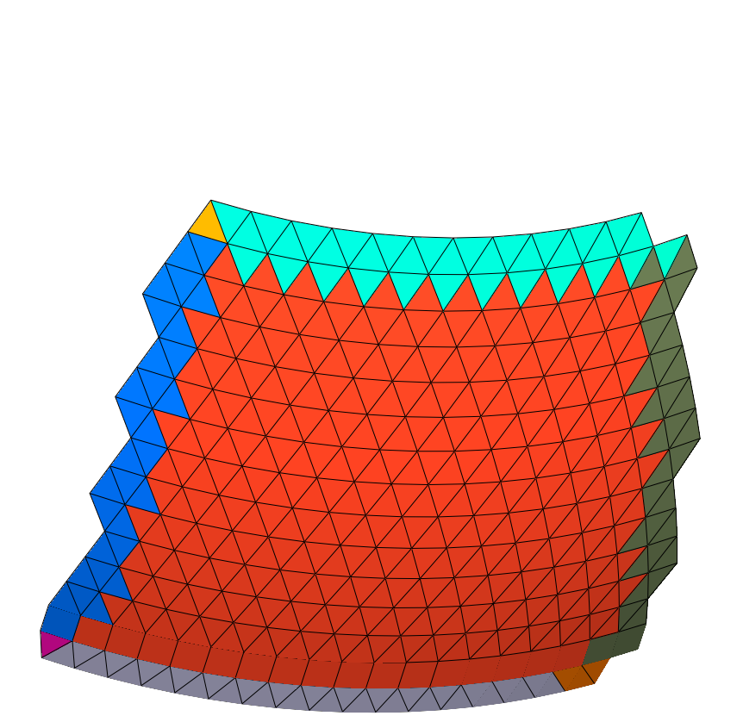
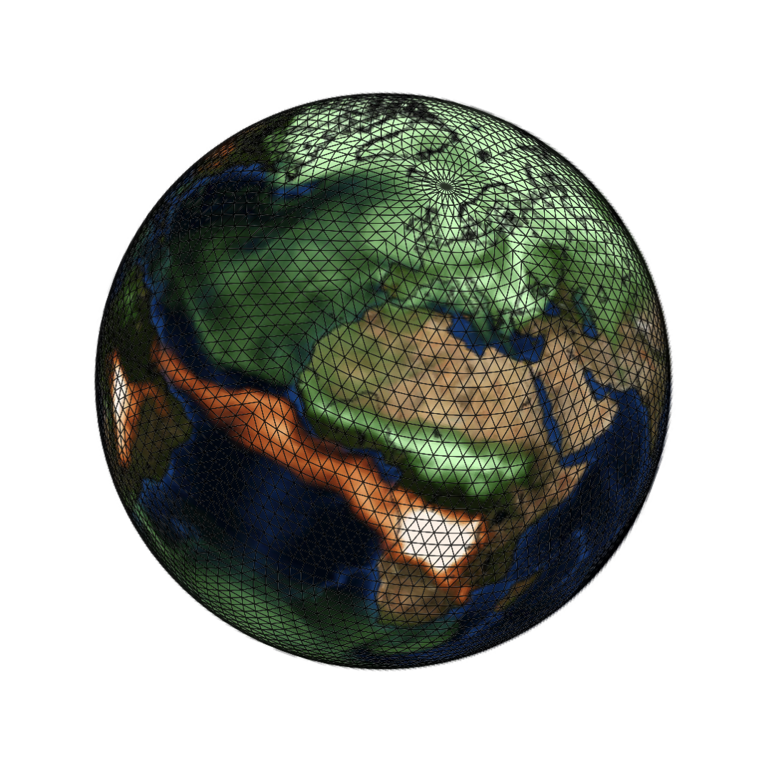

Atlas typical workflow
FunctionSpace
Mesh
Octahedral Gaussian grid (O32)
Finite Volume
Spectral
Transforms
The octahedral Gaussian grid is a “StructuredGrid"
Grid
Finite Element
Discontinuous
Spectral Element
Partitions
with halo’s
Field

Slide 13
A library of grid abstractions
y
x
y
y
x
x
Example creation of operational octahedral reduced Gaussian grid using unique identifier
C++
Fortran
atlas::Grid grid;
grid = atlas::Grid ( “O1280” )
type(atlas_Grid) :: grid
grid = atlas_Grid( “O1280” )

Slide 14
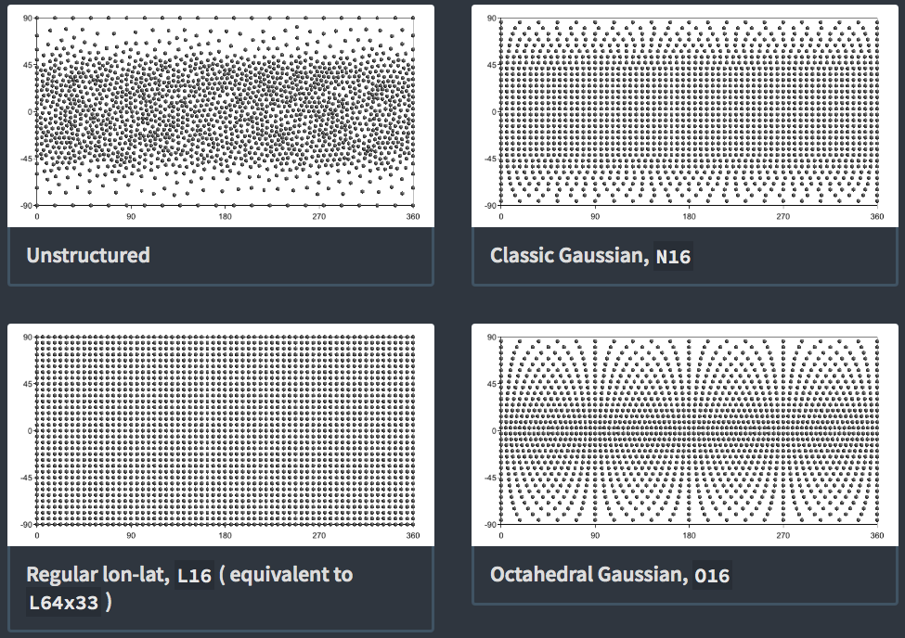

Slide 15
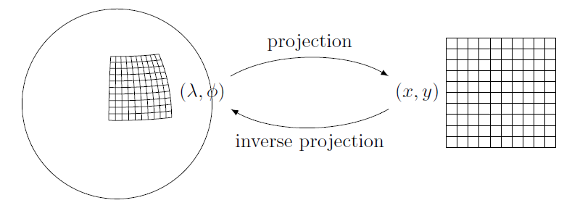
A library of grid abstractions
Iterating over all grid points, regardless of used projection, structure, domain
Grid coordinates (x,y)
Geographic coordinates (lon,lat)
for( PointXY p : grid.xy() ) {
double x = p.x();
double y = p.y();
}
for( PointLonLat p : grid.lonlat() ) {
double lon = p.lon();
double lat = p.lat();
}

Slide 16
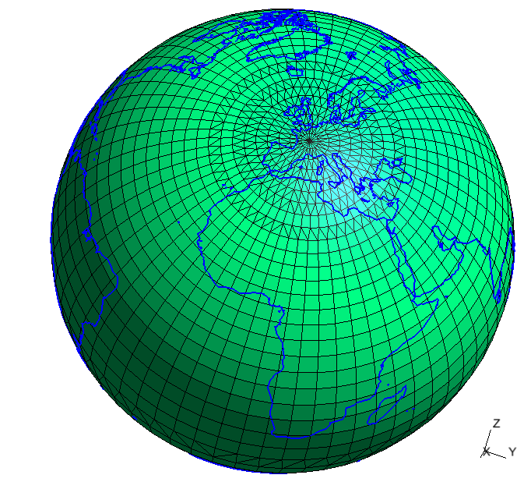
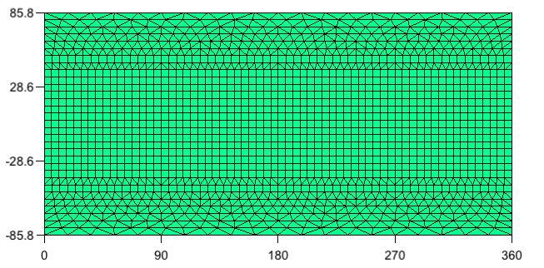
{
"type" : "classic_gaussian",
"N" : 16
"projection" : {
"type" : "rotated_schmidt",
"north_pole" : [3,47]
"stretching_factor" : 2
}
}
Stretching
ECEF (meters)
xy (degrees)

Slide 17
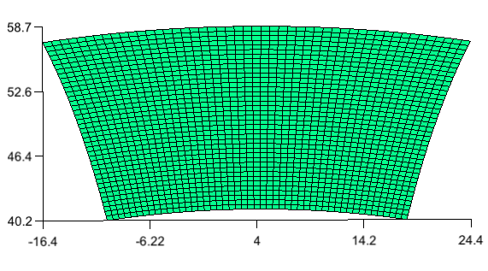
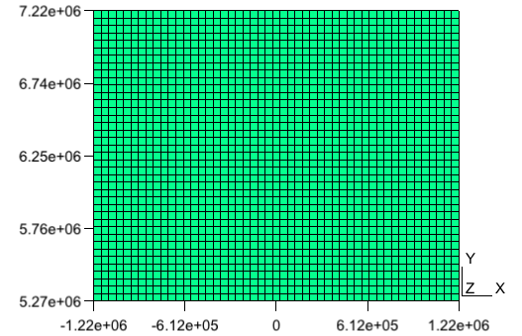
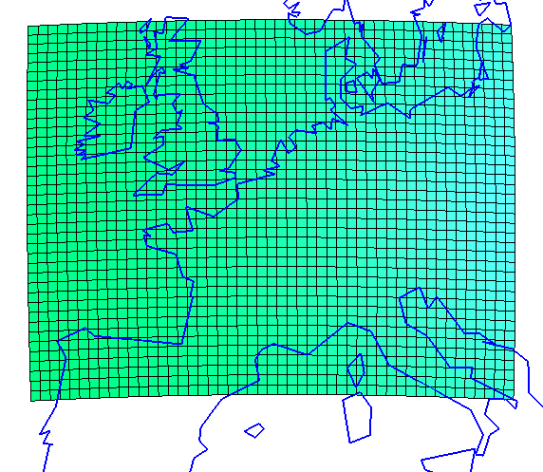
{
"type" : "regional",
"nx" : 50, "dx" : 50000,
"ny" : 40, "dy" : 50000,
"lonlat(centre)" : [4,50],
"projection" : {
"type" : "lambert_
conformal_conic",
"latitude1" : 50,
"longitude0" : 4
}
}
lonlat (degrees)
centre
xy (meters)
ECEF (meters)

Slide 18
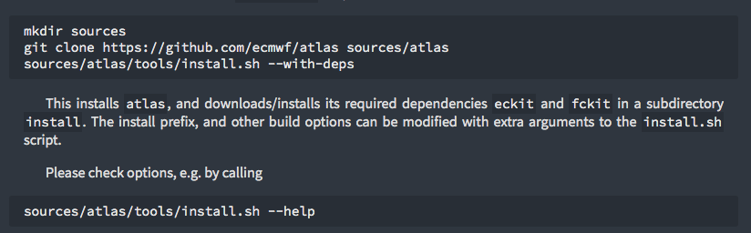
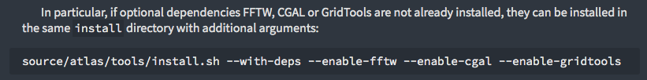
Getting started
http://download.ecmwf.int/test-data/atlas/docs/site/getting_started/ ( Temporary URL !!! )
Easy instructions

Slide 19
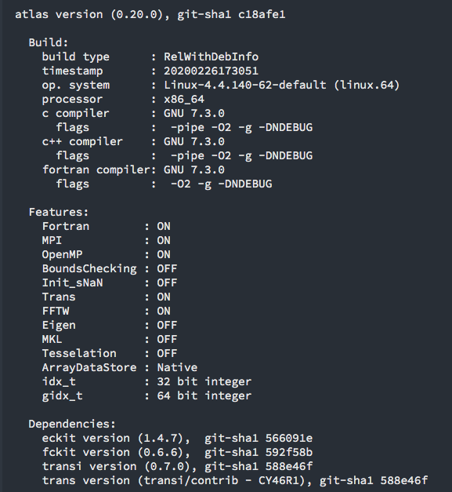

Checking installation
http://download.ecmwf.int/test-data/atlas/docs/site/getting_started/installation/

Slide 20
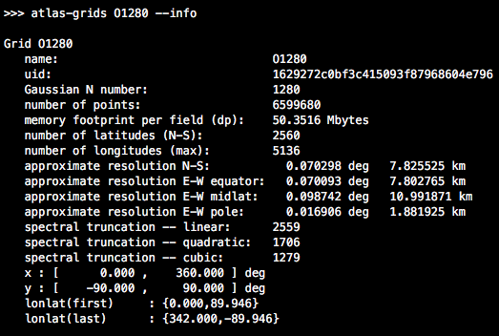
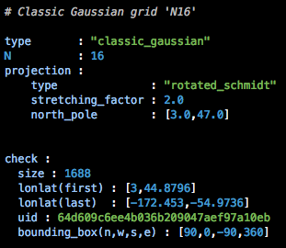
Grid information tool
Atlas contains a grid-information tool:
The <grid> argument can be a simple name, e.g. “O1280”
But it can also be a file-path containing a YAML or JSON grid specification.
Example:

Slide 21
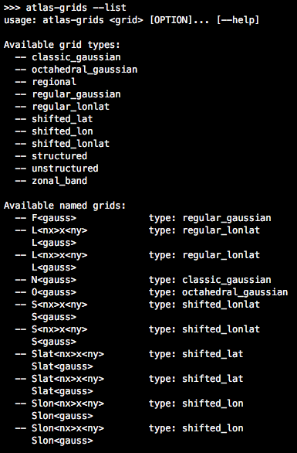
Grid information tool
To get a full list of supported grids:

Slide 22
Mesh generation tool: atlas-meshgen
It is helpful to visualize the grid by generating a mesh from it. The mesh format is Gmsh.
It accepts exactly the same <grid> argument as previous tool “atlas-grids”.
By default the mesh will be a horizontal XY domain.
For grids without any projection, this corresponds to LonLat.
For grids with projection you can visualize the actual LonLat by passing the argument --lonlat .
To visualize the mesh on a sphere, pass instead the argument --3d .
atlas-meshgen grid-config.yml mesh-xy.msh
atlas-meshgen grid-config.yml mesh-lonlat.msh --lonlat
atlas-meshgen grid-config.yml mesh-xy.msh --3d
Gmsh can be downloaded at http://gmsh.info

Slide 23
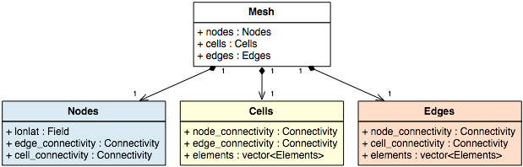

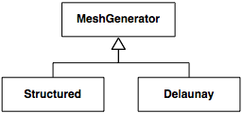

Atlas architecture
Mesh: connecting points (nodes) by edges and cells using connectivity tables
Support for multiple element types
Mesh generation
type(atlas_MeshGenerator) :: meshgen
type(atlas_Mesh) :: mesh
meshgen = atlas_MeshGenerator(“structured”)
mesh = meshgen%generate(grid)
MeshGenerator meshgen(“structured”);
Mesh mesh = meshgen.generate(grid);

Slide 24
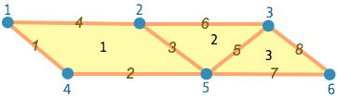

Mesh data structure
Simple hybrid mesh
Key features
6 nodes
3 cells
(1 quad, 2 triag)
8 edges
Multiple element types
Parallel distributed
Mesh is composed of
Nodes
Cells
Edges

Slide 25
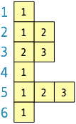
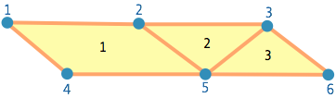


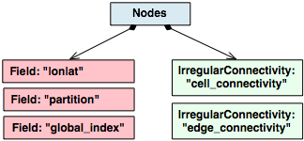
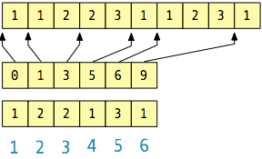
Mesh / Nodes
Coordinate field
(longitude, latitude)
Connectivity to cells
Connectivity to edges
contiguous array
offset
counts
…
…

Slide 26
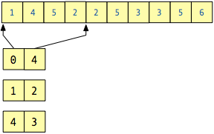
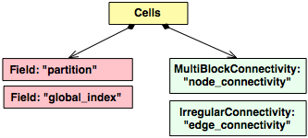
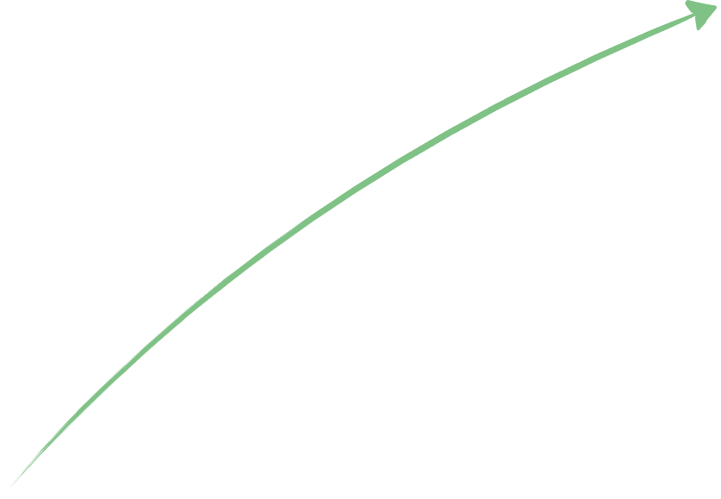

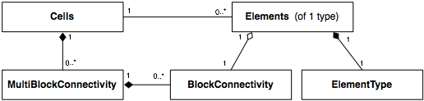
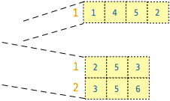

Mesh / Cells
contiguous array
all quads
all triags
all cells
offset
rows
Quadrilateral
Triangle
node-connectivity
for all cells
node-connectivity
only quads or triags
columns

Slide 27
Example "for" over all elements
MultiBlockConnectivity& node_connectivity = mesh.cells().node_connectivity();
// Loop over ALL elements
for( size_t jelem=0; jelem<mesh.cells().size(); ++jelem ) {
// Compute average over cell
double cell_average = 0;
for( size_t jnode=0; jnode<mesh.cells().nb_nodes(jelem);
cell_average += field( node_connectivity(jelem,jnode) );
cell_average /= double(mesh.cells().nb_nodes(jelem));
}

Slide 28
Example "for” per element type
// Loop over element types
for( size_t jtype=0; jtype<mesh.cells().nb_types(); ++jtype ) {
Elements& elements = mesh.cells().elements(jtype);
BlockConnectivity& node_connectivity = elements.node_connectivity();
// Loop over elements of one type
for( size_t jelem=0; jelem<elements.size(); ++jelem ) {
// Compute average over cell
double cell_average = 0;
for( size_t jnode=0; jnode<elements.nb_nodes();
cell_average += field( node_connectivity(jelem,jnode) );
cell_average /= double(elements.nb_nodes());
}
}

Slide 29
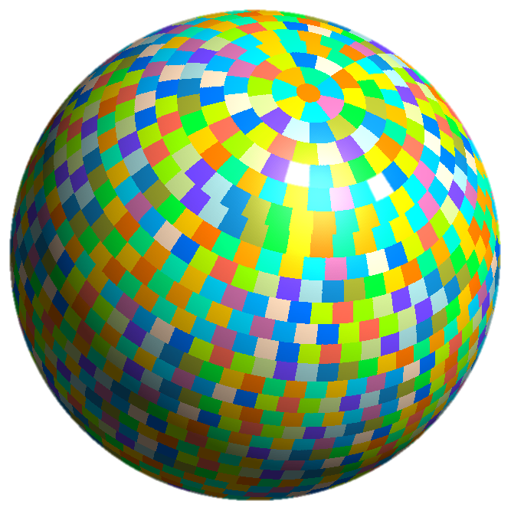
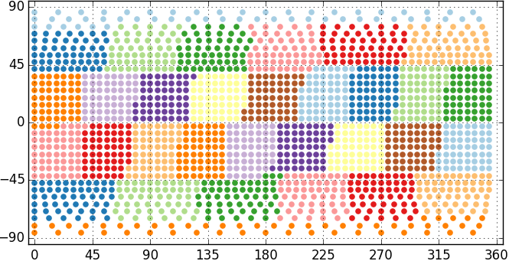
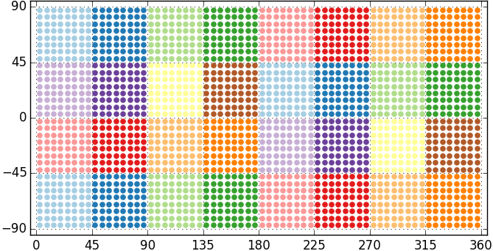
Multiple domain decomposition strategies
Equal Regions ( typical for IFS grids )
Checkerboard ( typical for regional grids )

Slide 30
Multiple domain decomposition strategies

Slide 31
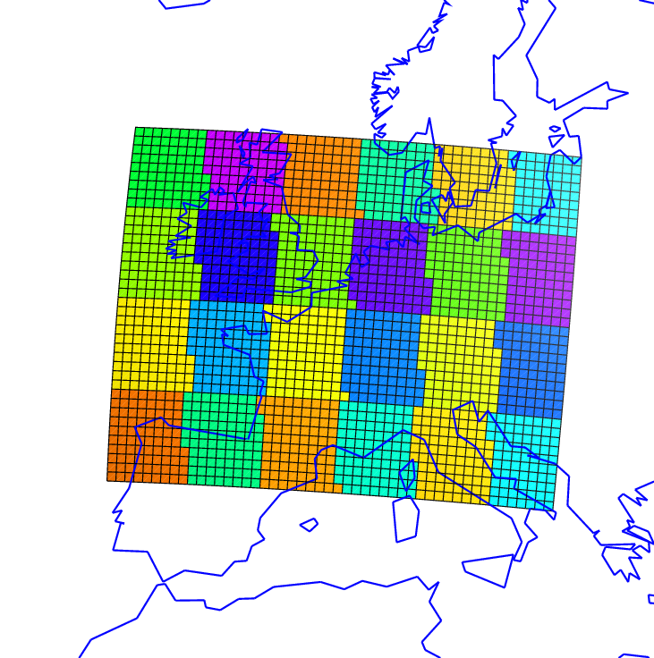

Thanks to Daan Degrauwe (RMI)
Atlas for LAM
Current capabilities:
Generation of parallel meshes for LAM grids
Projections: Mercator, Lambert, Schmidt, Polar stereographic
+ Rotations thereof if applicable
Checkerboard domain decomposition
Periodicity in X and Y (biperiodic)
31
Grid
coordinates
Projection
Geographic
coordinates

Slide 32


Halo exchanges
HaloExchange in
overlap regions

Slide 33

FunctionSpaces: Discretisation specific knowledge (arguably model specific)
FunctionSpace
functionspace::NodeColumns
functionspace::EdgeColumns
functionspace::StructuredColumns
Finite Volume method
Finite Difference method
Efficient semi-Lagrangian advection
Efficient spectral methods

Slide 34




FunctionSpaces: Discretisation specific knowledge (arguably model specific)
FunctionSpace
FunctionSpace knows the grid or mesh
FunctionSpace knows about halos and its parallelisation
FunctionSpace knows the memory layout

Slide 35
FunctionSpaces: Discretisation specific knowledge (arguably model specific)
FunctionSpace
Finite Volume
Finite Element
Discontinuous
Spectral Element
Spectral
Transforms

Slide 36
StructuredColumns FunctionSpace
What?
  Discretisation of Fields without a Mesh (only StructuredGrid, cfr. IFS)
  Distributed view of horizontal grid, plus structured vertical levels
Halos
  Fast algorithm to create halo
  HaloExchange capabilities !!!
  Halo’s over pole !!!

Slide 37

StructuredColumns FunctionSpace
What?
  Discretisation of Fields without a Mesh (only StructuredGrid, cfr. IFS)
  Distributed view of horizontal grid, plus structured vertical levels
Halos
  Fast algorithm to create halo
  HaloExchange capabilities !!!
  Halo’s over pole !!!

Slide 38
StructuredColumns FunctionSpace
How?
  Mapping ( i , j ) → local index
  Indirect addressing but… increased flexibility
    Room to optimise cache efficiency using space-filling curve
    One-to-one mapping with mesh-based functionspace (excluding halo)
    Halo points added at the end

Slide 39

Atlas architecture
Field: container for data with metadata
Field field = Field(
/* name */ “P”,
/* kind */ make_datatype<double>(),
/* shape */ make_shape(npts,nlev) );
field.metadata().set(“units”,“hPa”)
field.metadata().set(“time”,450)
type(atlas_Field) :: field
type(atlas_Metadata) :: field_metadata
field = atlas_Field( &
name=“P”, &
kind=atlas_real(jprb), &
shape=[nlev,npts] )
field_metadata = field%metadata()
call field_metadata%set(“units”,“hPa”)
call field_metadata%set(“units”,450)

Slide 40
Acces to field data
auto field_data =
make_view<double,2>( field );
for( int jnode=0; jnode<npts; ++jnode ) {
for( int jlev=0; jlev<nlev; ++jlev ) {
field_data(jnode,jlev) = …
}
}
real(8), pointer :: field_data(:,:)
call make_view( field, field_data )
do jnode=1,npts
do jlev=1,nlev
field_data(jlev,jnode) = …
enddo
enddo

Slide 41
StructuredColumns FunctionSpace
What?
  Discretisation of Fields without a Mesh (only StructuredGrid, cfr. IFS)
  Distributed view of horizontal grid, plus structured vertical levels
Halos
  Fast algorithm to create halo
  HaloExchange capabilities
  Halos over pole

Slide 42



Remapping, using matching
domain decompositions
Thanks to Pedro Maciel (ECMWF)
Domain decompositions match
to avoid MPI communication
Parallel interpolation:
- nearest neighbour
- k-nearest neighbour
- linear element-based
- structured linear, cubic, quasicubic
Example interpolation: O32 to F8
42

Slide 43
Remapping using matching domain decompositions
Coupling
43
grid_A = atlas_Grid("O1280")
partitioner_A = atlas_EqualRegionsPartitioner()
mesh_A = meshgenerator % generate(grid_A, partitioner_A)
fs_A = atlas_functionspace_NodeColumns(mesh_A)
grid_B = atlas_Grid("O640")
partitioner_B = atlas_MatchingMeshPartitioner(mesh_A)
mesh_B = meshgenerator % generate(grid_B, partitioner_B)
fs_B = atlas_functionspace_NodeColumns(mesh_B)
interpolation_AB = atlas_Interpolation(type="finite-element",
source=fs_A, target=fs_B)
call interpolation_AB %
execute(field_A, field_B)

Slide 44











Atlas – GridTools integration
What is GridTools?
GridTools is a
Domain-Specific-Language
(DSL), developed by
MeteoSwiss and CSCS,
to express computational
kernels that can be run
on different hardware
( CPU / GPU / MIC-KNL ).
Mathematical
description
Algorithm
development
Domain science
Physics
on_edges( sum_reduction, v(), l() ) / A()
Domain specific language (GridTools)
Abstractions
Multidisciplinary
MPI
memory layout,
parallelisation,
& data structures
Programming
models & libraries
Hardware specific
instructions

Slide 45
Atlas – GridTools integration
Prior to ESCAPE, GridTools only worked on specific regular grids as used in COSMO
In ESCAPE we extended this for unstructured meshes based on Atlas
GridTools has an internal data-storage framework that handles copying
the data back-and-forth between the host (CPU) and device (e.g. GPU), and
the DSL uses this extensively.
Challenge: How can we allow the GridTools DSL to
recognise Atlas fields instead?
Approach
Encapsulate the gridtools_storage features as a
standalone module.
Atlas Arrays and Fields can be compiled with
gridtools_storage module for its internal storage.
GridTools DSL
Atlas
gridtools
storage
native
storage
OR

Slide 46
C++ example
Atlas on GPUs
// Create field (double precision, with 2 dimensions)
auto field = Field( datatype(“real64”), shape(Ni,Nj) );
// Create a host view to interpret as 2D Array of doubles
auto host_view = make_host_view<double,2>(field);
// Modify data on host
for ( int i=0; i<Ni; ++i ) {
for ( int j=0; j<Nj; ++j ) {
host_view(i,j) = ...
}}
// Synchronise memory-spaces
field.syncHostDevice();
// Create a device view to interpret as 2D Array of doubles
auto device_view = make_device_view<double,2>(field);
// Use e.g. CUDA to process the device view…
some_cuda_kernel<<<1,1>>>(device_view);
// ... or GridTools or Kokkos
Two linked memory spaces:
host (CPU) and device (GPU)
Built on GridTools storage layer
Thanks to Carlos Osuna (MeteoSwiss)

Slide 47

Atlas on GPUS with OpenACC for Fortran
Copy field_A from CPU to GPU
Create a view of field_A into array A,
and map it to OpenACC runtime
Tell OpenACC that array A is already on GPU
Computations on GPU
Copy field_A from GPU to CPU

Slide 48
Atlas on GPUs with OpenACC for Fortran
type(atlas_Mesh) :: mesh ! Assume created
type(atlas_mesh_Nodes) :: nodes ! Nodes in the Mesh
type(atlas_Field) :: field_xy ! Coordinate field of nodes
real(8), pointer :: xy(:,:) ! Raw data pointer
!----------------------------------------------------------!
nodes = mesh % nodes() ! Access nodes
field_xy = nodes % xy() ! Access coordinate field
call make_view( field_xy, xy ) ! Access raw data
call mesh % update_device() ! Copy entire mesh to GPU
!$acc data present(xy)
!$acc kernels
do j=1,nodes % size() ! Operate on GPU data
xy(1,j) = ... ! e.g. modify X-coordinate
enddo
!$acc end kernels
!$acc end data
call field_xy % update_host() ! Update changed field
GPU enabled data structures
Cloning mesh to device recursively clones all encapsulated components to device

Slide 49
GPU-aware Halo exchanges
Thanks to Carlos Osuna (MeteoSwiss)
Early stage GPU adaptations:
Halo exchanges can now use GPU-aware MPI
Computations
Computations
GPU
Using MPI on host CPU
( Atlas uses host CPU
to fill halo-exchange
buffers)
Copy
Copy
CPU
Halo-Exchange
GPU-aware MPI
( Atlas uses CUDA to
fill halo-exchange
buffers on GPU )
Computations
Computations
GPU
Halo-Exchange

Slide 50


Mathematical operations
Example Fortran code to create and apply the Nabla operator to compute gradient and laplacian
method = atlas_fvm_Method( mesh, levels=137 )
nabla = atlas_Nabla( method )
call nabla%gradient ( scalarfield, gradfield )
call nabla%laplacian( scalarfield, laplfield )
FVM

Slide 51


Spectral Transforms in Atlas
C++ example
Grid grid(“O1280”);
StructuredColumns gp ( grid, levels(137) );
Spectral sp( 1279, levels(137) );
Field gpfield = gp.createField<double>();
Field spfield = sp.createField<double>();
Trans trans( gp, sp ); // TCo1279
trans.dirtrans( gpfield, spfield );
trans.invtrans( spfield, gpfield );
Grid (Octahedral Gaussian O1280)
FunctionSpaces gp and sp
Creation of fields
through FunctionSpace
Internally sets up IFS-trans
Transforms
MIR
Similar
in Fortran
FVM

Slide 52

Linking atlas in your own Cmake project >> Finding the existing atlas installation
http://download.ecmwf.int/test-data/atlas/docs/site/getting_started/linking/

Slide 53

Linking atlas in your own Cmake project >> Bundling atlas as subproject
Requires ecbuild 3.3 ( release during this week )
http://download.ecmwf.int/test-data/atlas/docs/site/getting_started/linking/

Slide 54

Creating a new project
→ ecbuild is recommended
ecbuild can help to make CMake easier
RPATH handling
Installation and export
Compact signature
Detection of compiler features
Fix compiler / linker issues
Testing
Fortran interface generation

Slide 55

Getting started
Create your own ecbuild or Cmake project, and link it with atlas.
  A simple program is for instance:
Create a simple named Grid
Output the number of points in the grid
Iterate over the points and output them.
What happens when you set any these environment variables?
  ATLAS_DEBUG=1, ATLAS_TRACE_REPORT=1, ATLAS_TRACE=1

