Slide 1
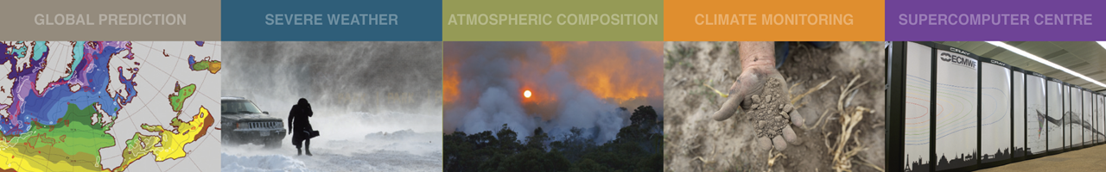
Current Satellite Observing Network and its Future Evolution
  A brief introduction to the Satellite GOS
  The WMO Integrated Global Observing System (WIGOS)
  EPS Second Generation / Meteosat Third Generation
  ESA Earth Explorer missions: EarthCARE (SMOS, Aeolus)
  Quick summary of other missions
Stephen English
Stephen.English@ecmwf.int

Slide 2
Current Satellite Observing Network and its Future Evolution
  A brief introduction to the Satellite GOS
  The WMO Integrated Global Observing System (WIGOS)
  EPS Second Generation / Meteosat Third Generation
  ESA Earth Explorer missions: EarthCARE (SMOS, Aeolus)
  Quick summary of other missions
Stephen English
Stephen.English@ecmwf.int

Slide 3
Roughly 1/3rd from American, 1/3rd from European and 1/3rd from Asian countries.
COSMIC-2
CMA
Metop
NOAA

Slide 4
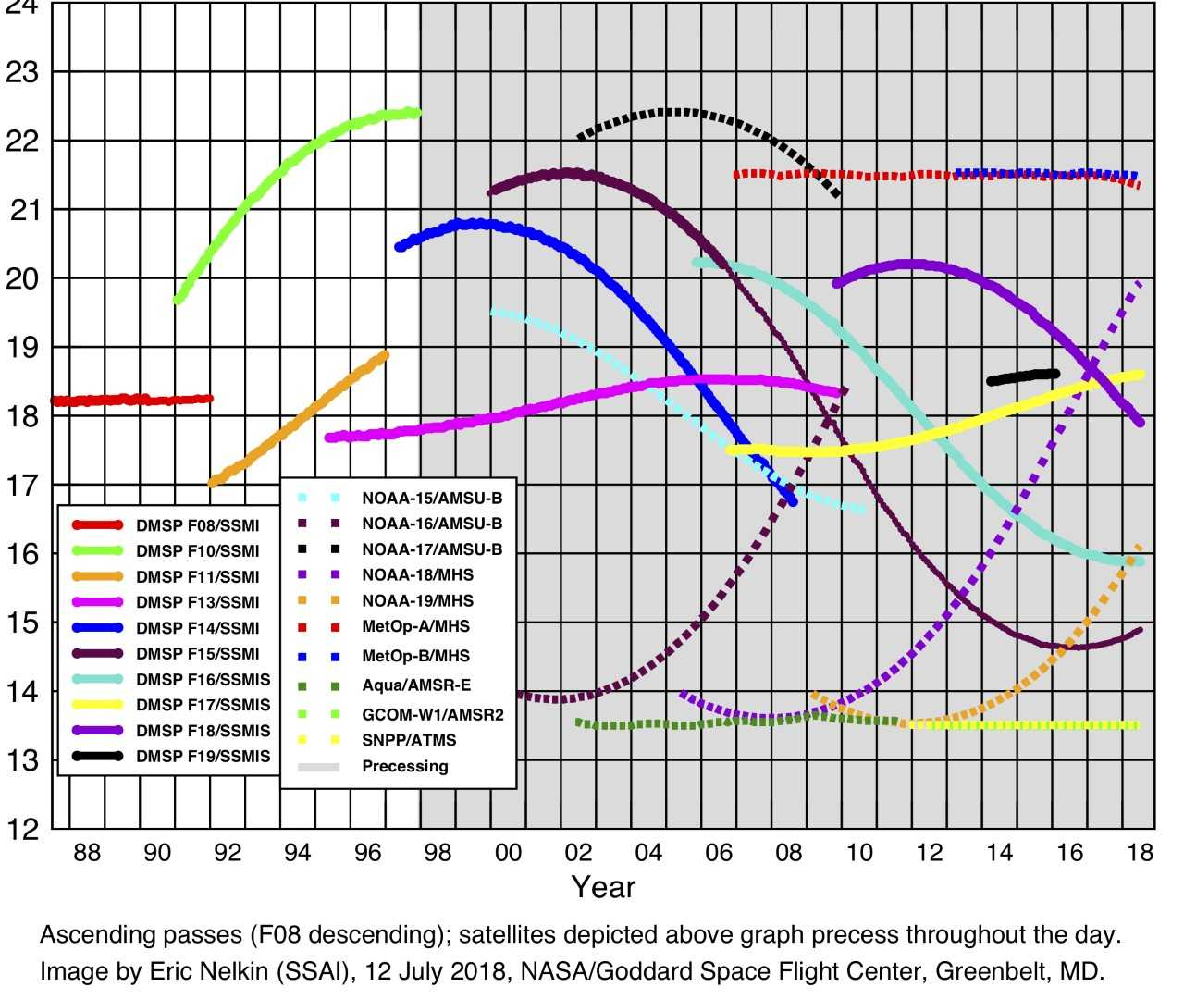
Satellite Equatorial Crossing Times (courtesy of Eric Nelkin)
Mid AM
Early AM
PM
Europe
China
South Korea?
US
China
e.g. Metop
T
i
m
e
Notes:
Colours for satellite names denotes what they started as e.g. NOAA-18 started as PM, and has drifted to Early AM

Slide 5
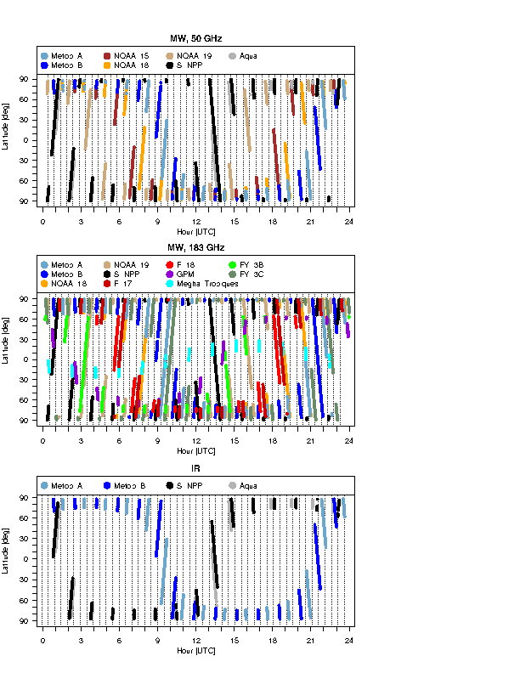
Temporal coverage of satellite data by type
In some bands e.g. 183 GHz excellent temporal coverage
In some bands e.g. 50 GHz gaps
In some bands e.g. IR major gaps

Slide 6
Current Satellite Observing Network and its Future Evolution
  A brief introduction to the Satellite GOS
  The WMO Integrated Observing System
  EPS Second Generation / Meteosat Third Generation
  ESA Earth Explorer missions: EarthCARE and Aeolus
  Quick summary of other missions
Stephen English
Stephen.English@ecmwf.int

Slide 7
WMO Coordination and WIGOS
WMO is striving towards a coordinated global observing system
(WMO Integrated Global Observing System – WIGOS)
Trying to make sure national efforts are complementary
Surface and space components
WIGOS Design
China
Europe
United States
Others
(Korea, Canada…..)
Japan
India
Russia

Slide 8
WMO Integrated Global Observing System (WIGOS)
Role of users and scientists
Input to the “Rolling Requirements Review” and gap analysis
Answering specific questions from space agencies
Preparation for future instruments such as lidar and radar (e.g. EarthCARE)
Which observations are most critical to forecast skill (and so must be maintained)?
Monitoring the WIGOS: health of the space sector and event (e.g. HCN) monitoring
Protecting meteorological applications e.g. radio-frequency interference (note 5G threat)

Slide 9
Developing WIGOS
Vision for WIGOS in 2025 adopted June 2009
Vision for WIGOS in 2040 drafted:
  Goal of new WIGOS vision
  Sets goals for the Space Agencies and the Coordinating Group for Meteorological Satellites – CGMS
WMO Space provide detailed support for satellite data from www.wmo-sat.info:
  OSCAR lists what exists, what is planned, what it can do, how this compares to requirements:
  http://www.wmo-sat.info/oscar/
  SATURN provides detailed information to prepare for forthcoming launches: data availability, formats, meta data, test data, points of contact:
  https://www.wmo-sat.info/satellite-user-readiness/
  The Product Access Guide provides information on existing datasets and how to obtain them:
  https://www.wmo-sat.info/product-access-guide/

Slide 10
Current Satellite Observing Network and its Future Evolution
  A brief introduction to the Satellite GOS
  The WMO Integrated Observing System
  EPS Second Generation / Meteosat Third Generation
  ESA Earth Explorer missions: EarthCARE SMOS, Aeolus)
  Quick summary of other missions
Stephen English
Stephen.English@ecmwf.int

Slide 11
EPS Second Generation
A little of the history that led to EPS-SG…
1970s : Research sounders with a few channels = SCAMS,VTPR+
1979 : TOVS (NOAA) = HIRS/2→/3,MSU,SSU,AVHRR
1999 : ATOVS (NOAA) = HIRS/3→/4,AMSU-A,AMSU-B→MHS,AVHRR
2002 : A-train: AIRS,MODIS,CloudSat,Calipso+
2007 : EPS First Generation (Metop) = ATOVS + IASI, ASCAT, GRAS, GOME-2
2011 : S-NPP = ATMS, CrIS, VIIRS, OMPS (USA)
2013 : FY3-C = MWHS-2, MWTS-2, MWRI, IRAS, GNOS, … (China)
2014 : Meteor M N2 = MTVZY-GA, IKFS, … (Russia)
2021: EPS-SG
  EPS-SG-A (3 sats) 2021-2042 = mostly EPS follow on instruments
  EPS-SG-B (3 sats) 2022-2043 = mostly new instruments

Slide 12
EPS Second Generation
1. Updated counterparts to Metop 1st generation
  ATOVS + AVHRR/MODIS → MWS + MetImage
  IASI → IASI-NG
  ASCAT → SCA (on EPS-SG-B)
  GOME-2 → Sentinel-5 UVNS
  GRAS → RO
2. New capability
  MWI: based on SSM/I
  3MI: based on POLDER and PARASOL (VIS/NIR/SWIR)
  ICI: completely new! Sub-mm imager for cloud ice

Slide 13
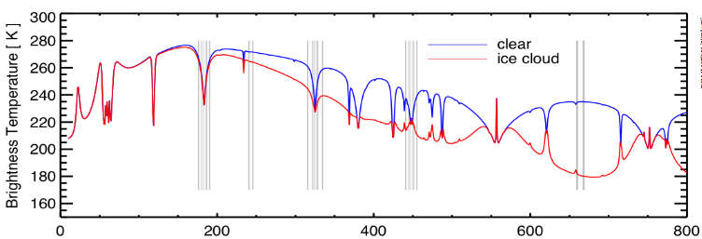
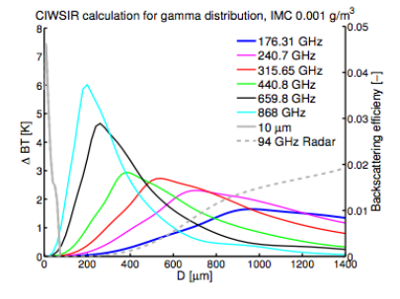
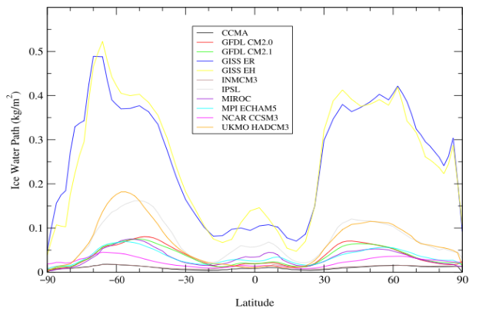
EPS-SG: Ice Cloud Imager - ICI
Ice water path
+
Some information on particles (size, shape, orientation….)
ICI
From CloudIce proposal (Buehler et al.)
From John and Soden (2006)

Slide 14
EPS-SG: Multi-Viewing Multi-Channel Multi-Polarisation Imaging Mission - 3MI
3MI = POLDER + MODIS heritage
Multi-directional : 10-14 views for one pixel
              Exploits bi-directional reflectivity
Multi-polarization : ±60, 0º
Multi-spectral : 12 channels
388 to 2130 nm (close to MODIS specification)

Slide 15
Meteosat Third Generation
A little of the history that led to MTG
1977 : Meteosat-1: 3 channel MVIRI instrument (by ESA)
1989 : Meteosat-4: first operational Meteosat
1995 : EUMETSAT takes over Meteosat operations
2002 : 2nd generational Meteosat: 12 channel SEVIRI on Meteosat-8
2005 : NASA plan GIFTS Geo interferometer launch but it never flies
2014 : JMA launch Himawari-8 with major improvement in imager (AHI)
2016 : NOAA launch GOES-16 with lightning imager and ABI imager (~AHI)
2016 : CMA launch FY4-A with GIIRS interferometer and a lightning imager
2020: Meteosat Third Generation
  MTG-I 2020 (4 sats) 2021-2040, MTG-S 2023 (2 sats) 2023-2038

Slide 16
Meteosat Third Generation
1. Updated counterparts to Meteosat second generation
  SEVIRI → FCI 16 channel imager
    European rapid scan 2.5 minutes, full disk 10 minutes.
2. New instruments
  IRS: IR interferometer
  LI: Lightning imager (777.4nm)
  UVN: Ultraviolet, Visible and Near IR imager

Slide 17
MTG: Infrared Sounder - IRS
An imaging Fourier-interferometer
Resolution of 0.625 cm⁻¹
Two bands
  700–1210 cm⁻¹ Long-Wave InfraRed (LWIR)
  1600–2175 cm⁻¹ Mid-Wave InfraRed (MWIR)
Spatial resolution of 4 km.
Full Disk basic repeat cycle of 60 min.
Note China’s FY4 series also carries an interferometer in Geo orbit
FY4-A launched 2017
ECMWF workshop in January 2017 dedicated to exploitation of high temporal Advanced IR Sounder information.

Slide 18
Current Satellite Observing Network and its Future Evolution
  A brief introduction to the Satellite GOS
  The WMO Integrated Observing System
  EPS Second Generation / Meteosat Third Generation
  ESA Earth Explorer missions: EarthCARE (SMOS, Aeolus)
  Quick summary of other missions
Stephen English
Stephen.English@ecmwf.int

Slide 19
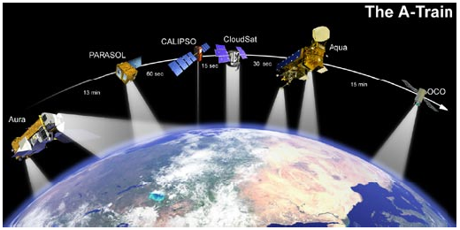
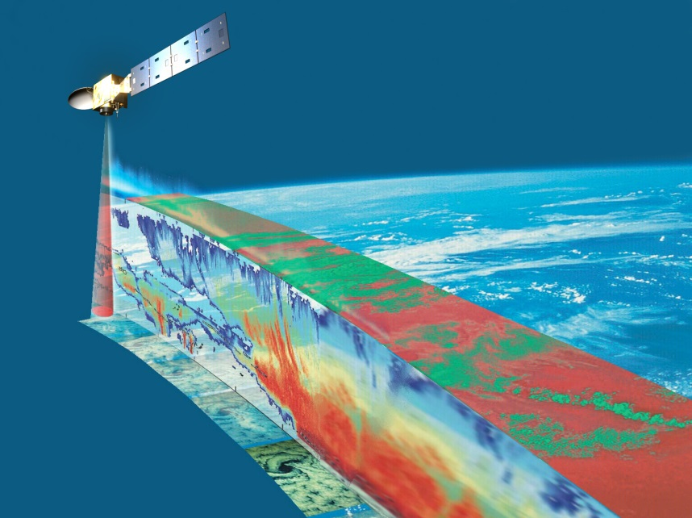
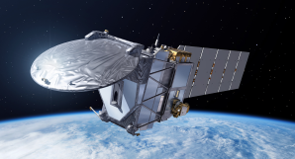
EarthCARE: cloud radar and lidar
EarthCare
ThA-Train
  Launched 2006
  NASA
  700-km orbit
  CloudSat 94-GHz radar
  CALIPSO 532/1064-nm lidar
  MODIS, CERES and AMSR-E radiometers
EarthCARE
  Expected launch c. 2018
  ESA+JAXA
  400-km orbit (more sensitive)
  CPR: 94-GHz Doppler radar
  ATLID: 355-nm lidar
  MSI and BBR radiometers

Slide 20
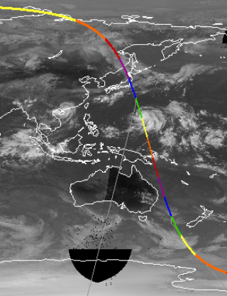
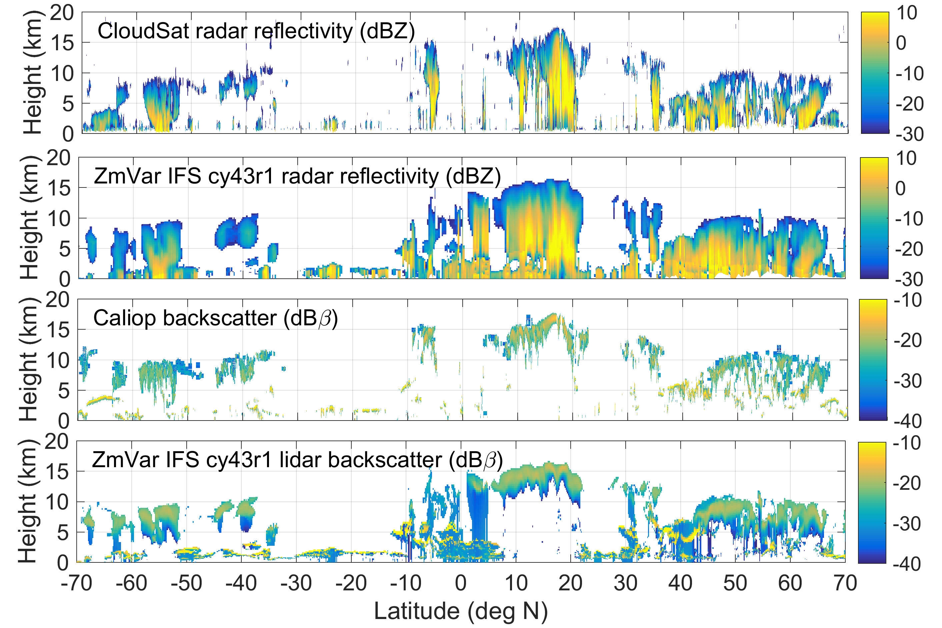
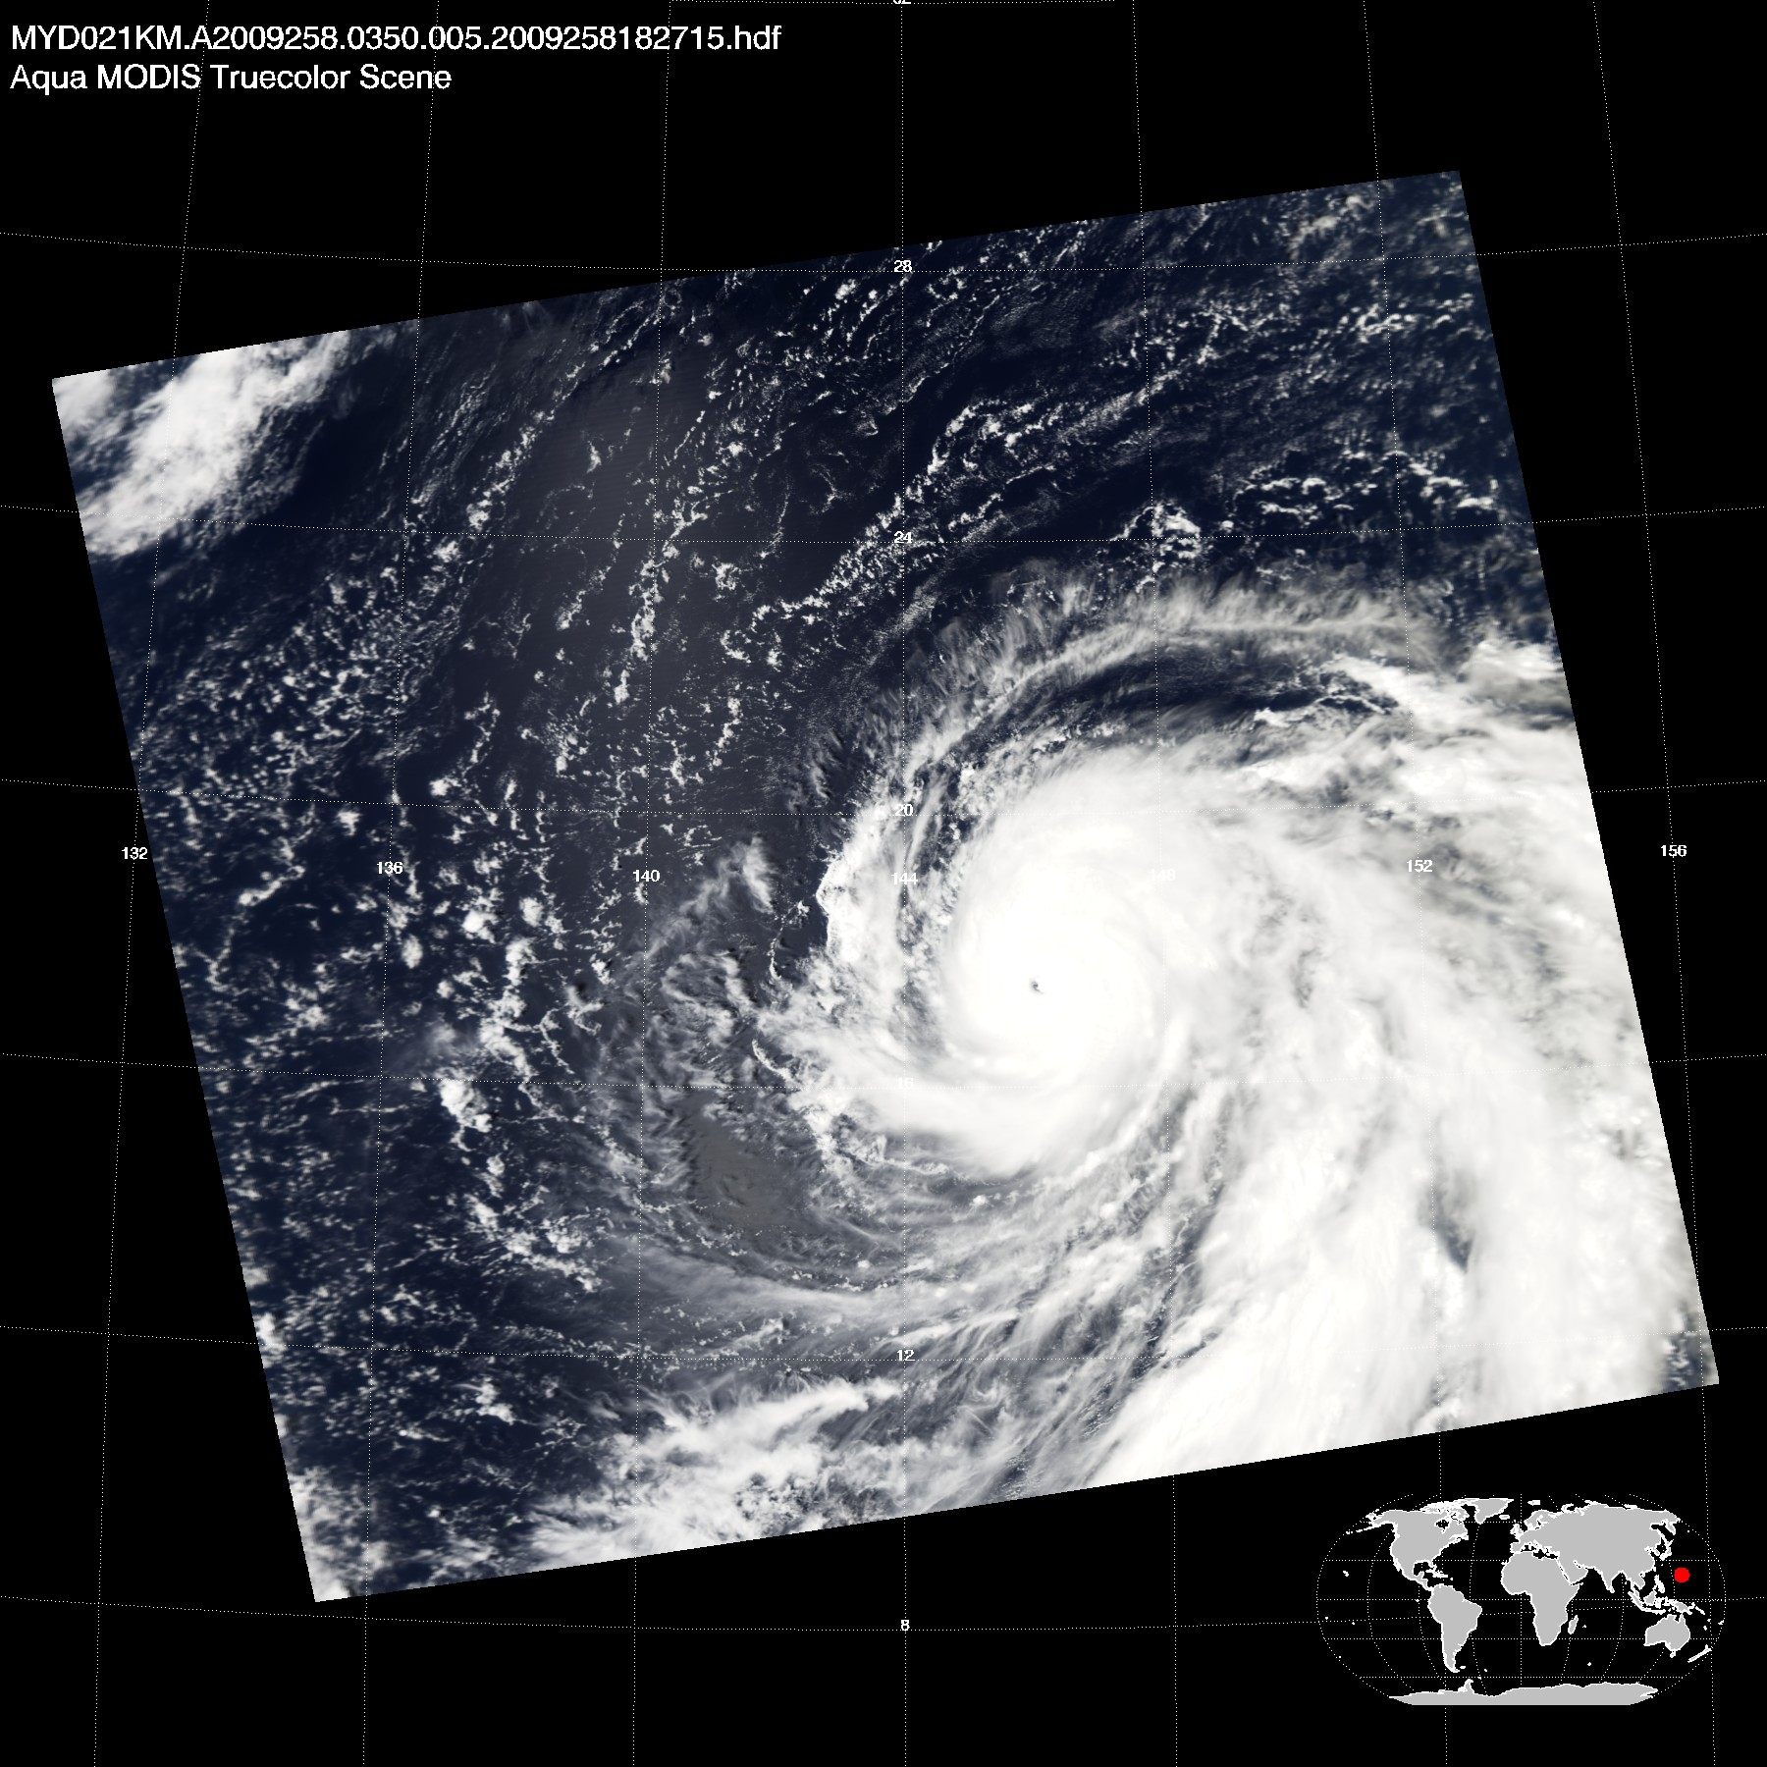

EarthCARE - clouds
Typhoon Choi-wan
(Sept. 15th 2009)
Demonstration with Cloudsat and Calipso data.
(Fielding and Janiskova)
20

Slide 21
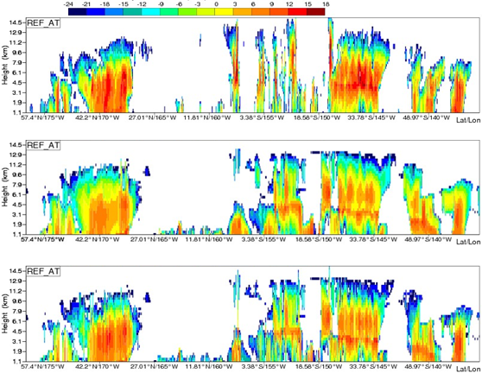
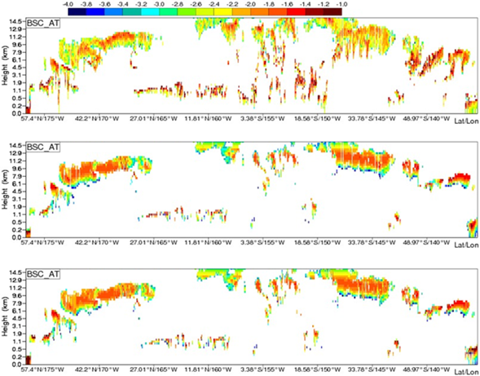
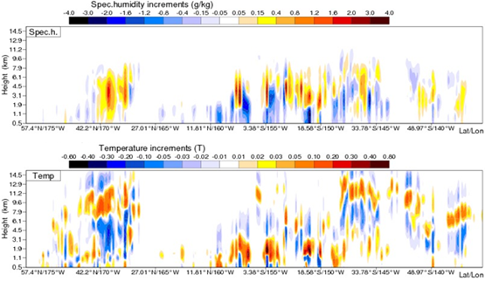
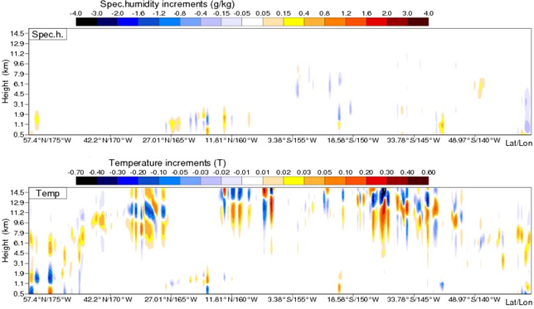
EarthCARE: assimilation in 4D-Var
O
B
A
δq
δT
Radar
Lidar
(S Di Michele and M Janisková)

Slide 22
Current Satellite Observing Network and its Future Evolution
  A brief introduction to the Satellite GOS
  The WMO Integrated Observing System
  EPS Second Generation / Meteosat Third Generation
  ESA Earth Explorer missions: EarthCARE (SMOS, Aeolus)
  Quick summary of other missions
Stephen English
Stephen.English@ecmwf.int

Slide 23
Cubesats, nanosats and other small satellites
Traditional approach:
  Large satellites with multiple pay loads
  +s Long life, colocation of observations, stability, good calibration should be achievable, time to develop science and increase impact, usually outstanding user support
  -s Infrequent observations, Inflexible, plan missions over 15-20 year period to run for 15-20 years, technology becomes out of date: 30-40 years from “user requirements” to end of programme so can’t respond well to changing user requirements, expensive
Cubesat approach
  Small satellites with single usually miniaturised payload
  +s Frequent observations from constellation, cheap, flexible
  -s: Short life, how to achieve stable and consistent calibration across constellation, compromises in design e.g. use 118 GHz rather than 50 GHz due to size, telecommand of many satellites, how will users cope with constellation constantly evolving, will user support match what big programmes can provide?

Slide 24
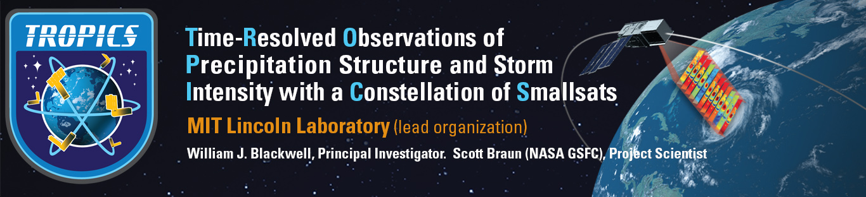
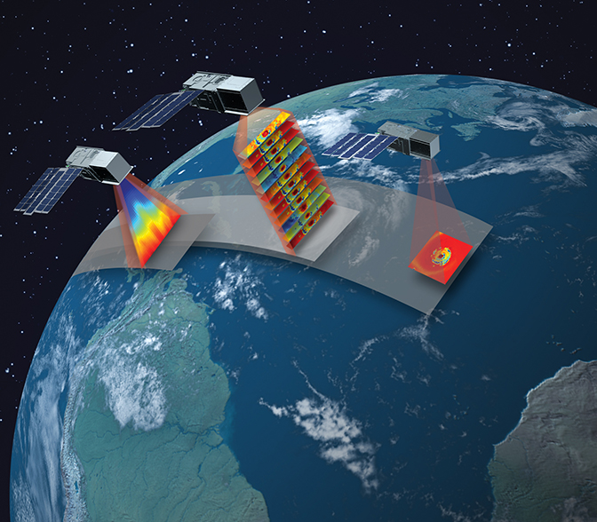
Six 3U CubeSats
Three orbital planes
30-deg inclination
550-km altitude
40-minute median revisit
12-channel radiometer
DISTRIBUTION STATEMENT A. Approved for public release. Distribution is unlimited.
This material is based upon work supported by the National Aeronautics and Space Administration under Air Force Contract No. FA8702-15-D-0001. Any opinions, findings, conclusions or recommendations expressed in this material are those of the author(s) and do not necessarily reflect the views of the National Aeronautics and Space Administration .
© 2018 Massachusetts Institute of Technology.
MIT Proprietary, Subject to FAR52.227-11 Patent Rights - Ownership by the contractor (May 2014)
Delivered to the U.S. Government with Unlimited Rights, as defined in DFARS Part 252.227-7013 or 7014 (Feb 2014). Notwithstanding any copyright notice, U.S. Government rights in this work are defined by DFARS 252.227-7013 or DFARS 252.227-7014 as detailed above. Use of this work other than as specifically authorized by the U.S. Government may violate any copyrights that exist in this work.

Slide 25
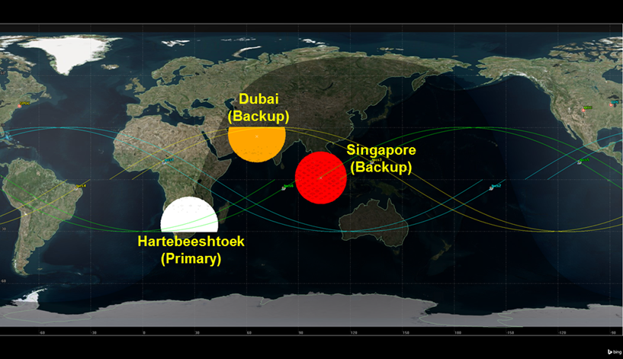
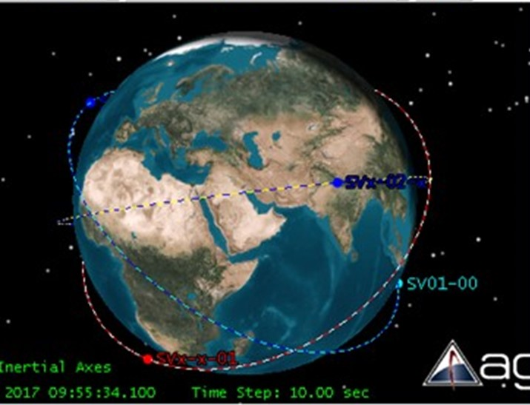
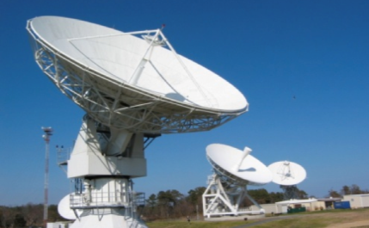
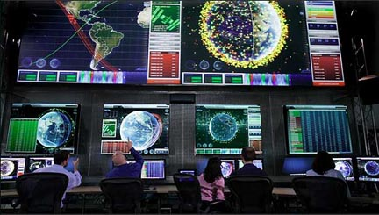


TROPICS Mission Overview
Six CubeSats
Three orbital planes
15-month lifetime
Better than 60-min median revisit rate over most of globe
State-of-the-art temperature and moisture sounding
Plan = 24-hr data latency – but significant % of data will arrive in 1-2 hours
KSAT
BCT
MIT LL
UW-SSEC
Ground Station Network
Mission Operations Center
Science Operations Center
Data Processing Center
Notes:
Other elements: Launch (550km/30°) DAAC
25

Slide 26
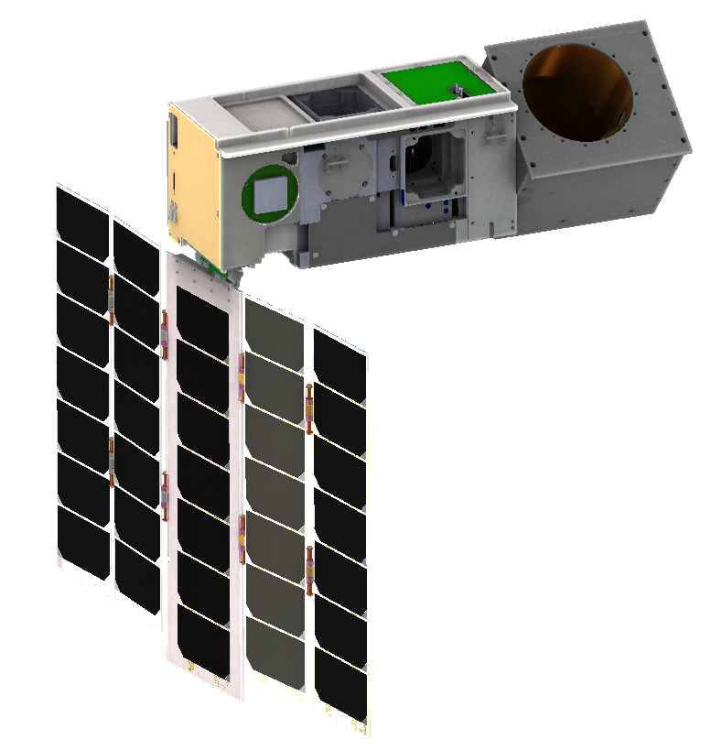
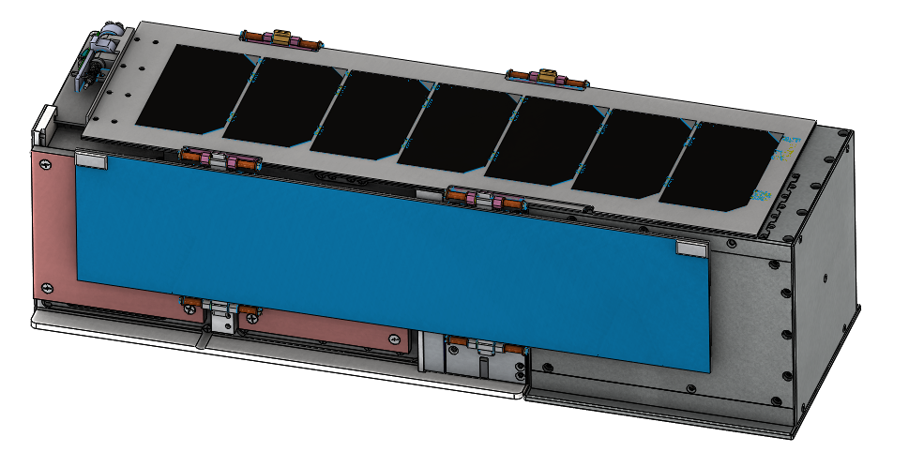
TROPICS CubeSat Overview
3U CubeSat
(10cm x 10cm x 36cm)
1U Payload
Rotating microwave radiometer
Scanner assembly
83 mm aperture
Noise-diode / sky calibration
Ultra-compact W / F / G radiometer
  W band 92 GHz
  F band 7 ch (114-119 GHz)
  G band 4 ch (183±1, 3, 7), 204 GHz
Deployed
2U Bus: BCT XB-1
S-band radio
ADCS: sun sensor(s), star-camera, reaction wheels, torque rods
Articulating 5-panel solar array
Stowed
Notes:
BCT is planning a roll maneuver to accommodate the antenna pattern. Will have small impact on power generation due to the non-optimal orientation, but no impact on the science data collect.
26

Slide 27
TROPICS Channel Set
TROPICS Chan. | Center Freq. (GHz) | Bandwidth (GHz) | RF Span (GHz) | Beamwidth (degrees) Down/Cross | Nadir Footprint Geometric Mean (km)* | Measured NEdT (K)
1 | 91.656 ± 1.4 | 1.000 | 89.756-90.756 92.556-93.556 | 3.0/3.17 | 29.6 | 0.66
2 | 114.50 | 1.000 | 114.00-115.00 | 2.4/2.62 | 24.1 | 0.96
3 | 115.95 | 0.800 | 115.55-116.35 | 2.4/2.62 | 24.1 | 0.82
4 | 116.65 | 0.600 | 116.35-116.95 | 2.4/2.62 | 24.1 | 0.86
5 | 117.25 | 0.600 | 116.95-117.55 | 2.4/2.62 | 24.1 | 0.79
6 | 117.80 | 0.500 | 117.55-118.05 | 2.4/2.62 | 24.1 | 0.81
7 | 118.24 | 0.380 | 118.05-118.43 | 2.4/2.62 | 24.1 | 0.90
8 | 118.58 | 0.300 | 118.43-118.73 | 2.4/2.62 | 24.1 | 1.03
9 | 184.41 | 2.000 | 183.41-185.41 | 1.5/1.87 | 16.9 | 0.58
10 | 186.51 | 2.000 | 185.51-187.51 | 1.5/1.87 | 16.9 | 0.55
11 | 190.31 | 2.000 | 189.31-191.31 | 1.5/1.87 | 16.9 | 0.53
12 | 204.8 | 2.000 | 203.8-205.8 | 1.35/1.76 | 15.2 | 0.52

Slide 28
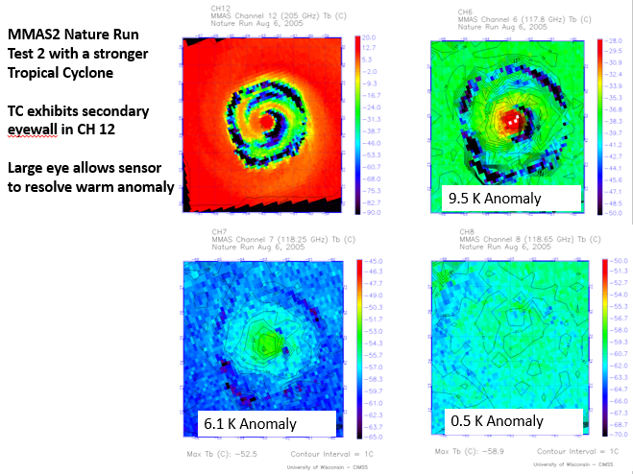
Simulated Warm Core Anomalies
Strong Storm: 110 kn

Slide 29
User readiness preparations
TROPICS user community includes academia, forecasters, NWP centres.
Engagement to prepare user community through:
  Applications workshop
  Quarterly telecons with users
  TROPICS has an ”early adopter" programme (e.g. ECMWF)
  https://www.nsstc.uah.edu/tropics/early_adopters.html
  Proxy data in various formats.
Data provision
  “Best endeavours NRT”
  No data restrictions (free exchange)
Mechanisms in place – but how ready are users for TROPICS and similar missions?

Slide 30
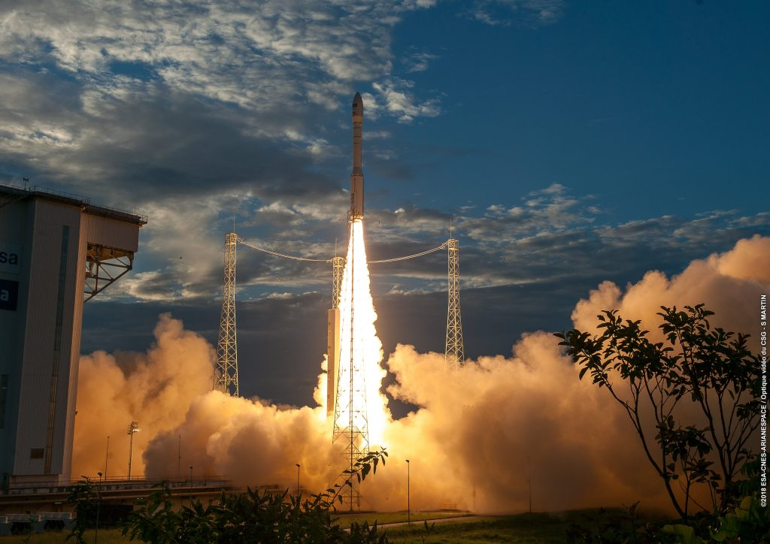
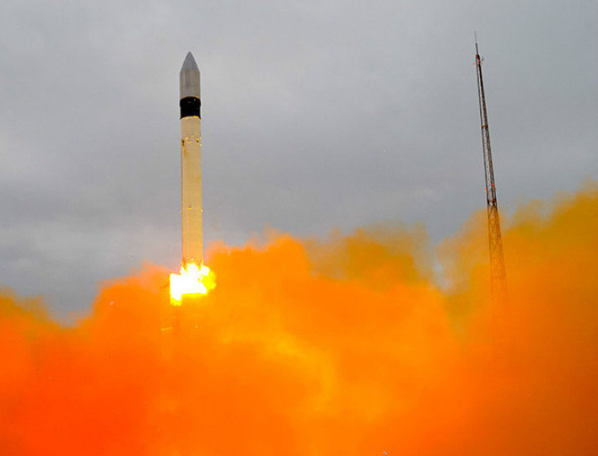
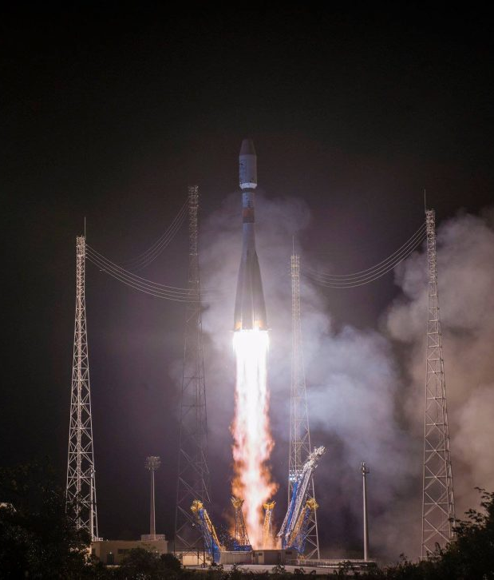
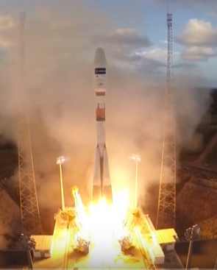
Some launches 2018
GPM
Feb 2014
FY4-A
Dec 2016
GOES-17 1st March
Sentinel-3B 25th April
GRACE-FO 22nd May
Aeolus 22nd August
GOSAT-2 29th October
Metop-C 7th November
GEO-KOMPSAT-2A 4th December
Selected upcoming 2019-2020
TROPICS, OceanSat-3, ELEKTRO-L-3
COSMIC-2a, Meteor-M-N2 2, HY-2C
FY-3E, FY-4B, GEO-KOMPSAT-2B,
GOES-16
Nov 2016
Sentinel-3
Feb 2016
Meghatropiques Oct 2011
Sentinel-1 April 2014
FY3C
Sept 2013

Slide 31
Summary
We live in an incredible era for earth observation!!!
Satellite data has driven data assimilation science to a remarkable level of skill
Big satellites likely to continue to be the core of WIGOS but a role for smaller satellites

