Slide 1
Delivering data and documentation to the CDS
X-CDR meeting, 8 November 2018
Rossana Dragani
On behalf of the ECMWF TOs, CDS team, Freja Vamborg, and AssimilaLtd

Slide 2
Content
The workflow for computers
What you deliver and what the users see
From data registration to data delivery: do’s and don’ts
Delivery of the documentation
Answers to your questions, issues and feedbacks:
  This talk ➔ most (general) points
  Confluence page ➔ above + any other general point
  A very small number of lot-specific point to be addressed in a 1-2-1 fashion.

Slide 3
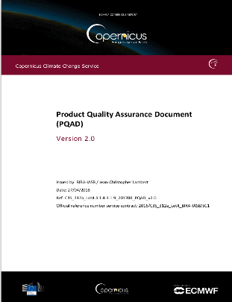
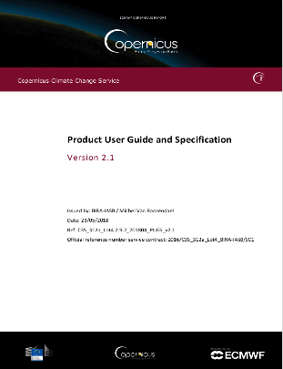
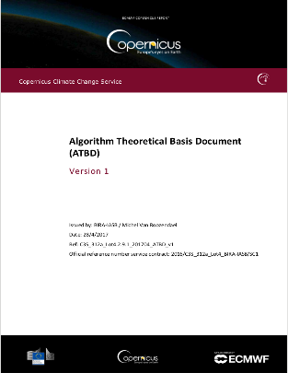
What are we talking about?
+
WORKFLOW for COMPUTERS

Slide 4
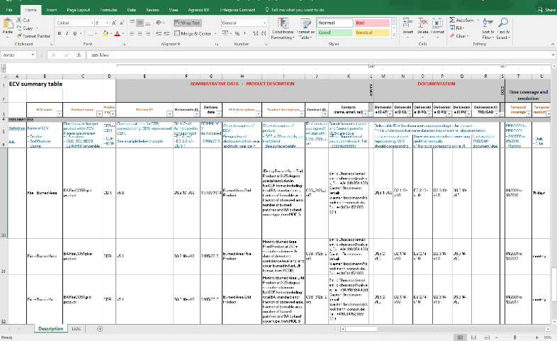
What you need to deliver:
+
+

Slide 5
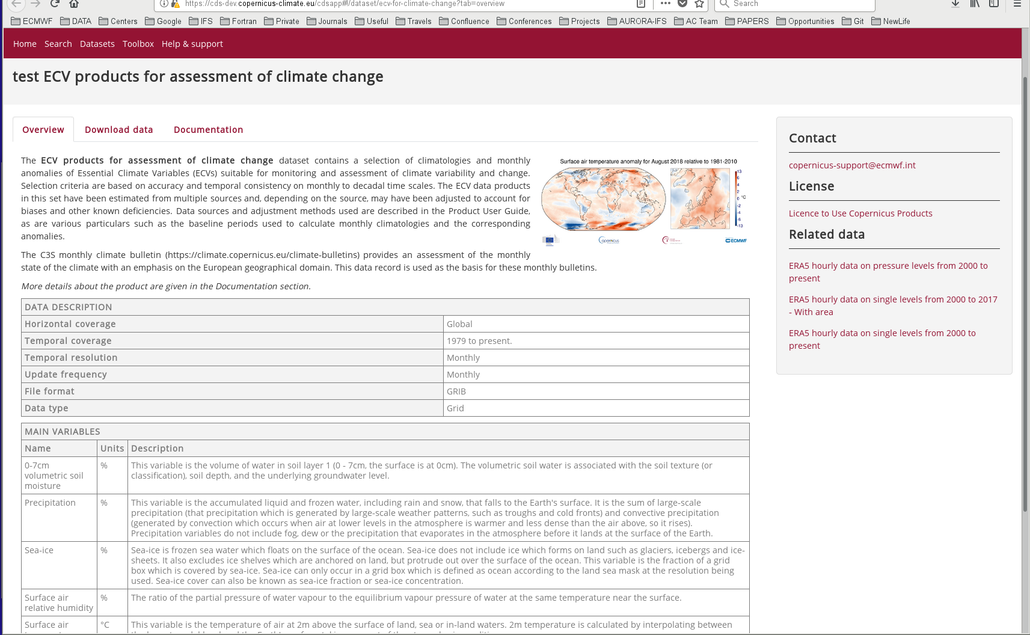
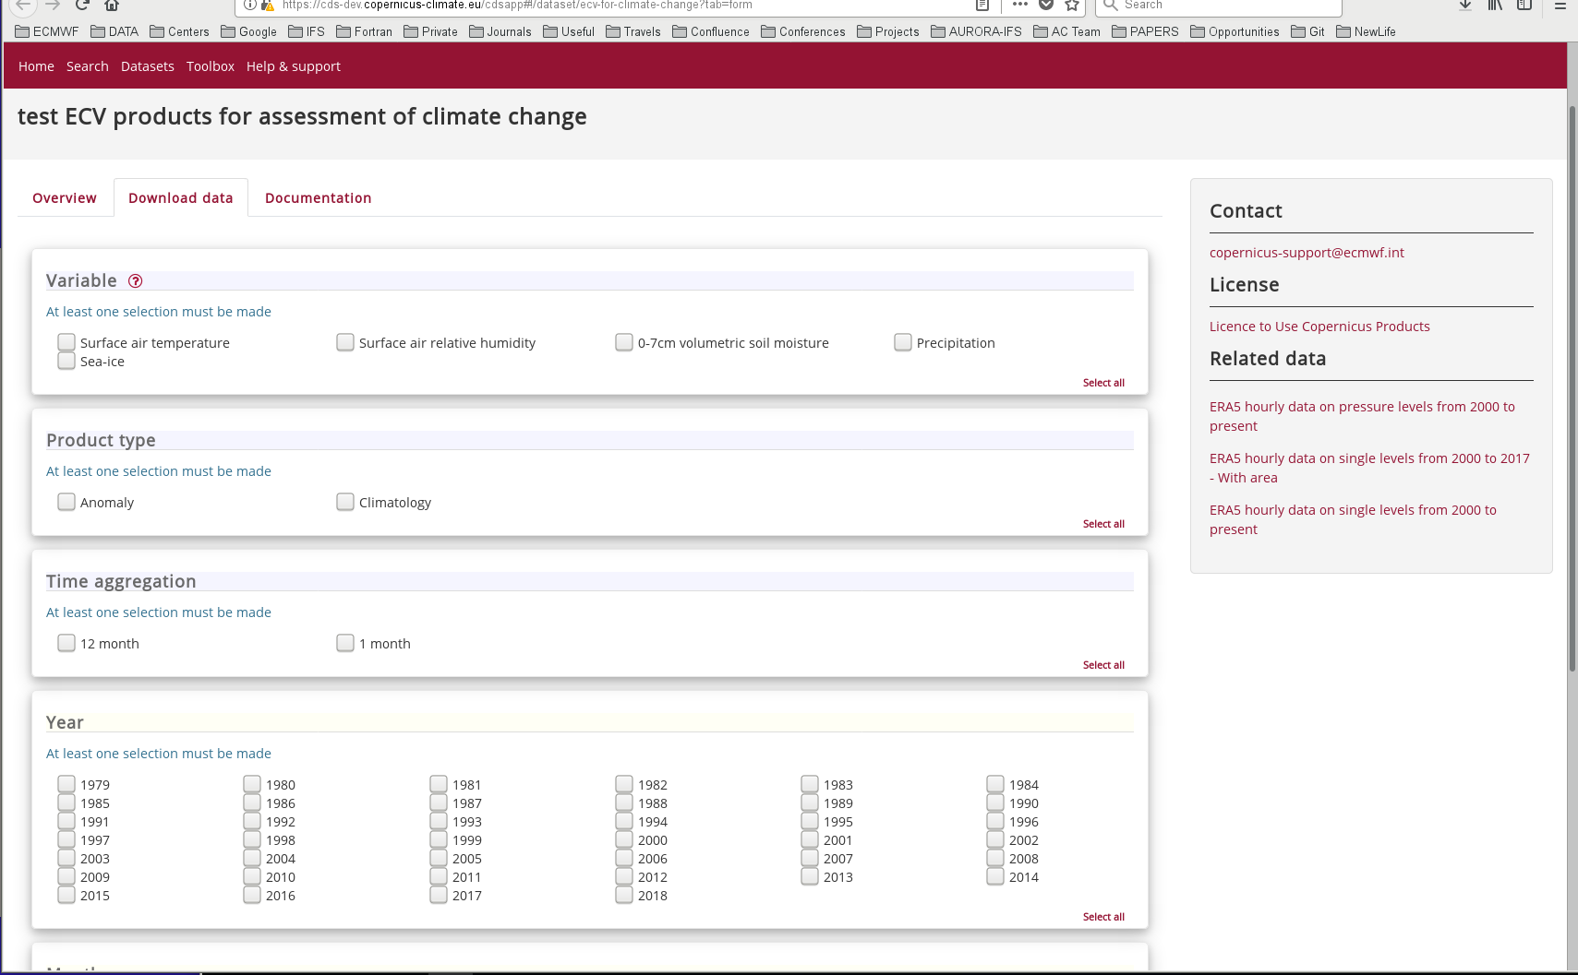
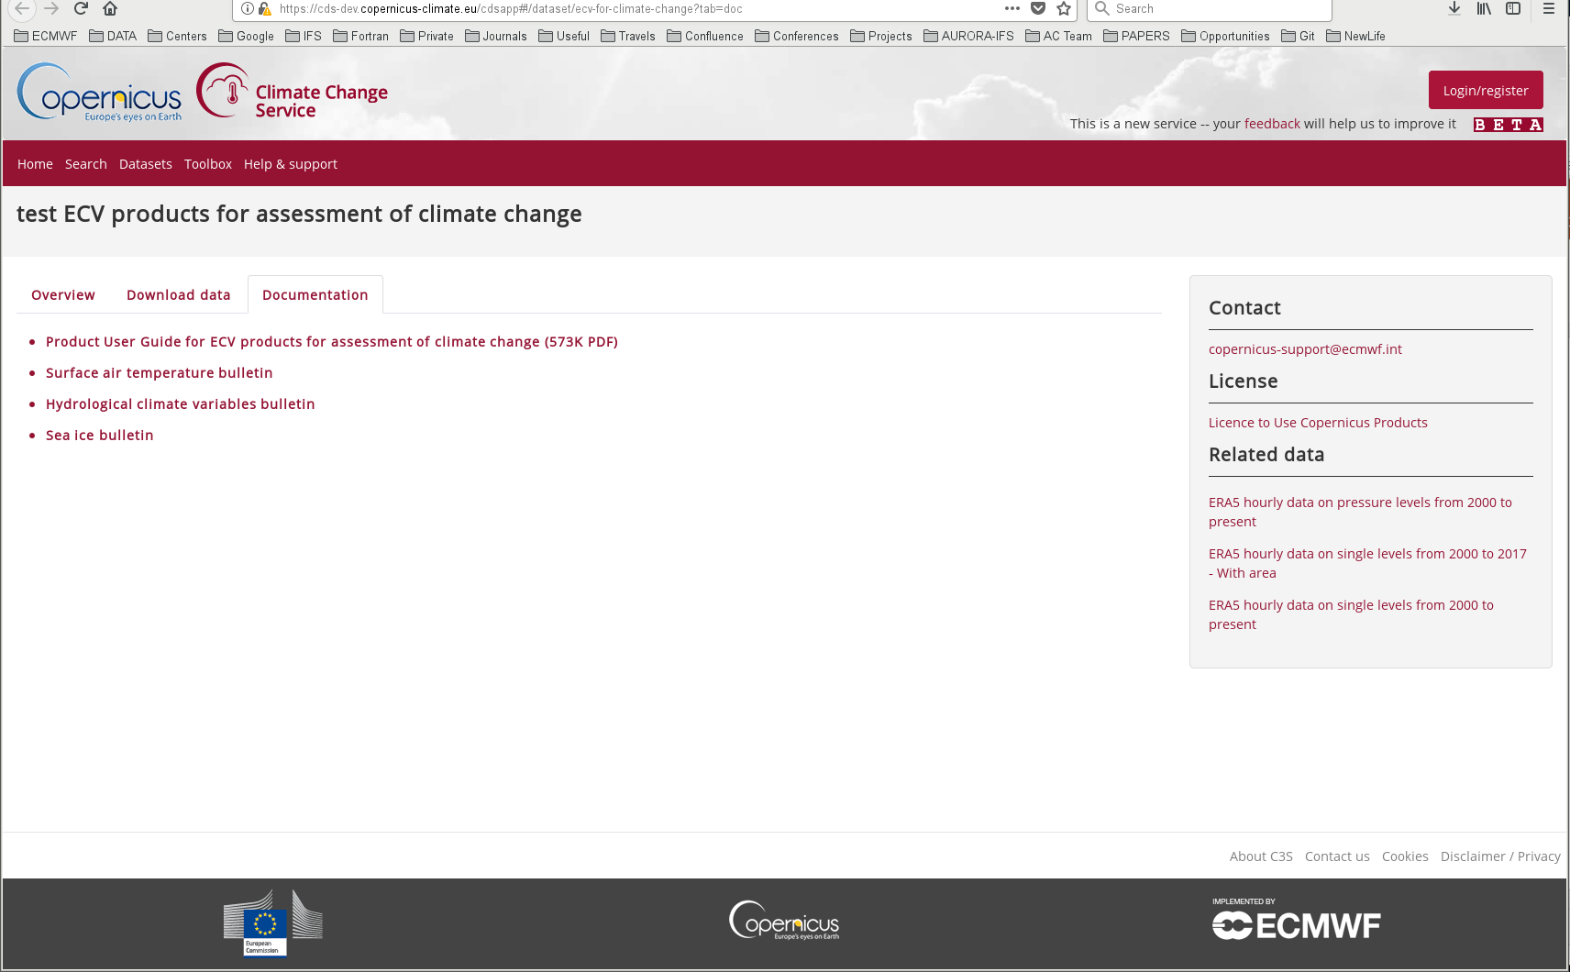
What an external user sees and uses:
Landing page:
brief text describing ECV and what a user can do with it
Plot
Table with main parameters
Downloading page
Documentation page

Slide 6
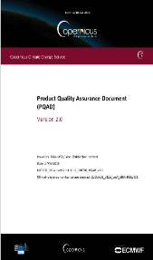
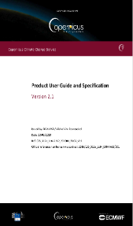
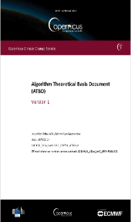
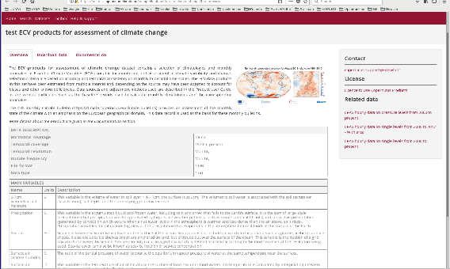
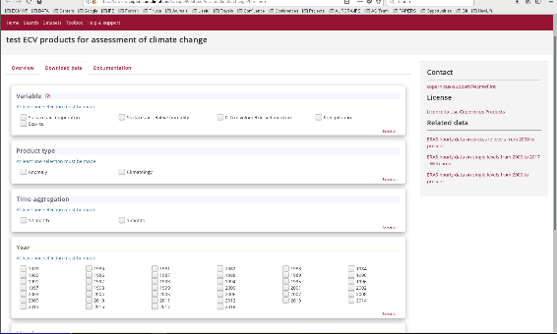
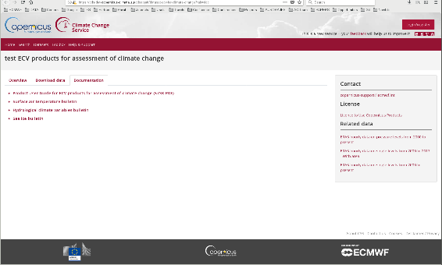

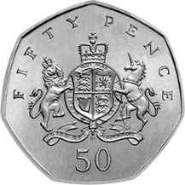
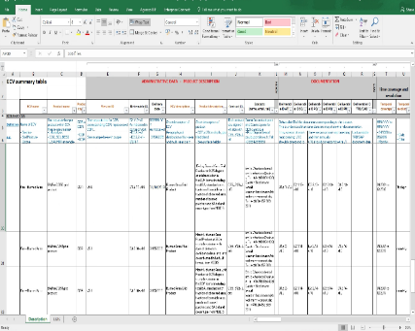
The two sides of the same coin
+
+

Slide 7
How to deliver the…
Data

Slide 8
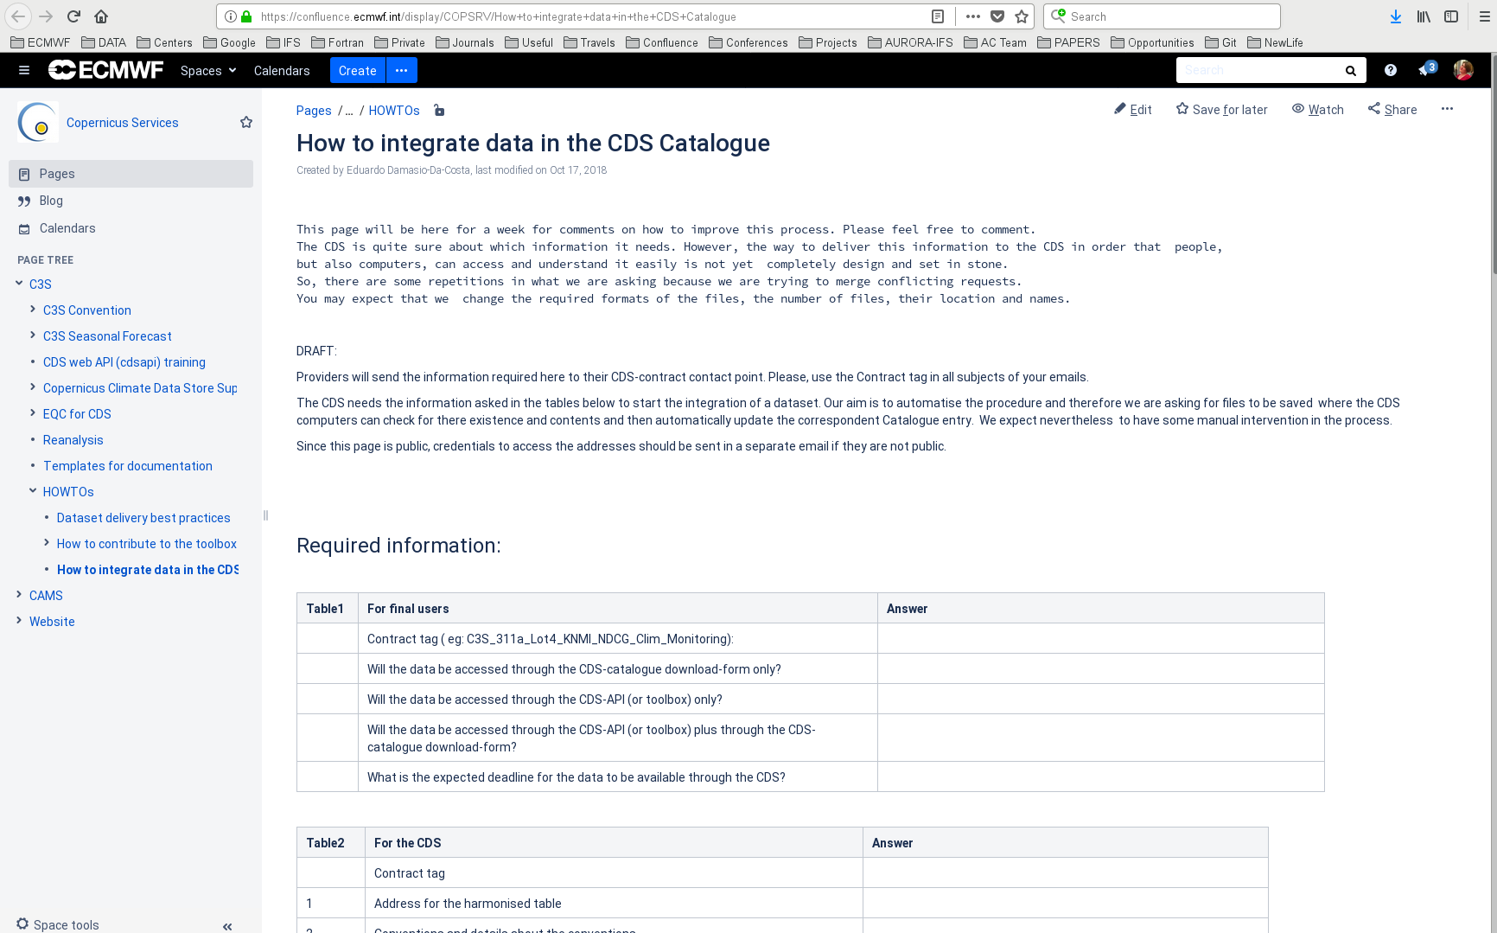
Information on confluence
https://confluence.ecmwf.int/display/COPSRV/How+to+integrate+data+in+the+CDS+Catalogue
We will try and add a page using your feedbacks.

Slide 9
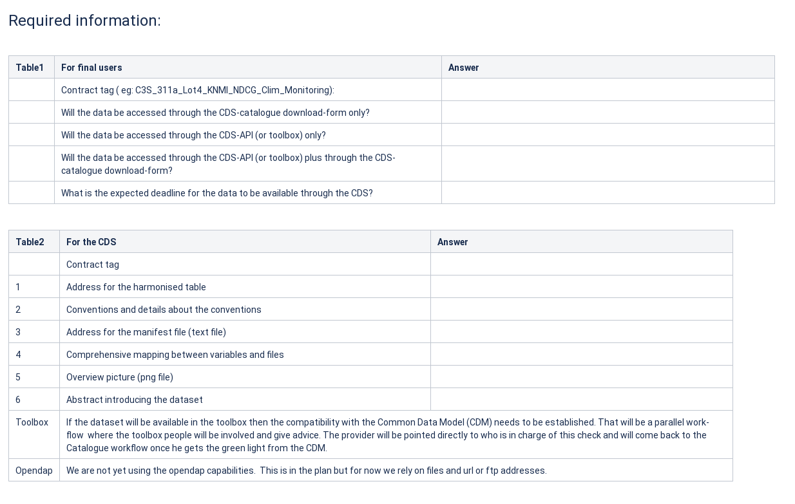
Required information for the CDS
You provide this information via the
Harmonized Table

Slide 10
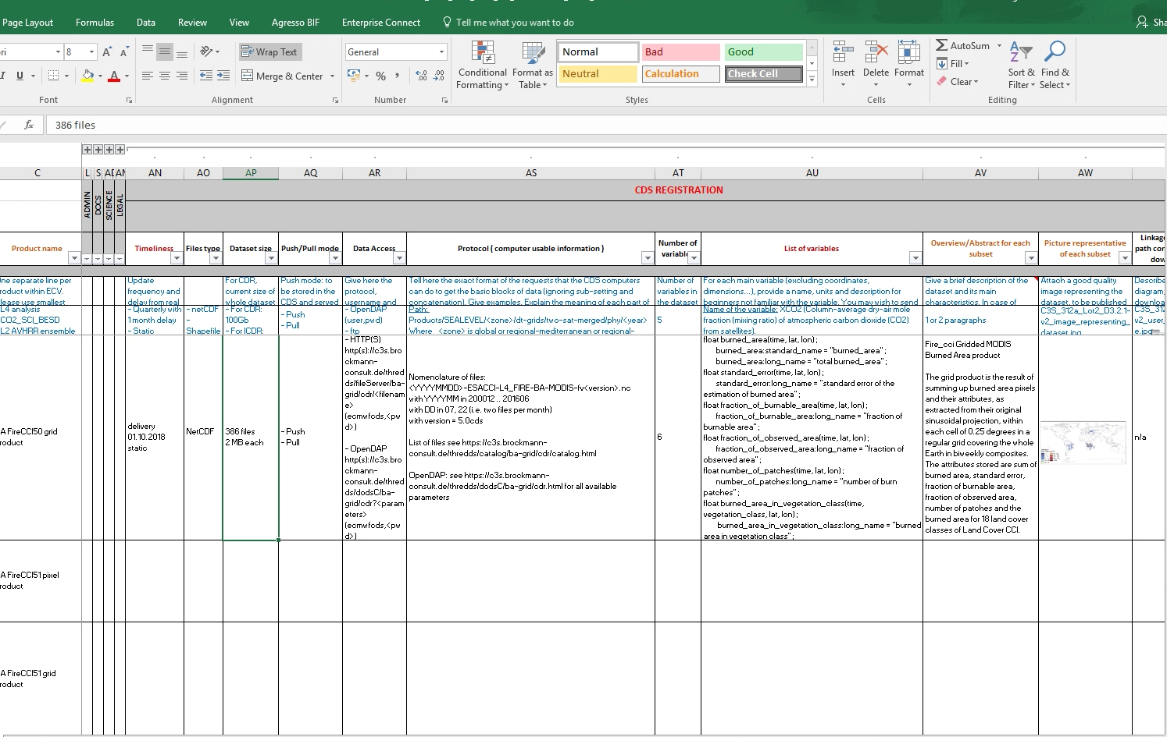

Data registration: HT
Only 1 HT should exist per product or family of products that is updated to reflect any changes.
These versions of the HT are named as ‘$yyyymmdd_HT*.xlsx’ so when searching they are all grouped together with the one to use/refer to being the most recent.
Older versions are only kept for tracking changes.

Slide 11
Data registration: HT ➔ DATA ACCESS

Slide 12


Data registration: Data access
Method: HTTP and OpenDAP both ok in principle, though OpenDAP not implemented yet. In the latter case, we are working with FTP.
For data provided via the ESFG infrastructure: OK but details are defined case by case (liaise with CDS)
  the dataset entry in the THREDDS server catalog, e.g.
https://esgf .$xyz /$data.nc.v1.html?dataset=$datafile.nc
b) the URL for download via HTTP, e.g.
https://esgf.$xyz/$path/$datafile.nc ⬅ currently this is the
preferred option!
c) the URL for download via OPeNDAP, e.g.
https://esgf.$xyz/$path/$datafile.nc.html
Notes:
12

Slide 13
OpenDAP plans
Q & A:
What are the plans with OpenDAP:
The use of OpenDAP is in the pipeline but it will take some time to become operational. Till then, those of you already working with OpenDAP deliver the files (via ftp).
What will be the impact [cf moving to opendap] for the data providers?
Those not using OpenDAP are encouraged to move to OpenDAP in the future
Is sub-setting handled at the CDS side or does the data provider needs to support it?
Currently, CDS does not do any sub-setting, providers need to split files e.g. in time (this can be done in the future once OpenDAP will be available).
NOTE: When you implement OpenDAP, you need to give CDS access to the native files

Slide 14
Access to providers servers:
The list of IP addresses that are currently anticipated to access providers’ servers are as follows:
  IPv4: 193.61.196.128/27 (193.61.196.129-158)
  IPv6: 2001:0630:0055:3d0d::129 to
2001:0630:0055:3d0d::158
Notes:
14

Slide 15
Data registration: HT➔ PROTOCOL

Slide 16
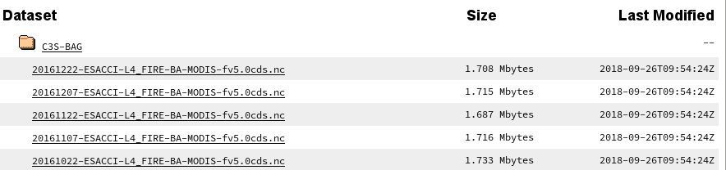
Data registration: Protocol
Define all strings, e.g. BA, MODIS, etc
It should have the
address of the
manifest file
(convenient location
is in the same
dir as the data - opt)

Slide 17


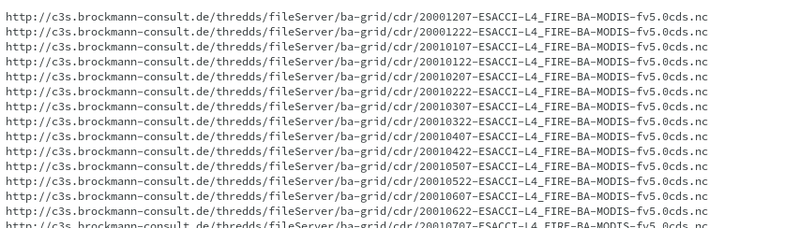
The manifest file:
Manifest_$DataTag.txt

Slide 18
Data registration: Protocol
It should have the
address of the
manifest file
(convenient location
is in the same
dir as the data - opt)
Manifest_$DataTag.txt

Slide 19
Manifest file name
The manifest file should be named as follows:
manifest_<Contract_tag>_<ECV_name>_<optional_tag>_yyyymmdd.txt
where yyyymmdd is the date when this manifest was created.
The manifest should be somewhere in the providers site where CDS can automatically download/check it and see if this file was update with new lines ➔ start the workflow (i.e. data approval) for ingesting the new data.
Adding any new data other than regular updates of new dates will not work automatically ➔ e.g. if the file name convention is modified to accommodate any change, they need to be added manually and the CDS team needs to be informed in advance.

Slide 20
Updating the manifest file
If you release additional data
manifest_<Contract_tag>_<ECV_name>_<optional_tag>_yyyymmdd.txt
Do’s
At the start you should have 2 identical manifest files:
  manifest_$tag4CDR_yyyymmdd.txt
  manifest_$tag4CDR_latest.txt
After a new data release:
  Make a copy of the latest manifest_$tag4CDR_latest.txt into manifest_$tag4CDR_${today}.txt
  Add extra lines for the new files at the end of manifest_$tag4CDR_${today}.txt
  Link manifest_$tag4CDR_${today}.txt to manifest_$tag4CDR_latest.txt
Don’ts
Do not delete old manifest files
Date the manifest file is created
e.g.
$path/manifest_${tag4CDR}_20180203
$path/manifest_${tag4CDR}_20180411
$path/manifest_${tag4CDR}_20180805
$path/manifest_${tag4CDR}_20181107
$path/manifest_${tag4CDR}_latest
Files in the grey box have the same content

Slide 21
Data registration: HT ➔ VARIABLES

Slide 22
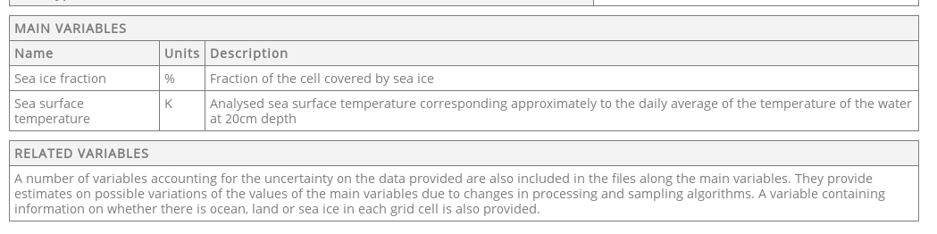

Data registration: HT
SI units

Slide 23
How to provide variables
variables:
${Name of the variable n 1}:
description: "TEXT in the 1st row / 3rd column "
units: $unit
${Name of the variable n 2}:
description: "TEXT in the 2nd row / 3rd column "
units: $unit
:
:
Indentation not necessary but appreciated

Slide 24
How to provide related variables
related_variables:
'A number of variables accounting for the uncertainty on the data provided are also included in the files along the main variable. They provide estimates on possible variations of the values of the main variables due to changes in processing and sampling algorithms.'
Indentation not necessary but appreciated

Slide 25
Data registration: HT ➔ ABSTRACT/FIGURE

Slide 26
Data registration: HT ➔ ABSTRACT
What it is
What you can use it for
Too detailed

Slide 27
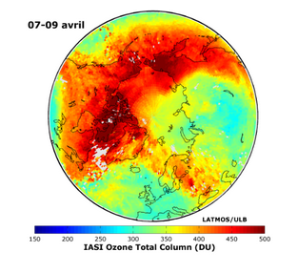
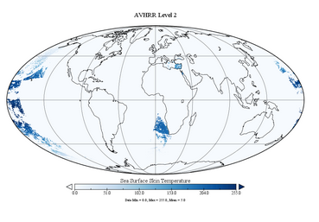
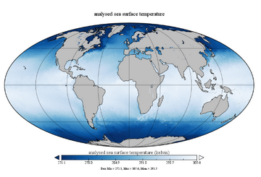
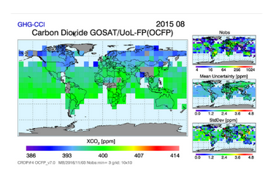
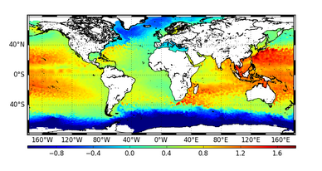
Data registration: HT ➔ FIGURE
IMPORTANT because it is the first thing that a new user will attempt at reproducing with the toolbox.
Think how to best show your data – in a simple way!
Add:
  A clear title (possibly in English)
  Colour bar (with units, and variable name) if it applies
Use visible/large enough fonts
This picture will be replaced by their toolbox sample application when the infrastructure will be ready.

Slide 28
Data registration ➔ ACCESS PATH convention

Slide 29
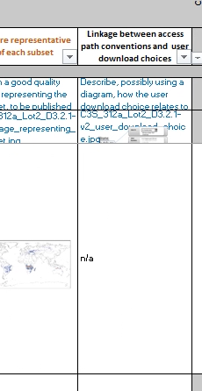
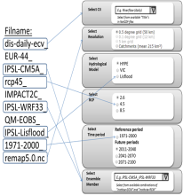
Access path conventions
Although optional, it helps if you describe, possibly using a diagram, how the user download choice relates to the access path to your data.
YOUR DOWNLOAD PAGE SELECTION

Slide 30

Suppose that
filename is
C3S_
$Variable_
$ProductType_
$AggregationTime_
$Year_
Algorithm_
Instrument_
institute_
versionX.Y.nc

Slide 31
How to deliver the…
Documentation

Slide 32
Data and document delivery timeline
Dday = Data Delivery
Dday + 3M
D0 + i years
Dreproc
Dday – 1M
DATA REGISTRATION + HT + Draft MANIFEST+
Sample data (in
The right location)
Delivery of
PQAR (v1.0)
Delivery of
PUGS (v1.i)
PQAD (v1. i)
PQAR (v1. i)
Delivery of
ATBD (v2.0)
PUGS (v2.0)
PQAD (v2.0)
Delivery of:
ATBD (v1.0)
PUGS (v1.0)
PQAD (v1.0)
TRD/GAD not considered here as they can be more general and apply to a group of products

Slide 33
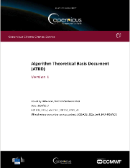
Individual document acceptance procedure
Prime Contractor X (PC X)
To: Assimila PoC
CC: ECMWF TO
Florence
Review
Upload doc in
Tempo box
PC X
Process up to 1.5 months
NOTE: C3S_312a documents (not in Tempo box) have been uploaded by FR in the livelink doc repository
Q & A:
What does the user see? Default is to link the latest docs
Are the previous docs stored somewhere? Yes, they are (will be)
Does it make sense to make them available to users? It could be done
How long does the approval take? It should take 45 days in total (this depends on both the contractors and Assimila/ECMWF)

Slide 34
Approval time and data access to users
Dpub = Dday + 4.5M
(Data Published, i.e available to users)
Dday = Data Delivery
Dday + 0.5M
Dday + 3M
D0 + i years
Dreproc
Dday – 1M
DATA REGISTRATION + HT + Draft MANIFEST+
Sample data (in
The right location)
Delivery of
PQAR (v1.0)
Delivery of
PUGS (v1.i)
PQAD (v1. i)
PQAR (v1. i)
Delivery of
ATBD (v2.0)
PUGS (v2.0)
PQAD (v2.0)
Approval
of HT
Period for the
CDS integration
Delivery of:
ATBD (v1.0)
PUGS (v1.0)
PQAD (v1.0)
Review/approval of PQAR
TRD/GAD not considered here as they can be more general and apply to a group of products

Slide 35
Review procedure- Deliverables
Contractor
ECMWF
Submit
Deliverable 1
Submit
Deliverable 2
Submit
last Deliverable
…
No
No
No
Review of Del1
Approved
?
Review of Del2
Approved
?
Review last Del
Approved
?
Submit
Notification of Milestone Completion
Yes
Yes
Yes
Details available in Framework Agreement – Annex 3C
Notes:
Use of Resources form for Cost Reimbursement contracts
35

Slide 36
Review procedure- Deliverables
Submit
Del1
Submit
Last Del
Contract Performance Review
Payment
No
…
No
Implement corrections
Progress meeting
Send invoice AND Notice of Acceptance to finance@ecmwf.int
Review of Del1
Approved
?
Review last Del
Approved
?
Submit
Notification of Milestone Completion
Yes
Yes
No
Issue Notice of Acceptance
Verify contract performance. All deliverables
Approved?
Yes
Payment
No
Contractor
Issue Notice of Need of Remedial Action
ECMWF
45 days
Max 30 days
Details available in Framework Agreement – Annex 3C
Notes:
36

Slide 37
Doc and Data
Q & A:
Who to notify that a product has been updated?
For DATA, after acceptance just add the new dataset files in the manifest file (follow procedure on how to update the manifest file).
For Doc, after approval upload it in the Tempo box.
Can the products be deleted from the manifest file?
Yes, it is not a problem in principle, if the product is withdrawn from the CDS.

Slide 38
Doc and Data Versioning (1)
Q & A:
If, due to some errors or improvements, a new version is needed, does the versioning needs to increment (minor version numbering)?
YES, correct, it increments the revision, e.g. v2.0 is updated in v2.1.
Brokered dataset have different version than the in-house produced dataset and this could be confusing for the end user. e.g a brokered dataset already delivered to CDS has a version number v1.5.1 while the new dataset produced inhouse will have a version number v1.0.1. The latter is and will be considered the most up-to-date version. We assigned the version v0 to the brokered dataset instead of the original version (v1.5.1). How will this be handled in the CDS and made transparent to the user?
The latest and most updated version should never be lower than older ones.
You should increment the revision of the version of the data brokered, e.g. if the brokered is 1.5.1, the in-house dataset would have a version v1.5.2. Also for versioning, please refer to the contract and HT.
Please disregard the example below, I’ll clarify the ‘rules’ in the confluence page.
Check the contract and harmonized table (they have the correct version numbers).
If in doubt, get in touch with Florence Rive.

Slide 39
Doc and Data Versioning (2)
Q & A:
  What is the policy for older data and document versions? Will they be accessible?
  How to deal with older datasets is on our list of things to discuss in the data governance board.
  If old datasets are archived and accessible, so should the docs that go with them. The intention is to make it possible for users to access older versions, but how this will be implemented is still under discussion.
  For now, the CDS main page links the latest data and docs.

Slide 40

Manifest file for documents
Q & A:
How do you manage document versioning?
The solution could be to have a manifest file for the documents ➔ not different from data
Same do’s and don’ts as for data
For now, save the documents in a place that the CDS computers can access and where CDS computers can download them automatically every time changes are made.
e.g.
$path/manifest_${tag4Doc}.20180203
$path/manifest_${tag4Doc}.20180411
$path/manifest_${tag4Doc}.20181107
$path/manifest_${tag4Doc}.latest
Notes:
40

Slide 41
To recap: documentation (1)
Documents online (at regime) are ATBD, PUGS, PQAD, PQAR, TRD, GAD. For the interim, keep liaising with your ECMWF TO and CDS team
  ATBD (SQAD): one document for each coherent group of ECV products at each new product release (v1.0 for v1) and at each reprocessed release (v2.0 for v2, v3.0 for v3, etc)
  PQAD/PUGS: one document for each coherent group of ECV products at each new release/reprocessing + annual updates
  PQAR: one document for each coherent group of ECV products 3 months after each new release/reprocessing + annual updates
If there is NO content changes in PQAD, PQAR and PUGS, update at least the version and release date (including the document history)
HT checked and approved by ECMWF within 45 days
Data published to user only after the PQAR is approved (3M + 1.5M = 4.5M after Dday)
At the data registration time, CDS needs a draft of the manifest file, and ideally also a sample data in the correct location

Slide 42
To recap: documentation (2)
After a document is approved, just upload it in the Tempo box.
Versioning should be incremental and increasing with data quality – if you have both brokered and in-house produced datasets, version of the latter (especially if of greater quality) should be an incremented revision of the former!
Once you reach a milestone, notify it ➔ the review should take up to 45 days to issue approval status. Payments should be made within 30 days from milestone approval.
If the procedure takes > 2 months (e.g. due to delays with the data integration in the CDS), liaise with Florence Rive to discuss a way forward.
Notes:
42

Slide 43
The three commandments of the CDS:
Use standard conventions for variables and names (CF).
Use the same rules (access path conventions and filenames) to locate the dataset in the CDS.
Don’t change* the rules to locate the data/docs (name, path, tree, etc), or the filename access conventions.
* If you can’t avoid it, let the CDS team (@Eduardo) know at your earliest opportunity and in advance!

Slide 44
Other questions

Slide 45
Digital Objective Identifiers (DOIs):
Q & A:
  Can we include a DOI? Do you have a way to provide DOIs?
  Introducing the DOI’s is in the pipeline but will not be available in the next few months.
  Once we create a DOI, everything will be frozen and our room to improve is severely diminished ➔ we need to converge to a stable system before issuing DOIs.
  We can agree to add the DOI info in the CDS – though not in the netCDF data - at a later stage.

Slide 46
Communication and PoCs
Q & A:
How are we to inform ECMWF and/or users if there is an outage in the distribution, system failure or if some issue with the data are noticed?
PoC for this is the C3S User Support. Two emails are available
  copernicus-support@ecmwf.int: for raising a ticket in JIRA Service Desk. If you receive a user query, you should forward it to this email address and a new ticket will be created automatically.
  copus@lists.ecmwf.int: for discussions without users' involvement. All members of the user support team will receive emails sent to this mailing list ➔ good to notify system failures
As a system failure or data availability is cross-cutting in the workflow, it is good to also copy the ECMWF TO, Florence Rive, and CDS.
How to receive timely feedback on data deliveries or questions by mail. Is there a main point of contact?
PoC depends on the topic:
  The ECMWF Technical Officer for data/document approval
  Florence Rive for admin-related topics (e.g. payment associated to data delivery)
  CDS team for registration and CDS-related questions

Slide 47
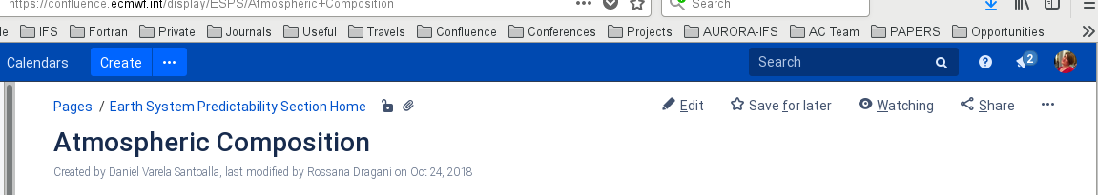

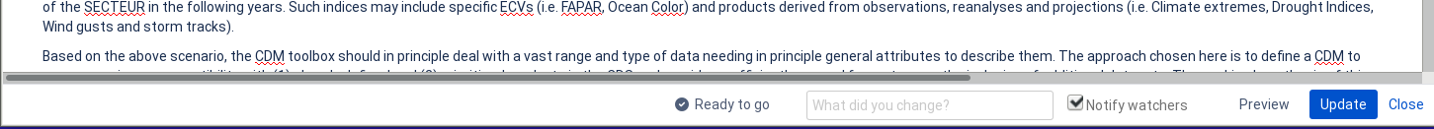
Common Data Model
Q & A:
Are the CDM specifications maintained? How do we know when it’s updated?
(https://confluence.ecmwf.int/display/COPSRV/CDM%3A+Common+data+model+specification+-+v1.0, Dec 04, 2017)
The CDM page is stable, hence it does not need to be updated.
CDM compliancy check possible before data delivery? Is there a tool we can use in-house to check the data compliancy before final delivery?
As part of the EQC dataset assessment , a git-hub checker (so publicly available) will be available (expected within the next 5 months).
Viewing mode
Editing mode

Slide 48
User registration
Q & A:
How is a login at other servers usually implemented; is every user registered once, or per transaction?
CDS users are only registered on the CDS itself. Because of the Terms and Conditions accepted when registering, CDS can not exchange users private information out of the CDS.
Could there also be just one designated user for CDS on our server via which all CDS users access the data? The latter option might make it easiest for us to shield our files from people searching the ESGF node, as the node itself should not be accidentally established as an alternative route for distribution of the data, especially for the many brokered products.
Internally (CDS and data providers), connections to data providers is done with a generic CDS user account, which is transparent to the user. Currently, there is one generic CDS user registered for ESGF (c3s-cds-user) that we are testing for accessing data on ESGF node.

Slide 49
Search engines
Q & A:
For data provided via ESGF infrastructure, does the CDS rely on the ‘The ESGF Search RESTful API’? As we understand it, for the API to work files need to be put on the publicly searchable index of the respective node, an action which we would like to avoid.
CDS does not currently use ESGF Search RESTful API as it gets the required information to configure the forms directly from the threads server catalog.xml.
How datasets are indexed on ESGF side to be accessible through the API is out of CDS scope. Whatever the case, we need to put in place a mechanism that allows us to discover all the file pattern names in order to create the forms. If API is not an option then a list of files needs to be provided on regular basis.
For additional questions, please contact Angel (angel.alos@ecmwf.int)
Will openSearch be used in the future?
We need to evaluate the related use cases for that and if considered as an added value for the CDS, we might definitively decide the way this can be implemented and used.

Slide 50
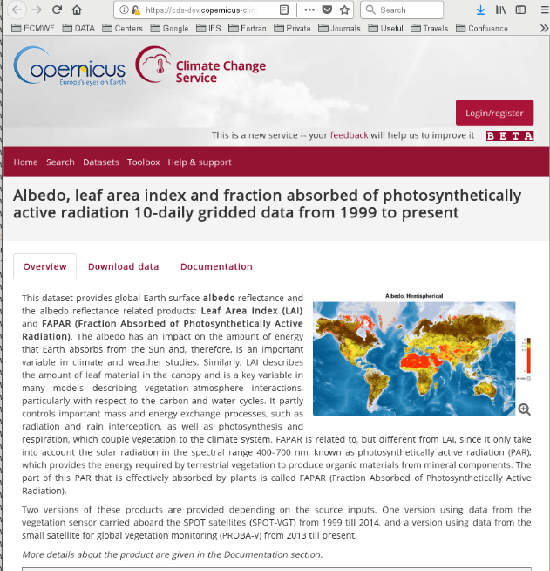
Use case: what is it?
Use-cases are examples of how to use the data, mainly for their discovery and exploration
They are intended as a first step to take towards using a dataset in the toolbox.
They need to be simple – many users might not be “expert users”
They should cover the most important aspects to showcase a dataset
These applications will be displayed as a separate tab next to 'documentation' on the ECV page.
Use cases

Slide 51
Use case: contingencies
Requirements:
  The data needs to be in the CDS
  The data need to comply to the CDM or at least there needs to be a mapping between the CDM and the data
A description / sketch of what the use case should look like
A python workflow needs to be written in the toolbox following the sketch
As per today, requirements 1. & 2. may be a show stopper for some ECVs.
You can start thinking about and prepare the description / sketch ➔ it can be archived until requirements 1. and 2. are met.
Point 4. will then follow.

Slide 52

Use case: description / sketch
The description / sketch could include the following information:
  What variable(s) to display
  What time frequency
  What levels (if multiple)
  Type of display (map/ time-series/ other type of 2d plot ... )
  What should be 'interactive'? e.g. drop-down menu for three different regions (which ones?), or the times-series (e.g. https://cds.climate.copernicus.eu/toolbox-editor/examples/03-extract-time-series-and-plot-graph [⬅ you need to register to the CDS])
  Small text to go with the applications to explain what it is and can be done with it.
  ….
The above can be prepared in advance & archived until the data are in the CDS.
Some suggestions!

Slide 53

Use case: the python workflow
Python software that reads the data and produces a showcase for your data
You’ll need to work and liaise with the CDS team on how to best showcase in a simple manner your dataset (CDS PoC to follow)
It would help if a python program was created independently from the toolbox (but bearing in mind how a workflow works) and delivered.
This could speed up the development in the Toolbox once the datasets become available in the CDS.

Slide 54
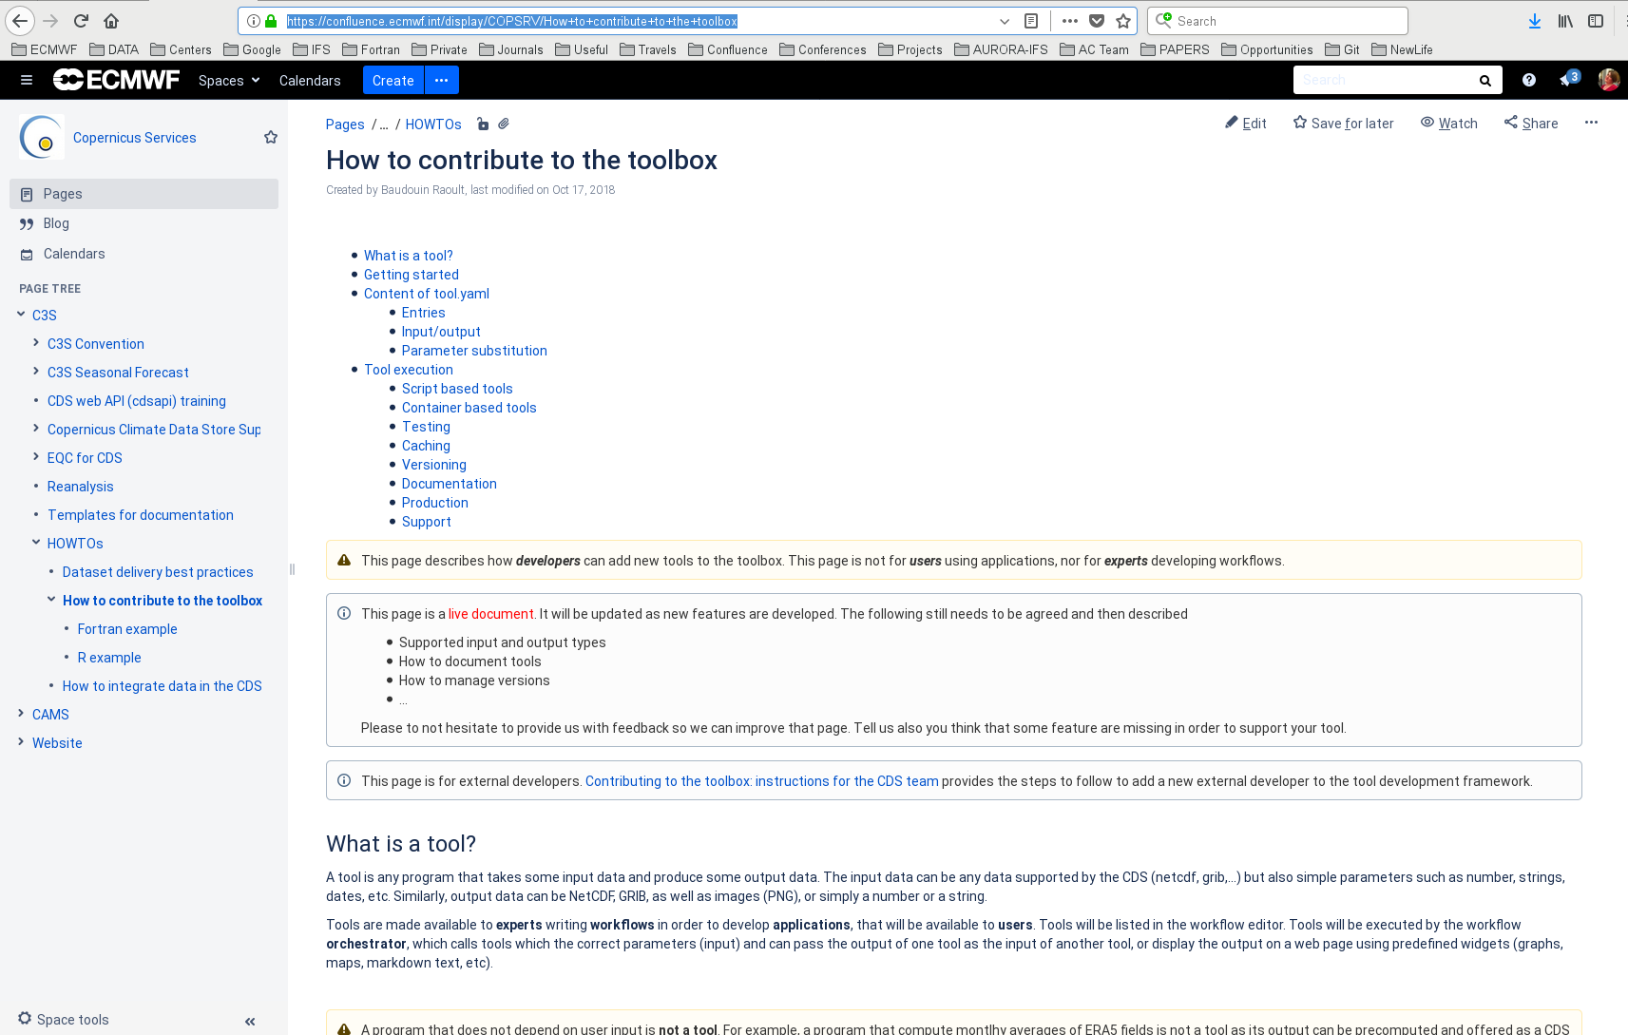
Information in confluence: Toolbox
https://confluence.ecmwf.int/display/COPSRV/How+to+contribute+to+the+toolbox
For simple examples, like those we aim at for the use cases, we do not anticipate the need for new tools (i.e. everything should already be available).

Slide 55
New features in the CDS web interface
Additional filters to search data in the CDS:
  General types of data: 'model reanalyses', 'seasonal forcast', 'climate projections', 'satellite observations'...
  Domains: atmosphere, ocean, land
  List of all physical / chemical parameters available among all datasets available
  Datasets with depth level or with only one vertical level of data.
  The use of such filters would require the definition of labels (to be defined in the harmonised table) that would allow automatic classification of the different datasets.
An online tool to list the versions of the documents that are available in the CDS. Currently, the 'documentation' tab does not include any version number.
Is it planned to offer the data as WMS layers as well? (There is such a service for the ESA LC-CCI products provided by UCLouvain.)
➔ These will be passed to and discussed with the CDS team.

Slide 56
Conclusions
Not everything is cast in stone ➔ What we all trying to do here is complex and new, so it is inevitable that we need to iterate until we converge with the process.
Use this presentation as a 1st aid tool, but (new) aspects may need to be addressed in the future ➔ we need to continue working together.
The integration process in the Catalogue cannot be completely captured e.g. in the harmonised table and its updates ➔ some lateral communication will still be necessary.

Slide 57
Information in confluence: CDS catalogue
https://confluence.ecmwf.int/display/COPSRV/How+to+integrate+data+in+the+CDS+Catalogue
We will add a page using your feedbacks.

Slide 58
Useful links
CDS test data web-page:
How to integrate data in the CDS:
Common Data Model:
How to contribute to the toolbox (for info only):
Use case example (you need to register to the CDS)
https://cds-dev.copernicus-climate.eu/cdsapp#!/dataset/ecv-for-climate-change?tab=overview
https://confluence.ecmwf.int/display/COPSRV/CDM%3A+Common+data+model+specification+-+v1.0
https://confluence.ecmwf.int/display/COPSRV/How+to+contribute+to+the+toolbox

