Slide 1







C3S seasonal forecast service
6-month forecasts issued every month on the 13th
Large ensembles
(members: ~50 forecast, ~25 hindcast)
Common reference period (1993-2016)
Common horizontal resolution (1-degree)
~30 surface variables
5 variables in pressure levels
(11 levels from 925hPa to 10hPa)
Data service through CDS
Graphical products through C3S webpage
Also likely: ECCC and BoM
Notes:
Current system: 5 European partners
In conversations with NCEP, JMA (to be incorporated in 2019)

Slide 2
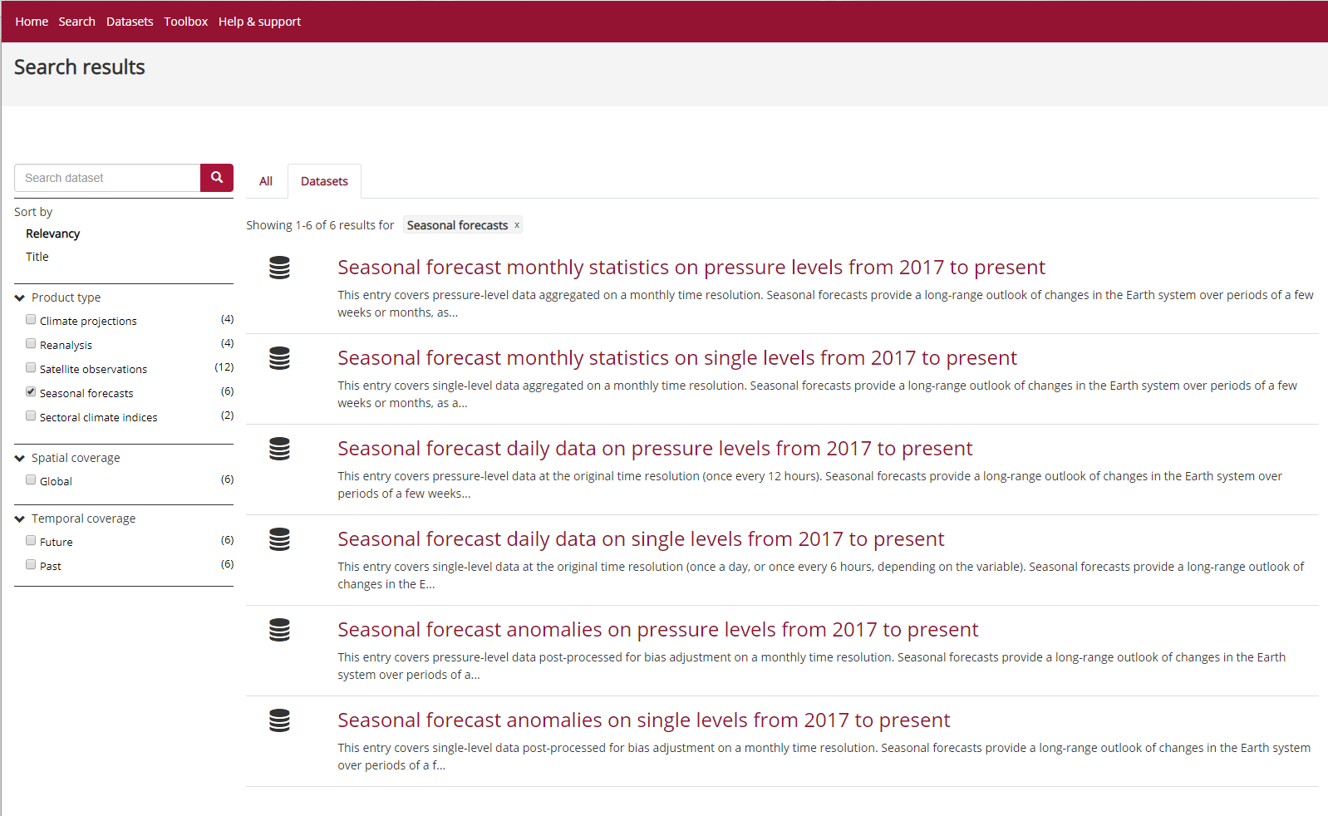
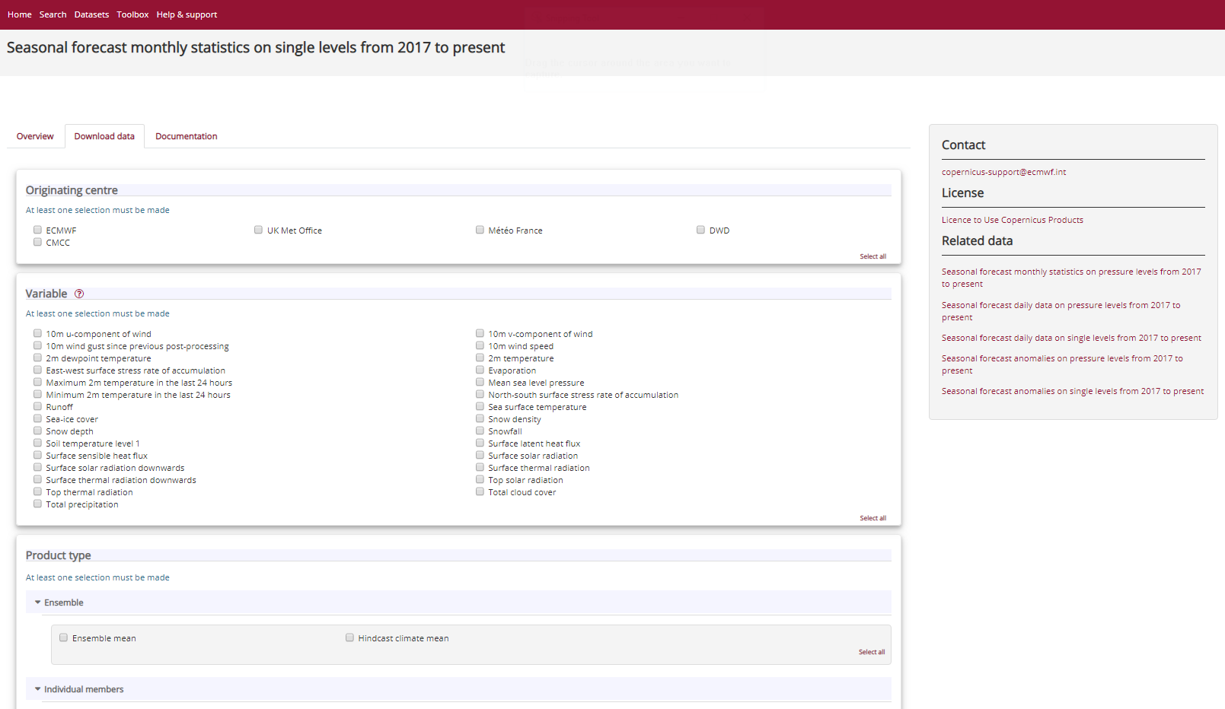
C3S seasonal forecasts – CDS data service
https://cds.climate.copernicus.eu/cdsapp#!/search?type=dataset
Notes:
ANIMATED SLIDE
Step 1:
CDS catalogue entries for seasonal forecasts
Note selection (filtering) of seasonal forecasts in the left column
Step 2:
One of the catalogue entries opened (the second of the list)
Example of form:
- Selection of centers, variables, etc.
- All other entries in “related data” column (right-hand side)
- Tabs for “overview” and “documentation”

Slide 3
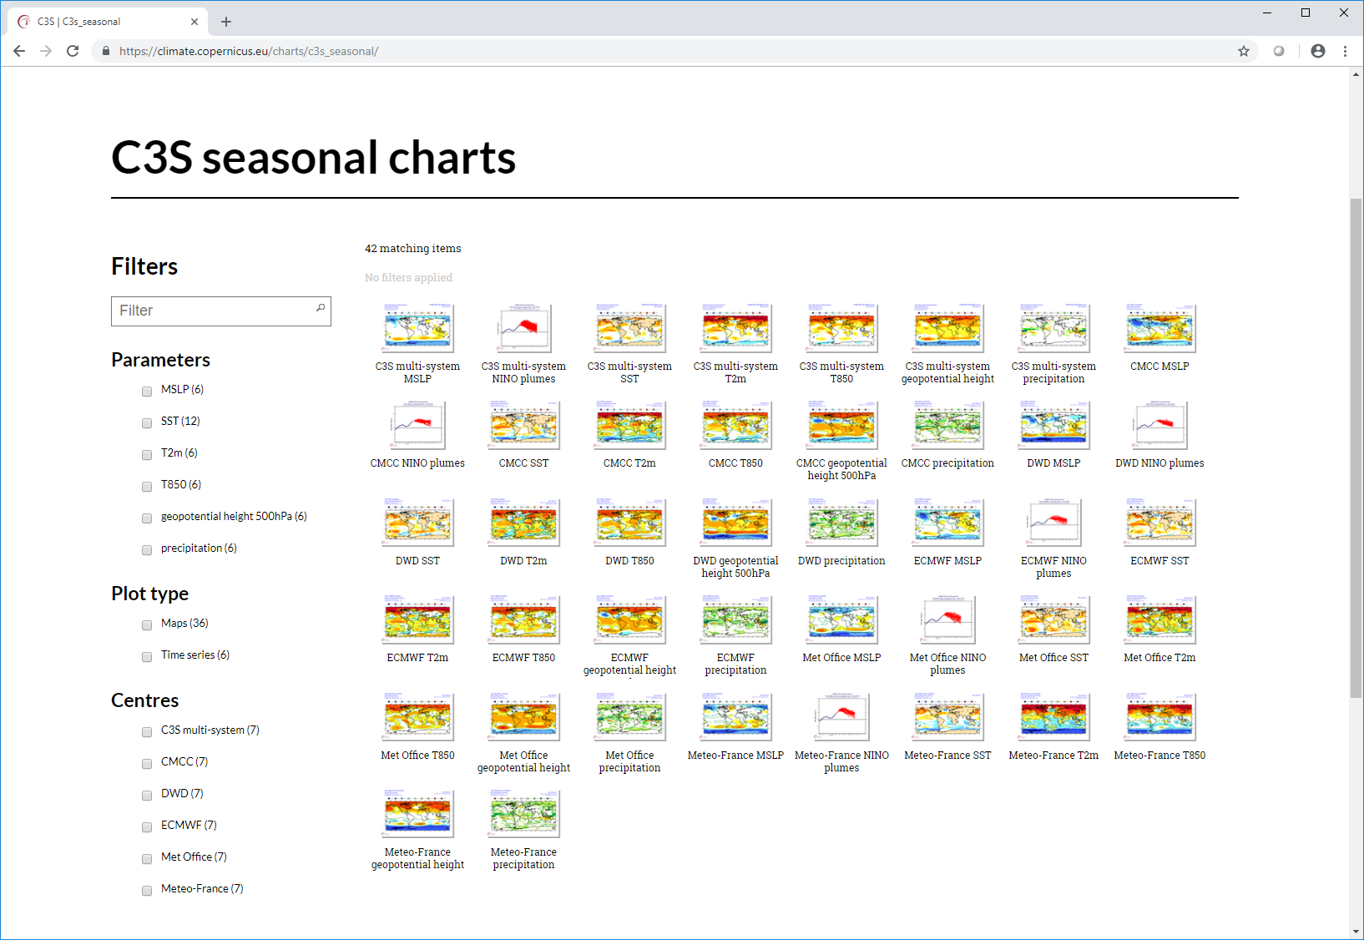
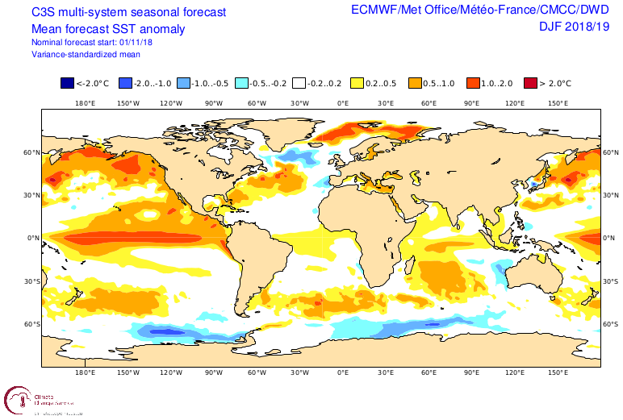
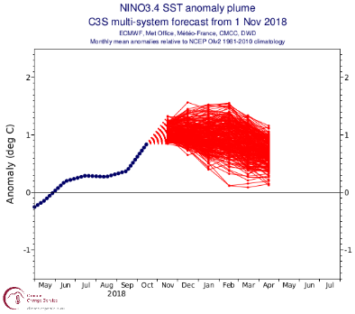
C3S seasonal forecasts – graphical products
Nov. 2018
https://climate.copernicus.eu/charts/c3s_seasonal/
Notes:
ANIMATED SLIDE
Step 1:
Chart browser in the C3S web site showing all the available models:
- Left-hand side column for filtering: parameter, plot type and originating centre
Step 2:
Example from multi-system real-time forecast for November 2018 (first one including all these 5 systems). Note title of plots showing the multi-model composition
Upper image: Map of SST ensemble mean anomaly for DJF
Lower image: plume plot with SST anomaly time-series averaged over region NINO3.4 over tropical Pacific. Blue line (observations), red lines (all systems, all forecast members)

Slide 4
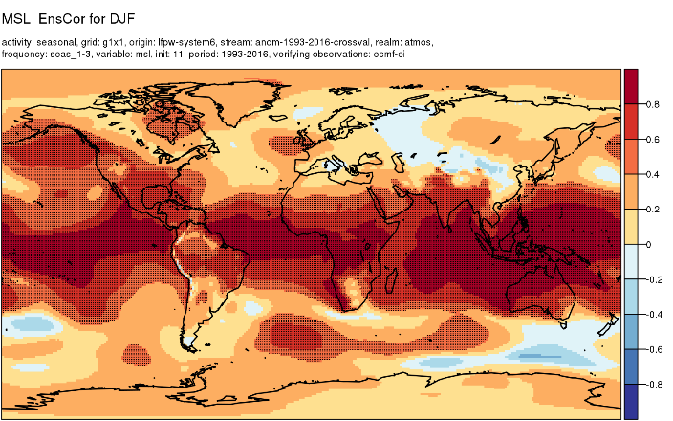
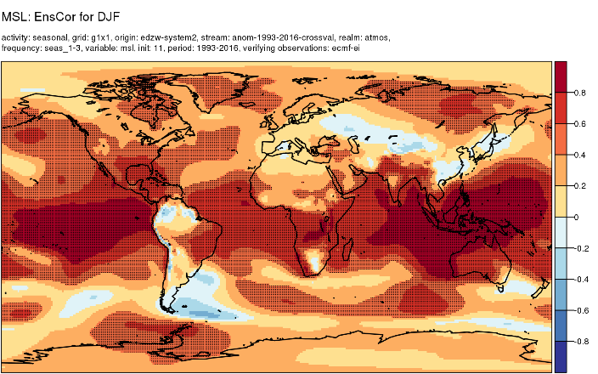
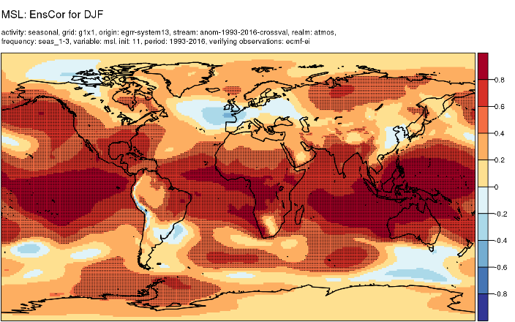
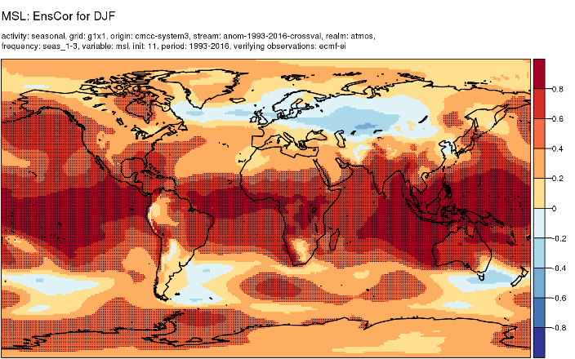
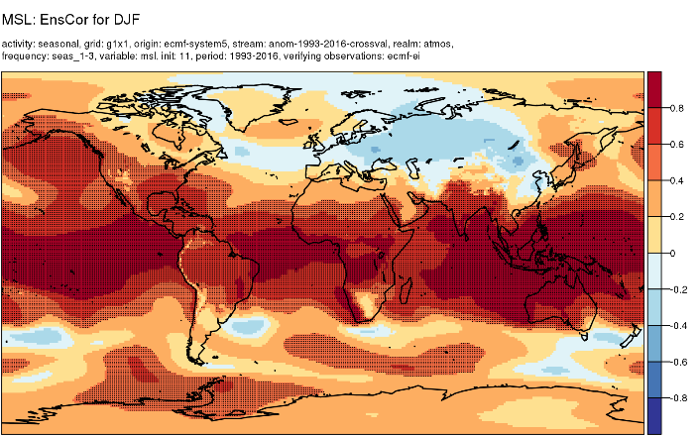
Verification
MF
DWD
Anomaly correlation - DJF from November
UKMO
CMCC
ECMWF

Slide 5
Verification
Verification plots expected before end of Q2 2019, for most products (including some currently not available – e.g. monthly means)
Verification scores (data for download) should also become available then
Scores planned:
  for deterministic forecasts (ensemble mean): (temporal) correlation, RMSE;
  for category (probabilistic) forecasts: RPS, ROC, Brier score
Also, will likely calculate CRPSS.
Comments:
verification of products, not forecast systems
verification of sample of hindcasts, not (currently) of real-time forecasts
verification scores for multi-model combination products will also be calculated

Slide 6
Verification
Verification plots expected before end of Q2 2019, for most products (including some currently not available – e.g. monthly means)
Verification scores (data for download) should also become available then
Scores planned:
  for deterministic forecasts (ensemble mean): (temporal) correlation, RMSE;
  for category (probabilistic) forecasts: RPS, ROC, Brier score
Also, will likely calculate CRPSS.
Comments:
verification of products, not forecast systems
verification of sample of hindcasts, not (currently) of real-time forecasts
verification scores for multi-model combination products will also be calculated

Slide 7
Good practice
Also important:
ensemble ‘generation’ (e.g. in the case of lagged start ensembles)
  contributing systems:
  burst start: ECMWF, DWD, CMCC; initial conditions 1st day of month
  lagged start: UKMO (2 members each day) and
  MF (25 members on each 20th and 25th of month, 1 member on 1st day of month)
correct pairing of forecasts and hindcasts!
bias correction
C3S plan to publish data corrected with (simple) method used for C3S (graphical) forecast products
multi-model combinations, combination with observations
Applications for post-processing seasonal forecasts could be made available through the CDS toolbox (e.g. alternative bias correction methods) – but timings may not fit in with users’ plans

Slide 8
Other news
More forecast systems to be added to the C3S service (NCEP and JMA in 2019)
More data products to be encoded, archived and made available for download
More variables (soil moisture, ocean model parameters) – Q3 2019
‘New’ encoding of derived data?
Seasonal forecast data (from CDS) in the toolbox?

