Slide 1
Contract
Kick-Off meeting
C3S_4XXXXXXXXXXXXXXX
XXXXXXXXXXXXXXX
Isabella Mazza
Contract Management Officer

Slide 2
Overview
ECMWF team
Copernicus ≠ Horizon 2020
Contractual Obligations: reporting and audits
Deliverables and Reports: templates and delivery to ECMWF
Meetings
Contract Verification and Payment Procedure
Contract Amendments
VAT exemption
Communicating as part of Copernicus
Copernicus User Support

Slide 3





ECMWF team
Main Contacts
Copernicus C3S Management
Isabella Mazza
Contract Management Officer
isabella.mazza@ecmwf.int
………..
……….Technical Officer
……………
C3S SIS Team
Jean-Noel Thepaut
Head, Copernicus Climate Change Service
jean-noel.thepaut@ecmwf.int
Dick Dee
Deputy Head, Copernicus Climate Change Service
dick.dee@ecmwf.int
Carlo Buontempo
SIS Manager
Carlo.buontempo@ecmwf.int
Samuel Almond
SIS Officer
Samuel.almond@ecmwf.int

Slide 4


Copernicus ≠ Horizon 2020
  CAMS and C3S are user driven service programmes : ECMWF’s role to conduct a critical assessment on milestones and deliverables : outputs reflect the needs of the CAMS/C3S programmes and driven by user needs?
Objectives | Sustainable operational services and service developments | Research and Innovation activities
Contractual aspects | Competitive procurement via Invitations To Tender (ITT) and Requests For Proposals (RFP) | Call for proposals
 | Contract | Grant
 | One prime contractor + potential subcontractors | Consortium
Payments | Output based - determined by deadlines and quality | Effort based – pre-financing, based on declared costs and expenses
Intellectual Property Rights | European Commission owns deliverables, IPR and assets | Consortium owns deliverables, IPR and assets
Branding | Copernicus branding | Determined by consortium
Reporting | Focus on service performance monitoring, KPIs and programme budget execution | Focus on grant management requirements

Slide 5

Contractual Obligations – Reporting
Feb 28th
Annual report
Oct 15th
Quarterly report
Jan 15th
Quarterly report
Apr 15th
Quarterly report
Jul 15th
Quarterly report
Jan
Feb
Mar
Apr
May
Jun
Jul
Aug
Sep
Oct
Nov
Dec
60 days after
end contract
Final report
Preliminary Jan 15th
Financial Information & Assets Inventory
Draft Feb 28th
Implementation Plan
Final Oct 31st
Implementation Plan
Institute Financial Jun 30th Statements and Audit Report
Quality checked
Brief
Self standing
Only covering the referred period
In Microsoft Word (+ PDF if signed)
Letter Financial Audit Jun 30th Opinion on Annual Report
Details available in Framework Agreement Clause 2.3
Notes:
Recurs with a similar pattern every year.
Phased on ECMWF’s own reporting to the EC => strict due dates

Slide 6
Contractual Obligations – Reporting
Implementation REPORTS:
  Quarterly reports (QIR): report contains overview of progress, risks from previous quarter, any compliance issues, financial aspects, checks and controls and assets.
      due 4 times a year, on Jan 15th, Apr 15th, Jul 15th and Oct 15th (whatever is the starting date of the contract) – Strict deadline
  Annual reports (AIR): report contains overview of progress, risks from previous year, any compliance issues, financial aspects, checks and controls and assets.
      due annually on February 28th – Strict deadline
  Final report: report contains overview of actual achievements in the performance of this Agreement, totals of prices claimed and costs and expenses incurred
  due 60 days after the end of the contract
Preliminary Financial Information (PFI): based on ECMWF reporting template (will be provided in due course)
      due annually on January 15th – Strict deadline
Implementation PLANS: will have to meet with ECMWF’s requirements and will feed into ECMWF’s own implementation plan for provision of C3S (as appropriate) in the next year (n+1) of the Copernicus Programme.
  Draft implementation plans for the year N+1
      due annually in February of the year N – Strict deadline
  Finalised implementation plans for the year N+1
  due annually in October of the year N – Strict deadline
Details available in Framework Agreement Clause 2.3

Slide 7

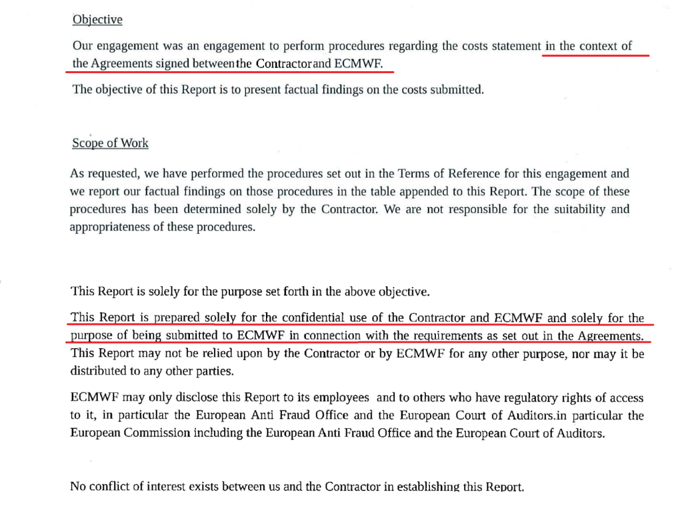

Contractual Obligations – Audits
At
prime contractor
level
At
subcontractor
level
Due annually:
      1) copy of institute’s audited annual report
Depends on prime contractor internal procedures
      2) letter from an auditor
      (opinion on the last Annual Implementation Report)
Audit opinion on all four points as laid down in Clause 2.3.1.4 of the T&Cs (version Oct 2015) or Clause 2.3.1.3 of the T&Cs (version May 2018)
      +
      Possible audits conducted by ECMWF or the EC
      +
      Possible audits conducted by ECMWF or the EC
Details available in Framework Agreement Clauses 2.3, 5.1
Notes:
Copy of the institute’s audited annual report:
NOT specific to Copernicus => standard document published annually by each institute.
Letter from an auditor.
Dedicated to the Copernicus contract => check of the financial figures of last annual report and of the use of resources (this applies to cost reimbursement contracts only).

Slide 8
Audits performed by ECMWF
  An audit company appointed by ECMWF performs ex-ante and ex-post financial controls including on-site checks on a sample of transactions made by ECMWF and the Contractors to its subcontractors to ensure that such transactions:
    are legal and regular,
    based on correct information as provided by the contractor during the negotiation phase,
    are implemented according to the principles of sound financial management and using adequate financial controls and checks.
    The scope of the ‘agreed upon procedure’ financial audits shall take into account the nature of the payment schemes (cost-reimbursement or fixed price) and the risk profile of the contract,
    Based on the outcome of the audit, contractors may need to provide additional clarifications and justification and if needed a reclaim of funds may be initiated by ECMWF,
    The auditors may raise additional questions in scope of data collection on lessons learnt for internal programme implementation purposes at ECMWF,
    Outcomes of the audit reports shall be communicated to the European Commission,
    Contractors are obliged to provide full support to the auditors.
Details available in Framework Agreement Clauses 2.3, 5.1

Slide 9
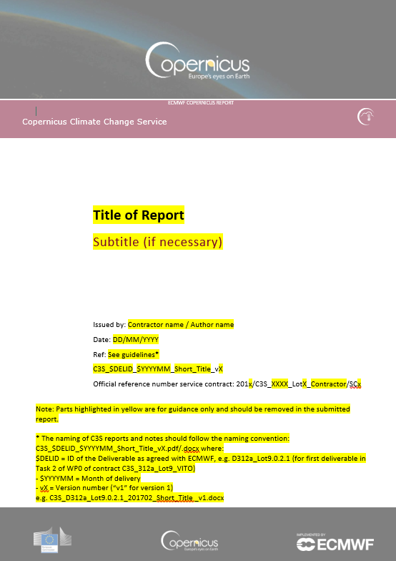
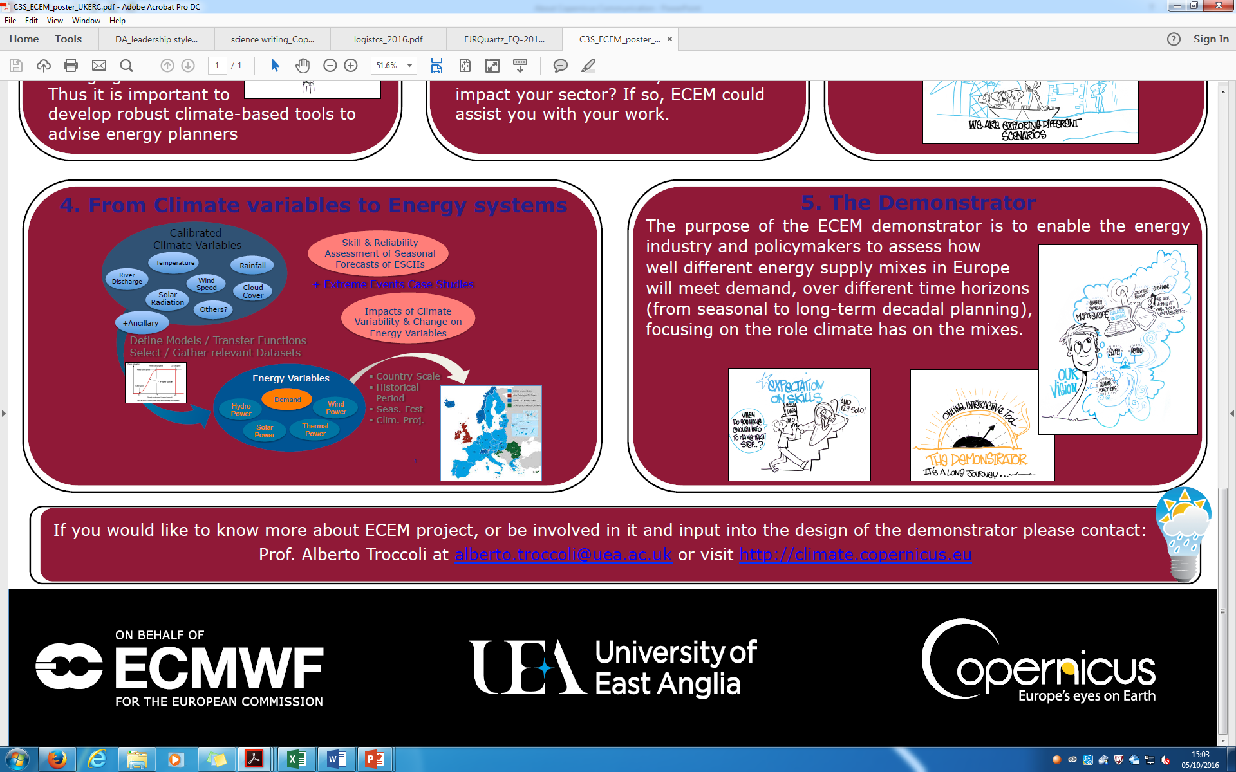
Deliverables and Reports
All reports and deliverables have to be:
  Based on C3S templates
  Follow a naming convention
Titles of all emails sent to ECMWF must start with the contract number: C3S_4XXXXXXXXX
Deliverable
D50.1.2.1-2017Q1_Short_Title_YYYYMM_vX
Contract number
WP number
Task number
Deliverable number
Period covered by the deliverable
Month of publication
Version number
Communication material

Slide 10
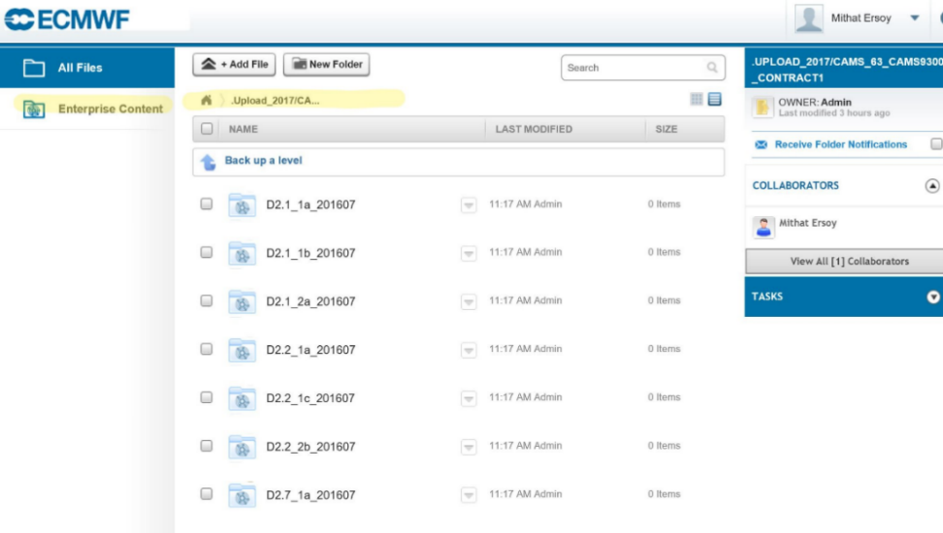
Document repository- EC Box
Online repository system
Contractor:
  Upload deliverables
  Download revised deliverables
ECMWF:
  Approve / reject deliverables
  Provide feedback to contractors
  Track status of deliverables
  Provide access to the European Commission to a repository of validated deliverables
Access:
- For prime contractors (Service Manager and PI)
- Via soft token, on computer, tablet or smart phone
- Email for access will be provided
Support for Contractor:
Copernicus Contract Management
EC Box manager (rebecca.calnan@ecmwf.int)

Slide 11
Meetings
 | Monthly review meetings | Progress review meetings | …….
Frequency | Monthly | Quarterly or six-monthly (at payment milestone)* | Ad-hoc meetings organized by ECMWF
Participants | Lead contractor and ECMWF | Lead contractor and ECMWF | ………..
Content | Main method of liaising with ECMWF Discuss progress in a more frequent and a less formal way | Discuss progress: Status on all work-packages Plans for the following months Update risk register and mitigation strategy | ………….
Actions | Lead contractor to provide: Agenda (min 2 days advance) Minutes | Lead contractor to provide: Agenda (min 5 days advance) Minutes | ECMWF to provide: Agenda Minutes
    * See Annex 3B for agreed frequency

Slide 12
Contract Verification / Payment Procedure
Contract Verification and payment procedure is described in Annex 3C
Two different payment schemes exist for Copernicus contracts:
  Cost-Reimbursement
    shall mean that the Price to be paid for Services is the actual and acceptable costs and expenses associated with the Services (See Clause 4 of Framework Agreement), claimed at rates which have been agreed between the Parties in advance;
  Fixed-Price or Pre-Agreed Price
    shall mean that the Price to be paid for Services has been agreed between the Parties in advance and will be paid, as agreed, subject to acceptance of the Deliverables and subject to audits against costs and expenses submitted in Annex 2.
    No use of resources (list of expenses) to be provided. However, costs incurred must remain eligible.

Slide 13
Review procedure- Deliverables
Contractor
ECMWF
Deliverable Review
Submit
Deliverable 1
Submit
Deliverable 2
Submit
last Deliverable
…
No
No
No
Review of Del1
Approved
?
Review of Del2
Approved
?
Review last Del
Approved
?
Submit
Notification of Milestone Completion
(and Use Of Resources)*
Yes
Yes
Yes
TIME
Details available in Framework Agreement – Annex 3C
Notes:
Use of Resources form for Cost Reimbursement contracts

Slide 14
Review procedure- Deliverables
Contractor
ECMWF
Deliverable Review
Contract Performance Review
Payment
Submit
Del1
Submit
Last Del
Submit
Notification of Milestone Completion
(and Use Of Resources)*
…
implement corrections
Progress meeting
Send invoice AND Notice of Acceptance to finance@ecmwf.int
No
No
Review of Del1
Approved
?
Review last Del
Approved
?
No
Issue Notice of Acceptance
Yes
Yes
Verify contract performance
All deliverables
Approved?
Yes
Payment
No
Issue Notice of Need of Remedial Action
45 days for development activities
21 days for operational activities
Max 30 days
Details available in Framework Agreement – Annex 3C

Slide 15
Contract Verification / Payment Procedure
The review from ECMWF (21/45 days) starts when we receive the Milestone Completion Notification document
The Notice of Acceptance is the document against which the contractor can issue ECMWF their invoice for the value accepted by ECMWF
We envisage contractors to submit their invoice as soon as possible upon reception of the Notice of Acceptance and preferably not later than 8 days before the end of the calendar quarter

Slide 16
Contract Amendments
The Amendment format is used, for instance, when there are:
changes to Specifications and/or Contractor’s proposal;
price changes;
changes in payment terms/schedules;
extension of duration of contract, etc.
Reflects an official agreement between ECMWF and the contractor of changing the terms and conditions (including contractor and contact person details) and technical, contract implementation and financial specifications of the Framework Agreement or Service Contract;
Request for amendments to be conducted in line with Clause 2.5 of the T&Cs;
Contractors shall notify ECMWF as soon as a request for changes is anticipated;
Delays in completing milestones and deliverables and/or reduced levels of quality of service provision shall not be a reason for ECMWF to accept an amendment unless it is justified by a force majeure.
Details available in Framework Agreement Clause 2.5

Slide 17
Contract Amendments
Amendment process:
Detailed request for amendment to be sent to the Contract Management Officer
Evaluation of the request by ECMWF (may involve Procurement/Legal/Finance departments)
Contractual documents to be updated by the contractor (track-changes)
Acceptance of contractual documents by ECMWF
Amendment Agreement prepared by ECMWF
Amendment Agreement signed
Details available in Framework Agreement Clause 2.5

Slide 18
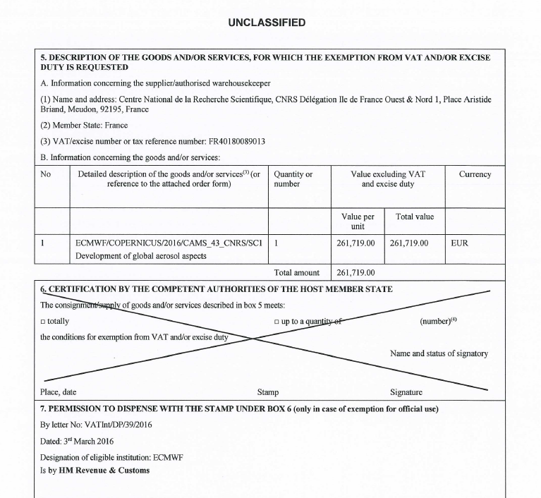
VAT exemption
Copernicus is an EU funded programme and is thus exempted from VAT
Two cases for VAT exemption:
Lead contractor is from an EU member state other than the UK:
  Shortly after contract signature, ECMWF will provide the lead contractor with a VAT exemption certificate
  Lead contractor should then get in contact with their national tax office in order to receive advice on how to proceed
Lead contractor is from the UK:
  can invoice us the VAT (ECMWF gets reimbursed via the UK tax office)
Article 51 - Annex II:
https://eur-lex.europa.eu/legal-content/EN/ALL/?uri=CELEX%3A32011R0282

Slide 19
Communicating as part of Copernicus
Copernicus is a single programme consisting of six services delivered by entrusted entities on behalf of the European Commission.
ECMWF is charged by the European Commission with communicating on their behalf in a unified and consistent way to:
  Raise awareness of the Copernicus brand
  Raise awareness of CAMS and C3S specifically
  Increase take up of the services/data
This unity extends to all types of communication whether by ECMWF or its contracted providers. We are not a series of independent contracts but one Copernicus Climate Change Service/Atmosphere Monitoring Service.

Slide 20
Communicating as part of Copernicus
In practice, this means that we should:
Use standard branded templates for posters and any publicity material
Use agreed wording in all press releases and media briefings, which should be co-ordinated with and approved by Copernicus Press Manager 4 weeks before release
Inform Copernicus Communication team at ECMWF about your events via copernicus-events@ecmwf.int, as they can provide events support and branded promotional materials
Have only one website (per service) which must have the look and feel of the main service site (template is provided); preserve a seamless user journey; adhere to the service url structure, i.e example.climate.copernicus.eu; and be approved by the Copernicus Web Officer.
Have one, centrally managed social media presence: no individual Twitter accounts for the service but content can be tweeted from personal/institutional accounts with mention of @CopernicusECMWF; also tag @CopernicusEU and use #Copernicus #ClimateChangeService or #C3S hashtags.
Do not create sub-brands; acronyms for contracts should be avoided

Slide 21
Copernicus Communication team
The Copernicus Communication team sets the strategy for communicating on ECMWF’s Copernicus Services and co-ordinates the communication activities.
They are here to help and can provide you with:
Guidance on the EC Copernicus brand guidelines
Assistance with and feedback on any promotional materials you produce or plan to produce
Assistance in promoting your work for Copernicus e.g Supporting and advertising your workshops; creating newsletter articles on your project, co-authoring press releases
Opportunities to showcase your work at the key events
Branded promotional material when needed/available
Guidance and templates for approved web-related work
More information on Communication contractual obligations ref. Articles 2.4.6.1 and 3.1.5.2 of the Framework Agreement
Gorana Jerkovic | Copernicus Communication Lead | gorana.jerkovic@ecmwf.int
Eva Remete | Web Content Officer | eva.remete@ecmwf.int
Francesca Fusco | Events and Support Officer | francesca.fusco@ecmwf.int
Annabel Cook | Digital Editor | annabel.cook@ecmwf.int
Please always cc the Contract Management Officer and the Technical Officer

Slide 22

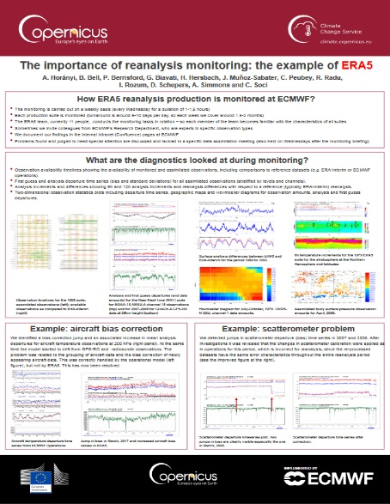
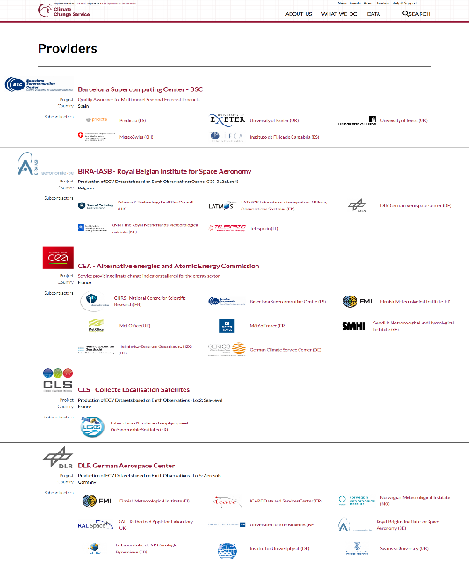
Communication material
New C3S website
A variety of poster templates
How we acknowledge subcontractors via the service website
How to acknowledge the lead contracted provider
All the material can be found here:
ftp://ftp.ecmwf.int/pub/CopernicusComms/Design%20material/C3S%20design%20material/

Slide 23
Copernicus User Support
Copernicus User Support provides a joint help desk platform (JIRA Service Desk)
    Web https://copernicus-support.ecmwf.int
    Mail Copernicus-support@ecmwf.int
  Copernicus User Support provides level 0 and 1 technical support for CAMS and C3S
  Contractors provide level 2 and 3 support: you can be contacted on this through our help desk platform (no need to implement your own platform, only register to ours)
  Copernicus User Support team:
Xiaobo Yang | Copernicus User Support Lead | xiaobo.yang@ecmwf.int
Anabelle Guillory | User Support Officer | anabelle.guillory@ecmwf.int
Kevin Marsh | User Support Analyst | kevin.marsh@ecmwf.int
Please always cc the Contract Management Officer and the Technical Officer

Slide 24
Thank you
Isabella MAZZA
Tel: (+44) 118 949 9783
Email: isabella.mazza@ecmwf.int
https://climate.copernicus.eu/
http://copernicus.eu/

